Slide 1
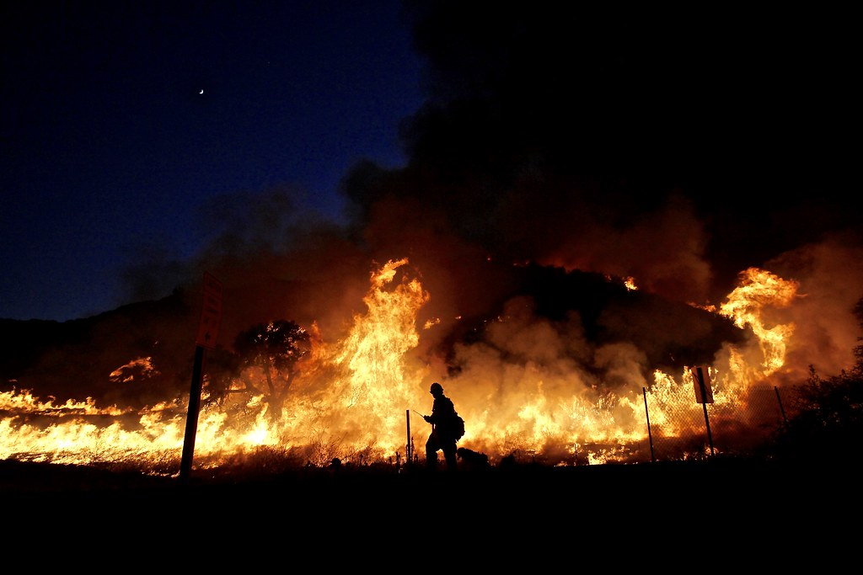



2023 CAL FIRE PRESEASON MEETING
CAL FIRE SANTA CLARA UNIT 2025 Unit Update

Slide 2
UNIT CHIEF
C1600 Marcus Hernandez
Cell (408)-472-1600
DEPUTY CHIEF OPS
SPECIAL OPERATIONS
C1601 Chuck Carroll
Cell (408) 472-1601
SOUTH BAY DIVISION
MOBILE EQUIPMENT
SSCCFD/MHFD DIVISION
ADMINISTRATION
D1607 Carlos Alcantar
Cell (408) 710-1856
D1603 Cole Periera
Cell (408) 472-1603
FIRE EQUIPMENT MANAGER
R1630 James Lopez
Cell (408) 472-1608
Office (209) 892-5781
D1605 Nick Giampaoli
Cell (408) 472-1605
Office (408) 778-8605
FAX (408)779-1679
C1602 Bo Lee
Cell (408) 472-1602
Office (408) 778-8602
EAST BAY DIVISION
SAFETY BATTALION
B1618 Vacant
Cell (408) 472-1618
D1604 Steven Blythe
Cell (408) 472-1604
MORGAN HILL BATTALION
B1611 Ryan Burgard
Cell (408) 472-1611
SOUTH SANTA CLARA CO FD
B67 Vacant
Cell (408) 234-1617
RESOURCE MANAGEMENT
TRAINING/EMS
HEAVY EQUIPMENT MECH.
R1631 Tiffany Black
Cell (408) 310-7395
UNIT FORESTER
D1606 Ed Orre
Cell (408) 206-3704
ALAMEDA BATTALION
B1614 Jeff Nichols
Cell (408) 472-1614
Office (925) 862-2197
SAN JOSE BATTALION
B1612 Mario Rivera
Cell (408) 472-1612
Office (408) 268-1600
TRAINING BATTALION
B1606 Chris Steggall
Cell (408) 206-3706
MORGAN HILL CITY BATT
B57 Brad Terry
Cell (408) 722-8507
Office (408) 778-3259
HEAVY EQUIPMENT MECH.
R1635 Nico Robbins
Cell (408)602-3991
FORESTRY AID
F1691 James Edwards
Cell (408) 499-4255
STANISLAUS BATTALION
B1615 Jeff Cox
Cell (408) 472-1615
Office (209) 892-5781
EMS BATTALION
B69 Dave Riley
Cell (408) 710-7196
ALMA BATTALION
B1613 Sean Ketchum
Cell (408) 472-1613
Office (408) 867-1613
HEAVY EQUIPMENT MECH.
R1637 Kevin Murry
Cell (408)-234-1106
MORGAN HILL CITY
FIRE MARSHAL
B59 Mike Gil
Cell (408) 722-5184
ENV. SCIENTIST
F1692 Pearl Hoogs
Cell (699) 253-3366
CONTRA COSTA BATTALION
B1616 Bryan Goff
Cell (408) 472-1616
Office (925) 672-6400
LAW ENFORCEMENT/ FIRE PREVENTION
RELIEF BATTALION
B1610 Alex Mikesell
Cell (408) 415-0495
SERVICE CENTER
PREVENTION BATTALION
B1620 Zach Rutherford
Office (408) 778-8620
PRE-FIRE ENGINEER
P1625 John Reynolds
Cell (408) 489-2086
CREW PROGRAM B1619 Joe Ortegel
Cell (408) 472-1613
Office (408) 867-1613
FORESTRY LOGISTIC OFFICERS
S1610A Derek Lyon-McKeil
Cell (408) 763-9038
S1610B Averell Ramirez
Cell (408) 710-1846
RELIEF BATTALION
B1617 Vacant
Cell (408) 415-0559
Office (209) 892-5781
FIRE CAPTAIN SPECIALIST
P1621 Scott Weatherby
Office (408)778-8620
ECC
HEADQUARTERS
FIRE CAPTAIN SPECIALIST
P1622 Zack Spinetto
Office (408) 778-8620
ECC Contact Numbers Public
(408) 779-6611
24 Hr. Non-Emergency
(408) 201-0490 (Agency Only)
Emergency
(408) 779-4111
FAX (408) 778-6149
ECC BATTALION
B1609 Erik Alldrin
Cell (408) 472-1609
Office (408) 779-2121
FAX (408) 779-1679
Unit PIO Duty
(408) 201-4378
RESEARCH DATA SPECIALIST
Emily Wilkinson
Cell (408) 710-1861
FIRE PREVENTION SPEC.
FPS 1623 C. Burkett
Office (408) 778-8623
FAX (408) 778-6041

Slide 3
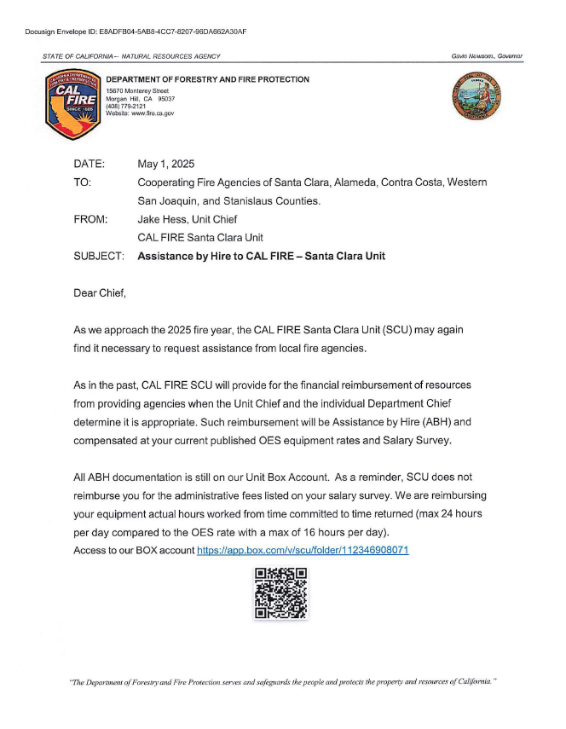
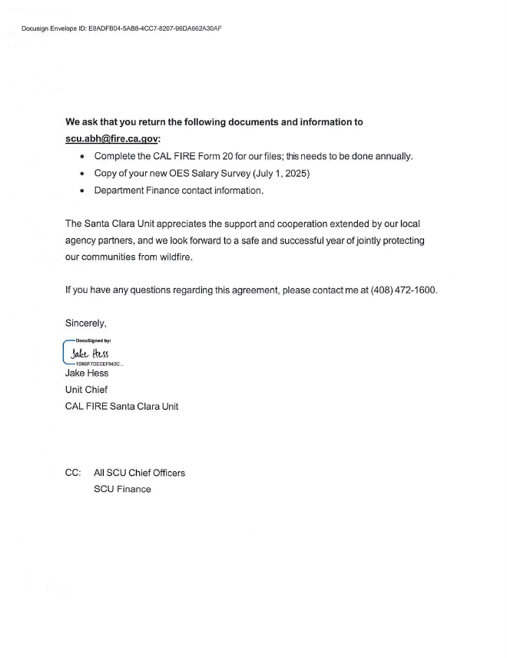
Assistance by Hire to CAL FIRE

Slide 4
CAL FIRE SANTA CLARA
WILDLAND FIRE STANDARD RESPONSE PLAN
LOW DISPATCH LEVEL
1 Battalion Chief
4 Engines
1 Dozer
MEDIUM DISPATCH LEVEL
1 Battalion Chief
1 Air Attack
2 Air Tankers
1 Copter
6 Engines
2 Dozers
2 Fire Crews
HIGH DISPATCH LEVEL
1 Battalion Chief
1 Air Attack
2 Air Tankers
1 Copter
8 Engines
2 Dozers
2 Fire Crews
1 Safety Officer

Slide 5
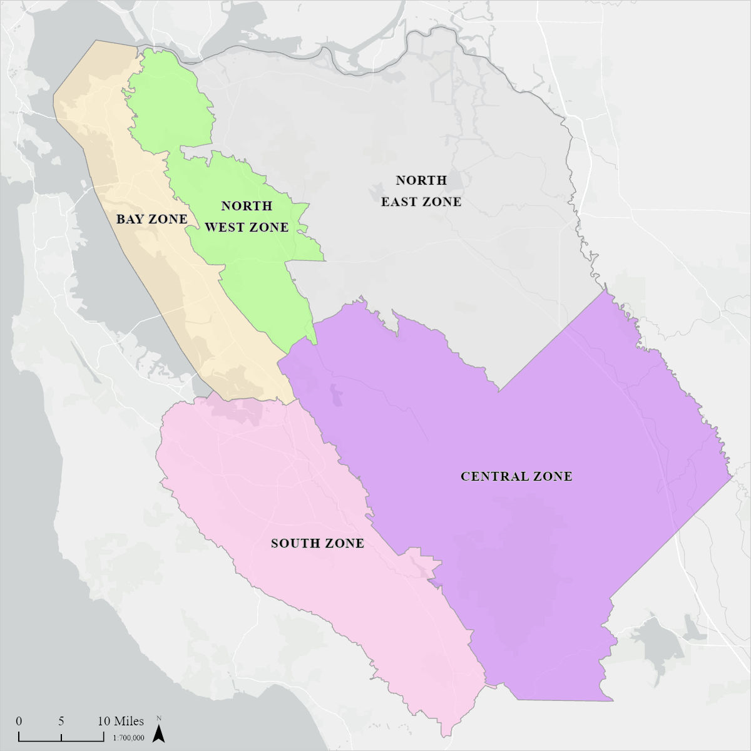
Fire Danger Rating Area

Slide 6
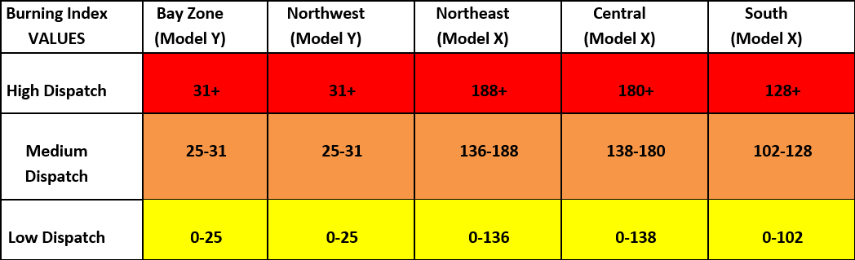
Dispatch Level Decision Thresholds

Slide 7
CAL FIRE Santa Clara Unit
TACTICAL RADIO FREQUENCY ASSIGNMENTS FOR WILDLAND FIRES BY COUNTY
Incidents that automatically include a CAL FIRE response (SRA or MTZ fires) will be assigned a tactical frequency by CAL FIRE as established in advance planning. Frequencies will be assigned in the established order with a new incident receiving the first preferred frequency unless it is in use elsewhere in the Santa Clara Unit. Once contacted by the local agency dispatch center, CAL FIRE Morgan Hill will establish the incident name, a tactical frequency, and a command frequency. The information is relayed to the local agency dispatch center to advise their responding resources.
ALAMEDA COUNTY
SAN JOAQUIN and STANISLAUS COUNTIES
CDF TAC 2
VFIRE 22
VFIRE 23
CDF TAC 6
CDF TAC 2
VFIRE 22
VFIRE 23
CONTRA COSTA COUNTY
SANTA CLARA COUNTY
CDF TAC 2
VFIRE 22
VFIRE 23
CDF TAC 9
CDF TAC 6
CDF TAC 9
VFIRE 22
VFIRE 23
OTHER AVAILABLE FREQUENCIES
CDF TAC 10
VFIRE 26

Slide 8
CAL FIRE SCU FREQUENCY LIST
FREQUENCY | RX | RX PL | TX | TX PL
SCU LOCAL | 151.4450 | 156.7 | 159.3450 | Tone 1-6
CDF COMMAND 1 | 151.3550 | 103.5 | 159.3000 | Tone 1 and 9
CDF COMMAND 2 | 151.2650 | 103.5 | 159.3300 | Tone 7,9,11,12
CDF COMMAND 4 | 151.4000 | 103.5 | 159.3750 | Tone 7-8
CDF TAC 2 | 151.1600 | 192.8 | 151.1600 | 192.8
CDF TAC 6 | 151.3250 | 192.8 | 151.3250 | 192.8
CDF TAC 9 | 151.3850 | 192.8 | 151.3850 | 192.8
CDF TAC 10 | 151.4000 | 192.8 | 151.4000 | 192.8
CDF AIR TO GROUND 1 | 151.2200 | 192.8 | 151.2200 | 192.8
CDF AIR TO GROUND 2 | 159.2625 | 192.8 | 159.2625 | 192.8
CDF AIR TO GROUND 3 | 159.3675 | 192.8 | 159.3675 | 192.8

Slide 9
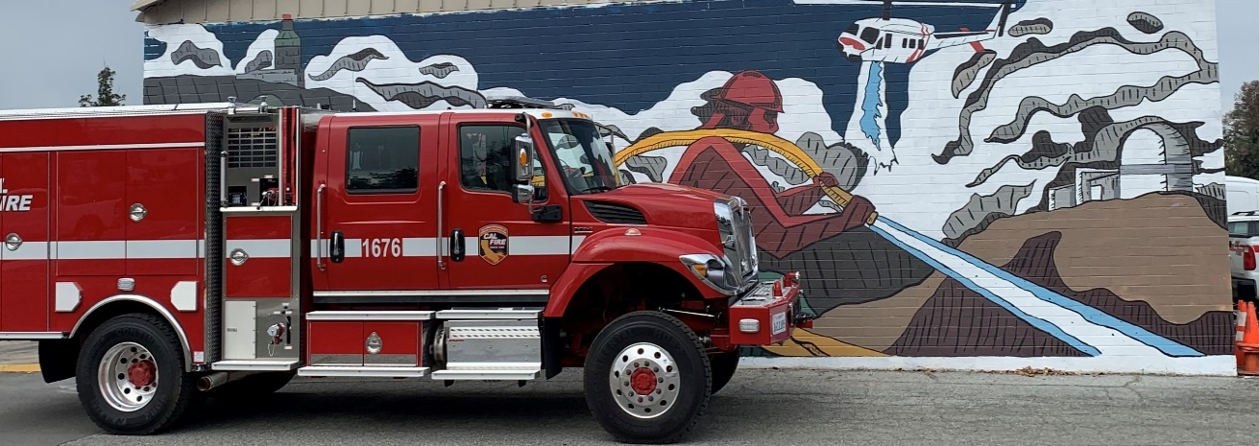
SCU OPERATIONS UPDATE - ENGINES
Base Staffing – Staffing Level 1
  5 CAL FIRE Stations - 6 Engines
Peak Staffing – Staffing Level IV
  12 CAL FIRE Stations - 16 Engines

Slide 10
SCU OPERATIONS UPDATE - CREWS
Mt. Hamilton/California National Guard (CMD) • Pacheco Firefighter I Crews (PCH)
Emergency Response & Fuel Mitigation
Type I
Emergency Response & Fuel Mitigation
Type I
Fireline Construction
Burning
Mop up
Falling
Fireline Construction
Burning
Mop up
Falling
13 Crew Members
1-Fire Captain
1-Fire Apparatus Engineer
B & A Level Sawyers
Emergency Crew Transports
Radio Identifiers: Mt. Hamilton Crew 1 and Crew 2.
13 Crew Members
1-Fire Captain
1-Fire Apparatus Engineer
B & A Level Sawyers
Emergency Crew Transports
Radio Identifiers Pacheco Crew 1 and Crew 2

Slide 11
SCU OPERATIONS UPDATE - AIRCRAFT
CAL FIRE S70i FireHawk status
Alma Copter is night qualified for water dropping missions and available if the fire meets 1 of the 4 criteria's.
  Immediate threat to human lives.
  Immediate threat to structures.
  Immediate threat to high-value resources and/or critical infrastructure.
  Response would inhibit significant fire growth.
Alma FireHawk Info sheet
Alma Copter in service year-round for water dropping and Rescue Missions.
  Staffed with Crew on April 7th
All Bases except one base are S70i FireHawk's.
New numbering on all S70i Copters. (C601-C613) No specific number per base.
All Air Attack Bases will be in service Mid May.
CAL FIRE has 1 C-130 in-service now with plans of 2 more by mid Summer.

Slide 12
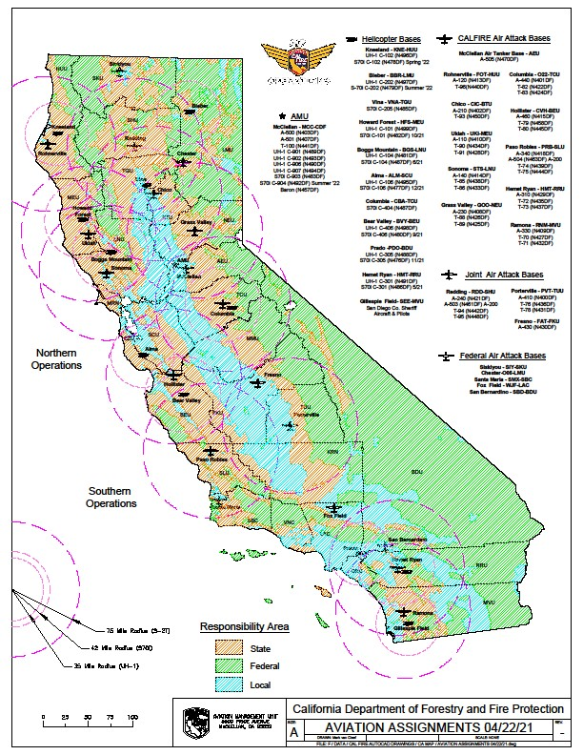
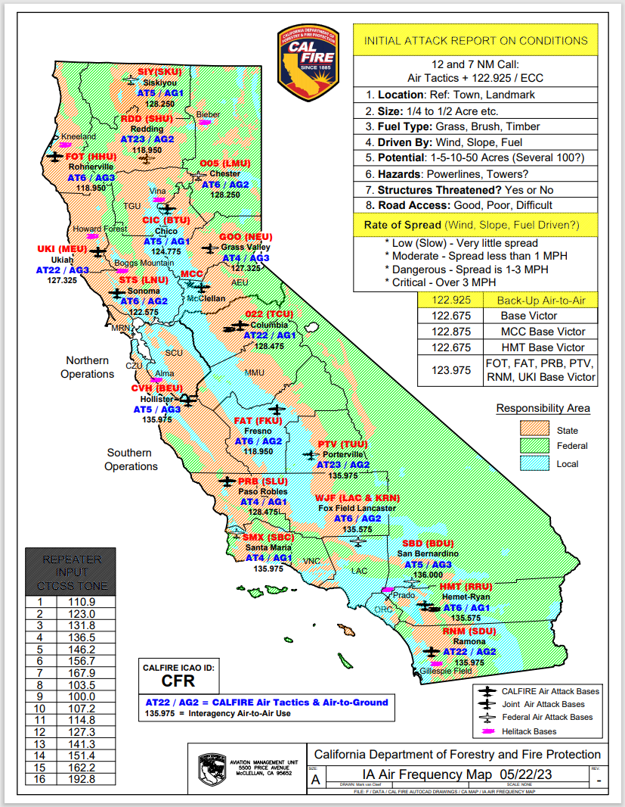

Slide 13
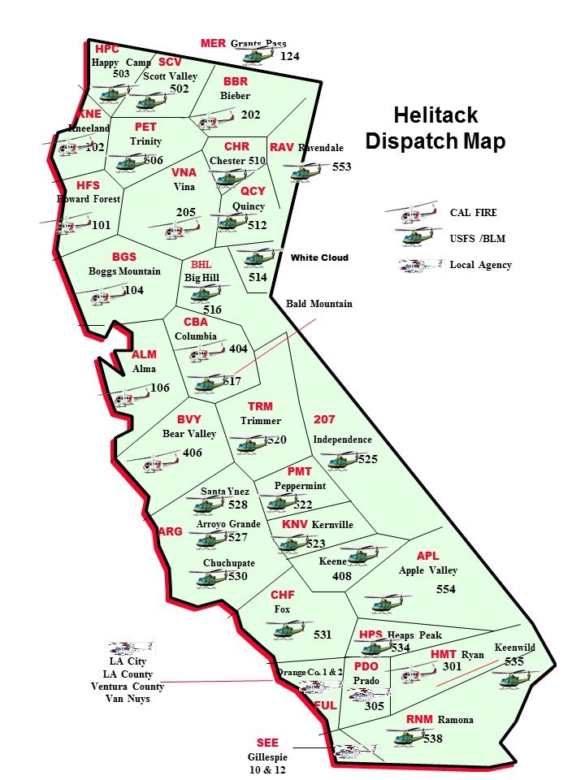
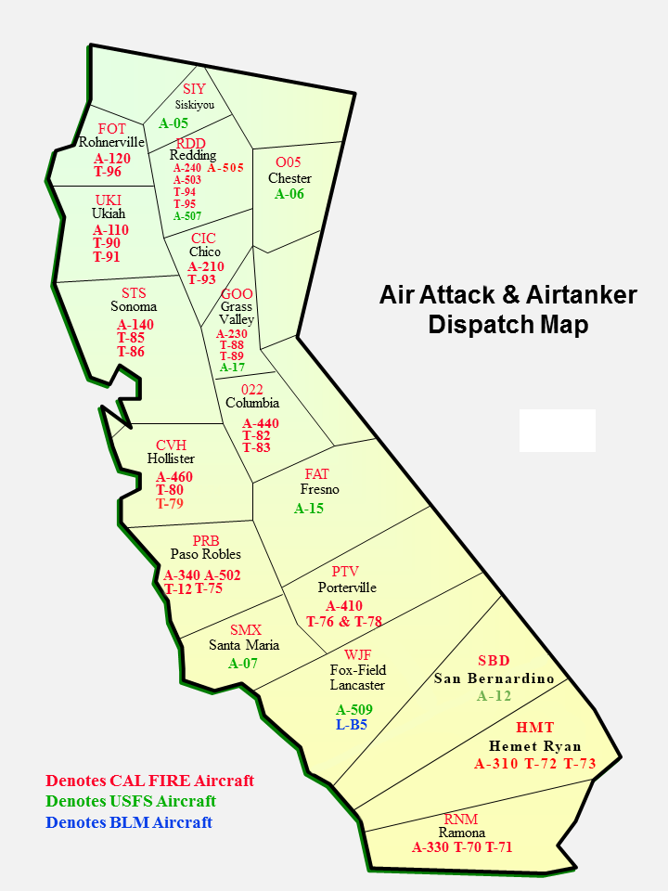

Slide 14
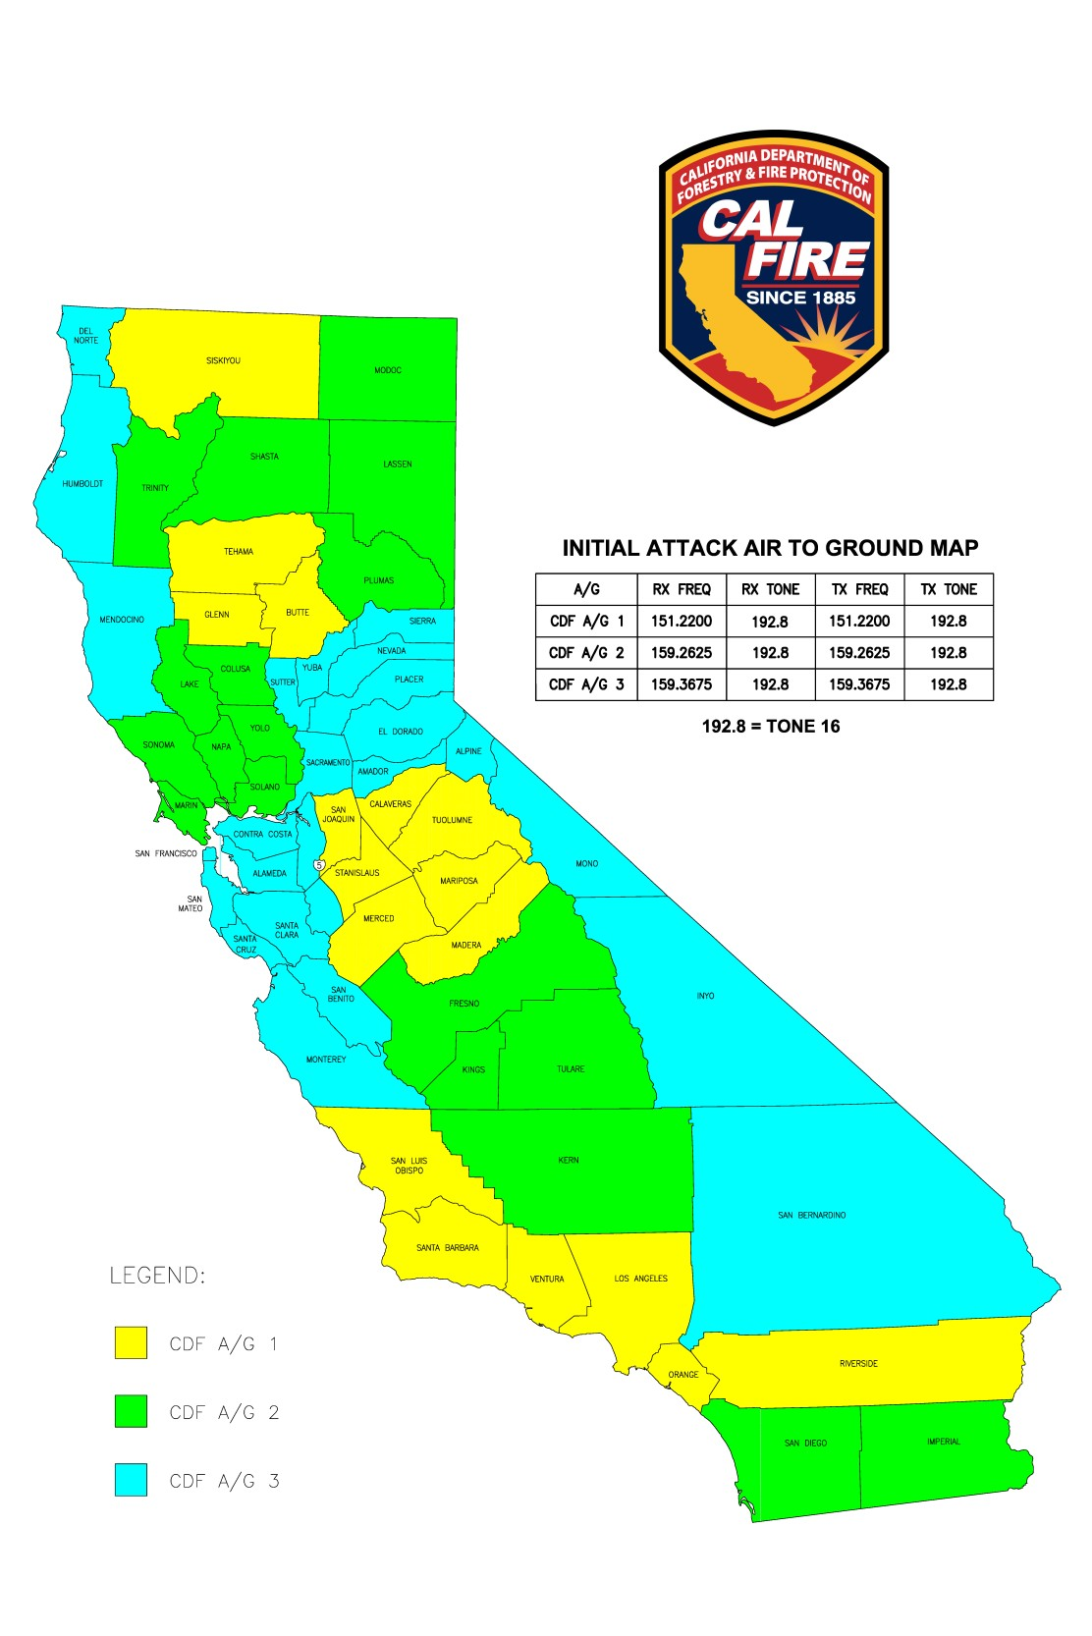
Initial Attack Air to Ground Map

Slide 15
North ops predictive services
2025 fire season outlook early analysis

Slide 16
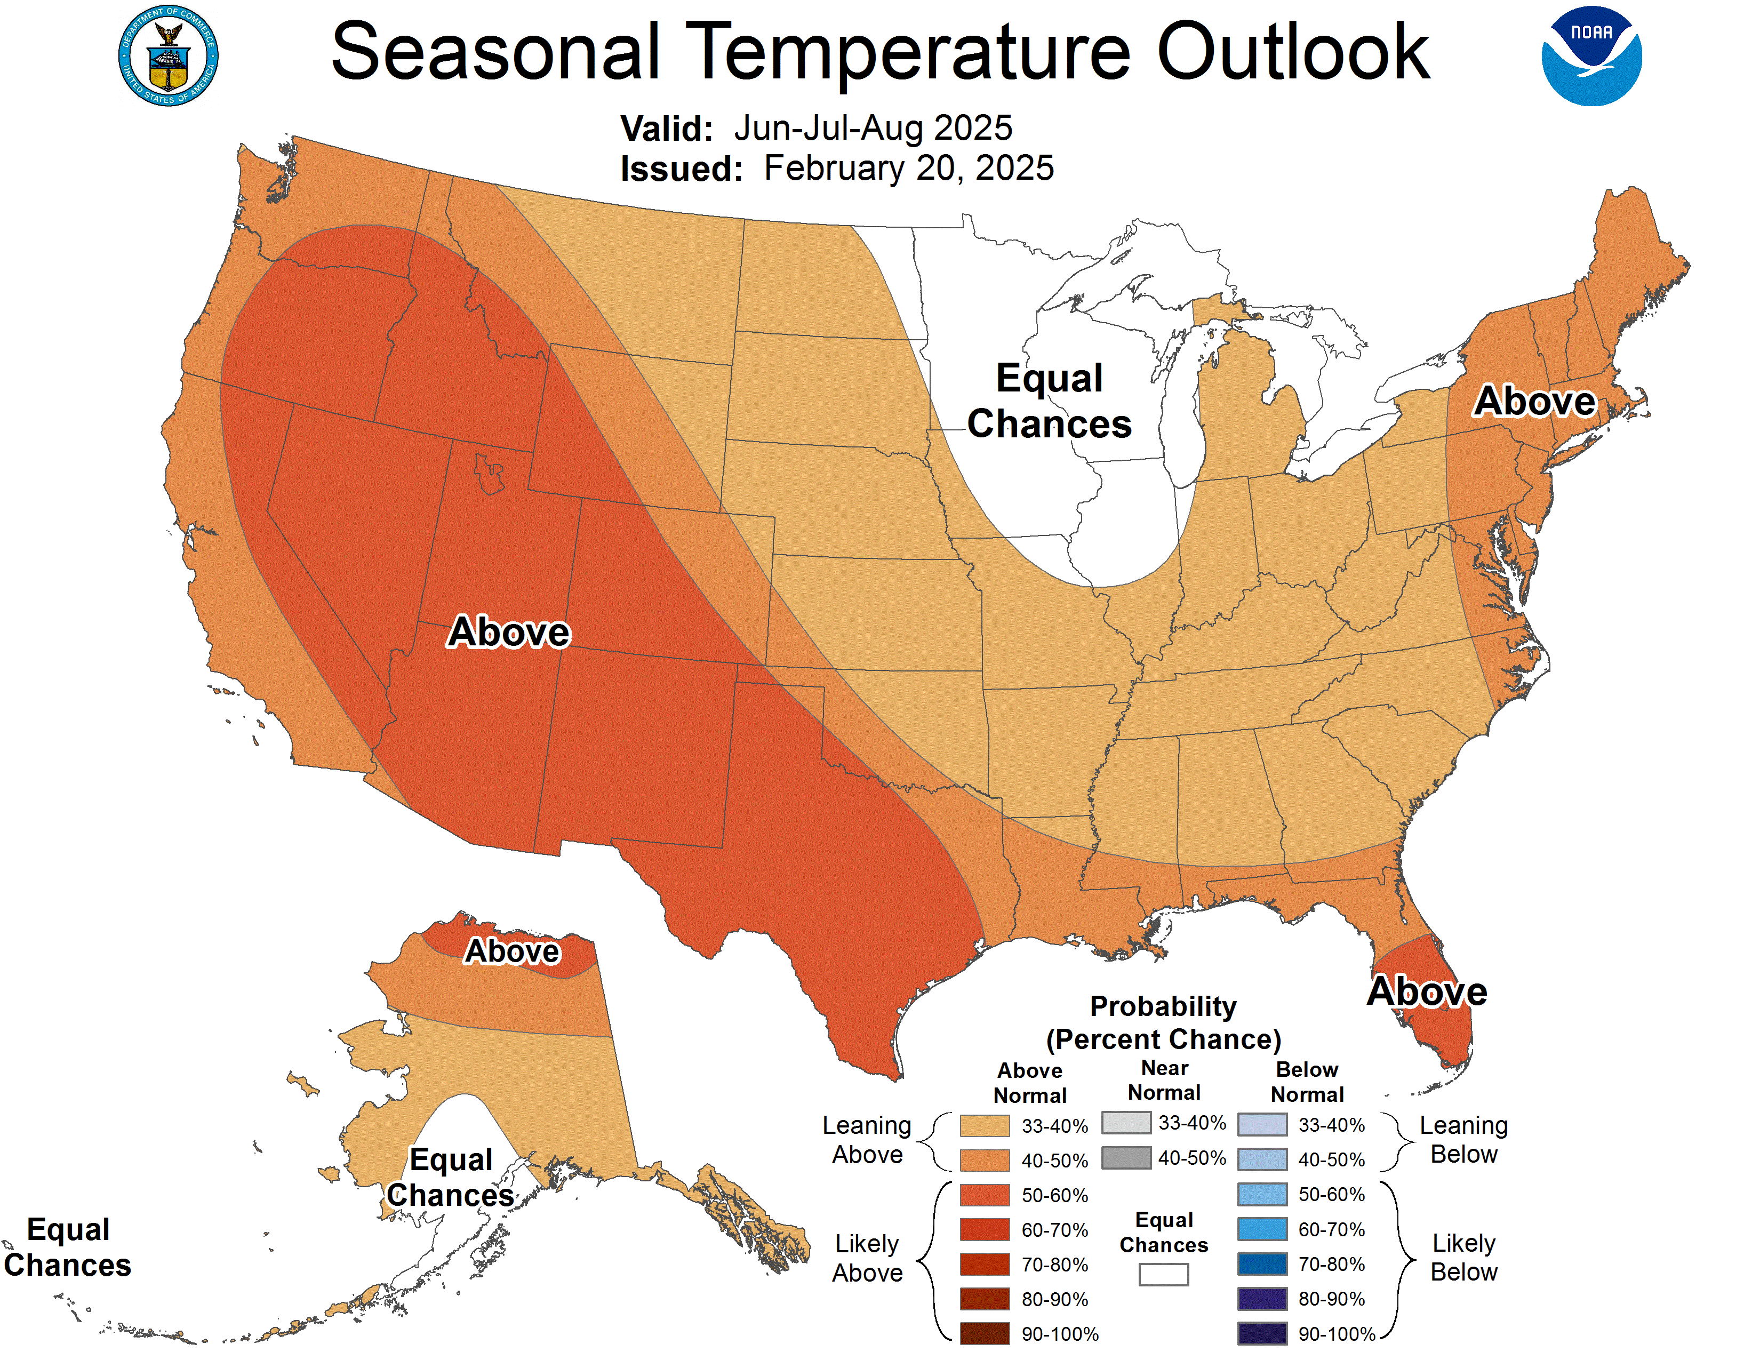
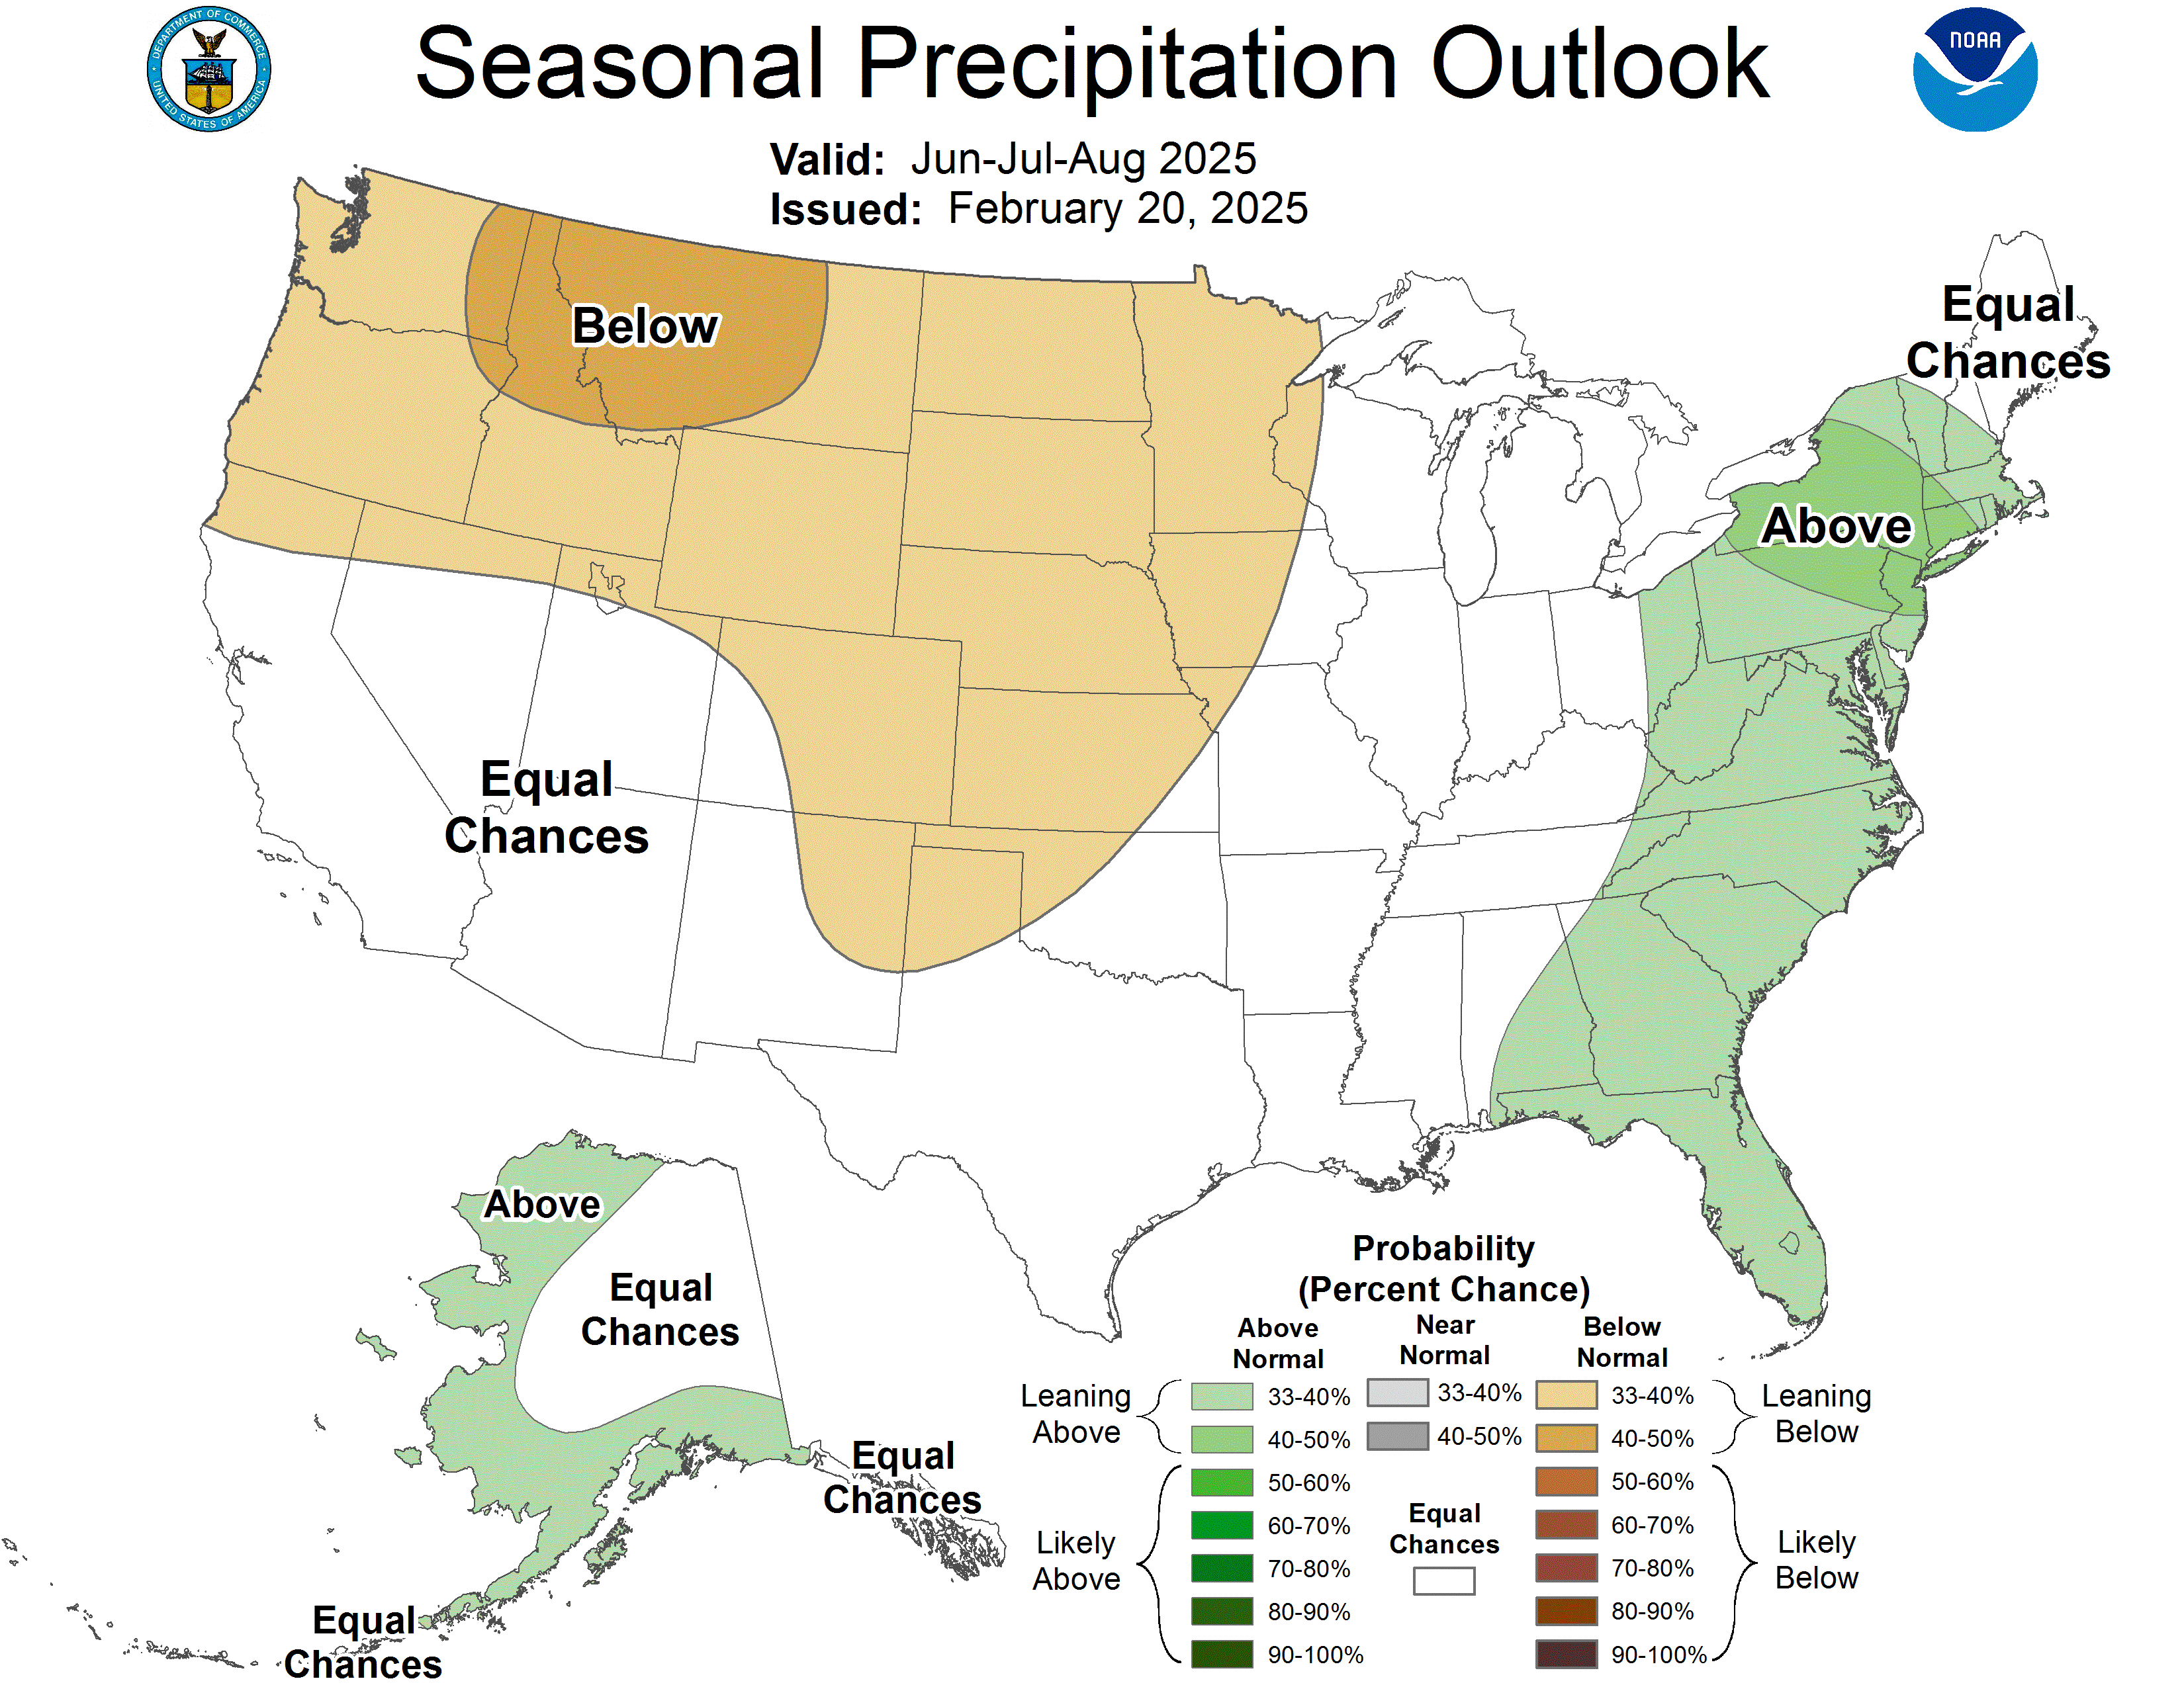
2025 Seasonal Outlooks – June, July, August

Slide 17
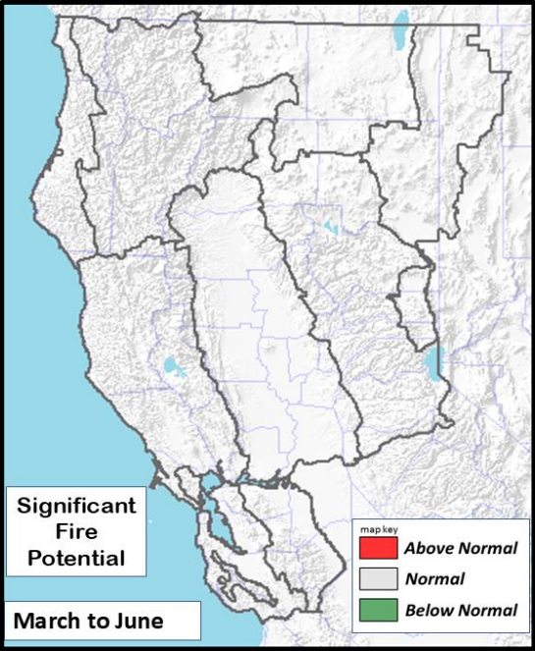
Looking Forward – Significant Fire Potential
ISSUED March 1, 2025 VALID March - June 2025
• Active jet stream periods creating cool/moist weather expected during most of March.
• April is expected to be the transition month with timely moisture intrusions and near to above normal precipitation while May and June trend warmer and drier than normal.
• Transitional green-up and snow cover will serve as fire spread barriers during this period.
• Extended flammable fuel alignments in terms of cured grasses and critically dry dead fuels will be possible across the lowlands during June but confidence is not high enough at this time to warrant an above normal outlook.
• Significant Fire Potential is projected to be normal from March through June and June historically represents the month when large fire activity increases.

Slide 18
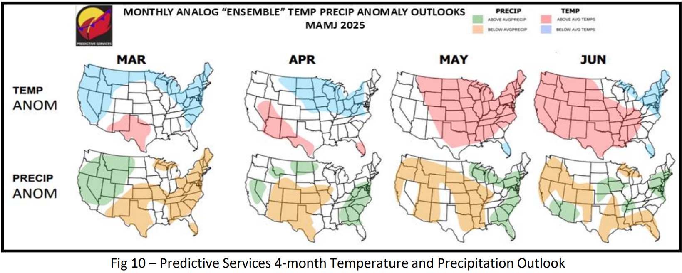
Predictive Services 4-Month Outlook​

Slide 19
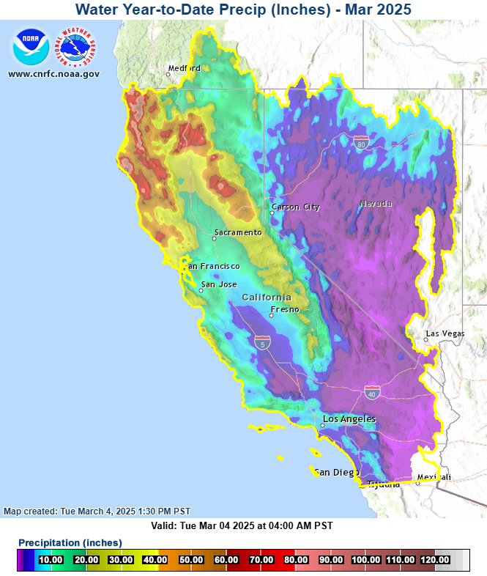
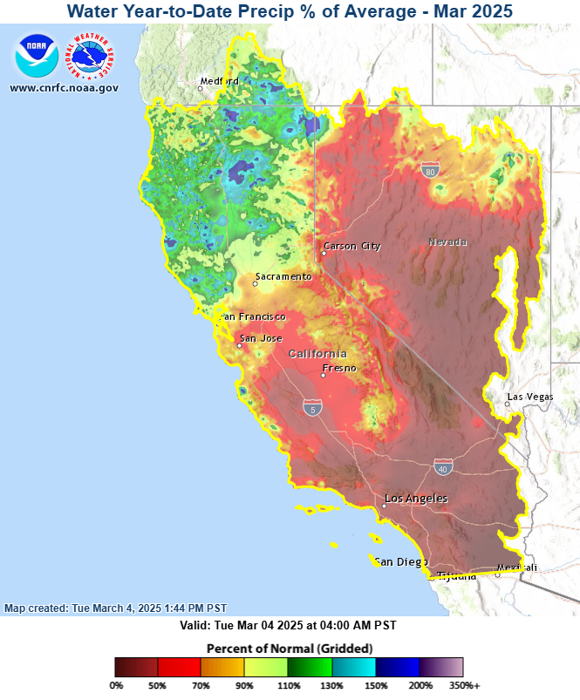
California Precipitation (Water Year)

Slide 20
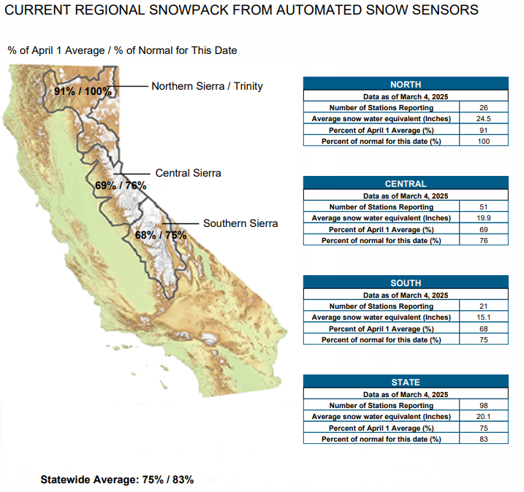
SNOWPACK
Snow Pack Conditions - Snow Water Content Chart Accessed March 4, 2025

Slide 21
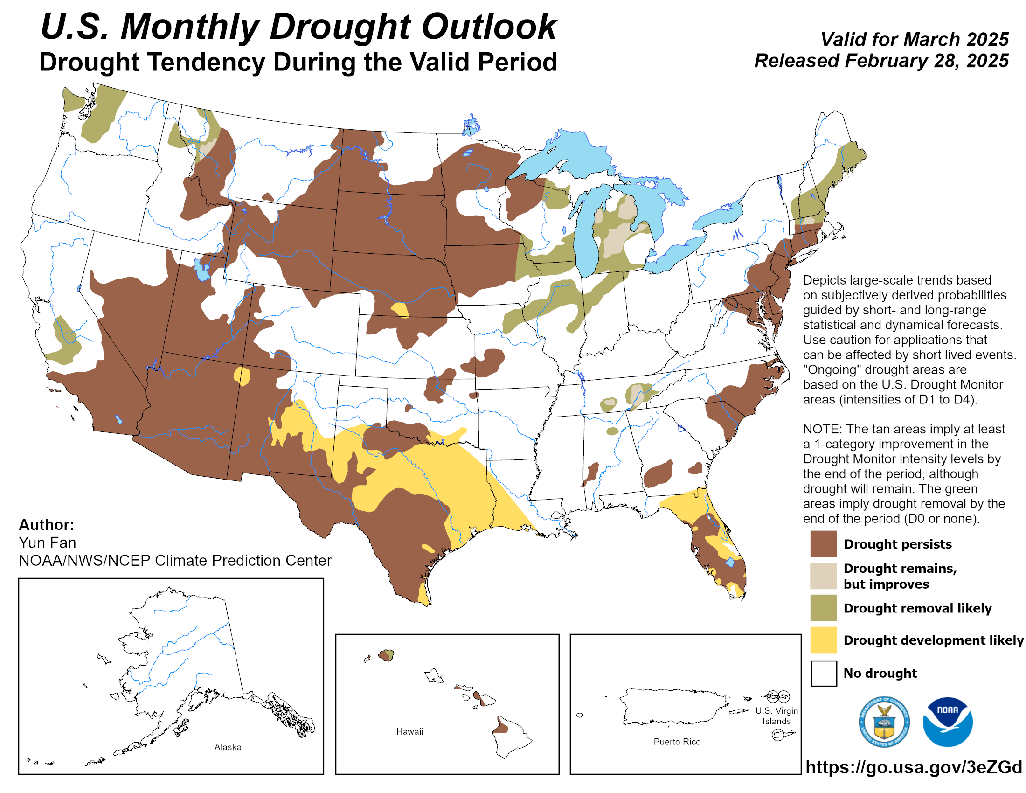
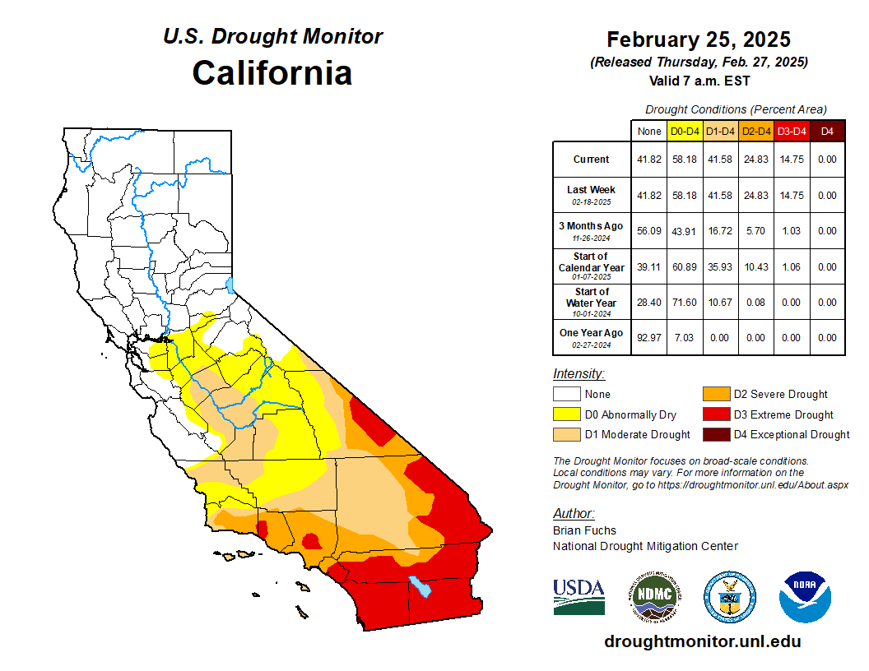
California Drought Monitor

Slide 22
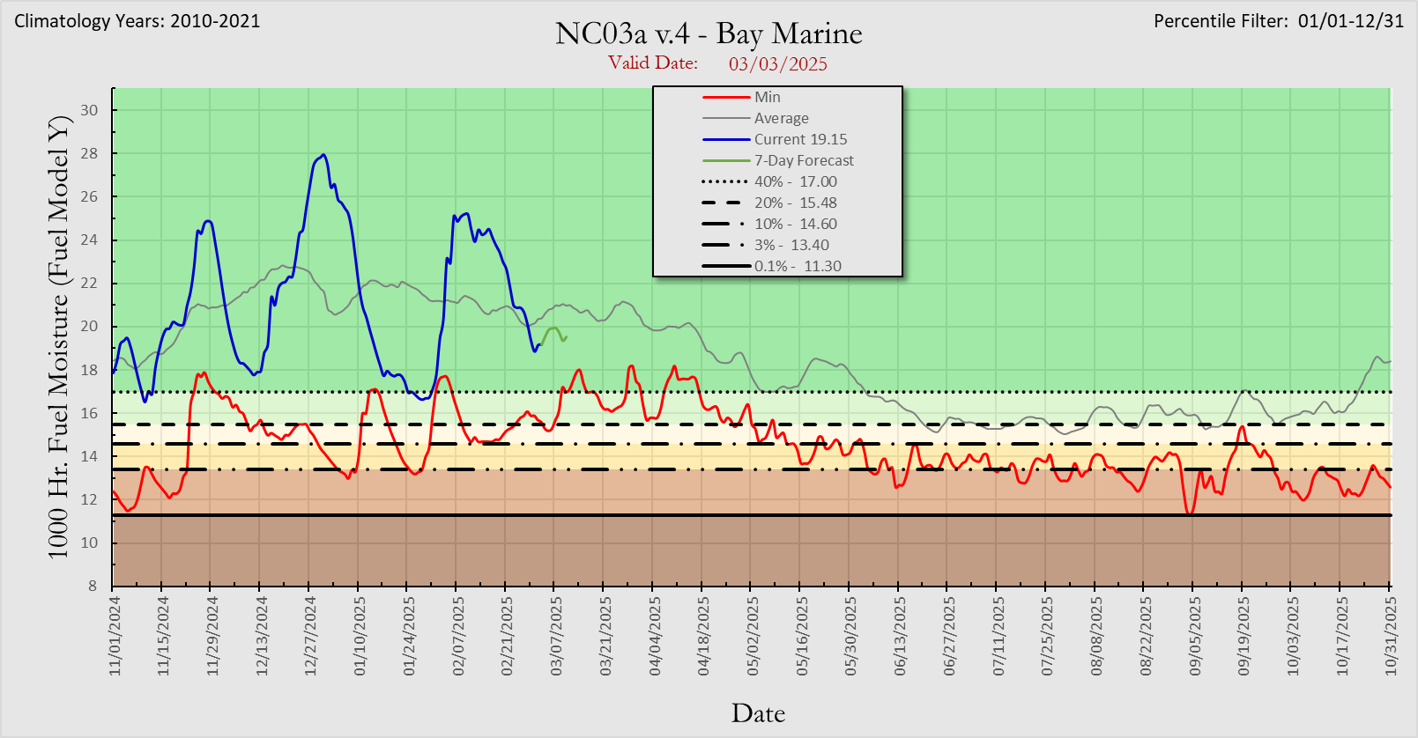
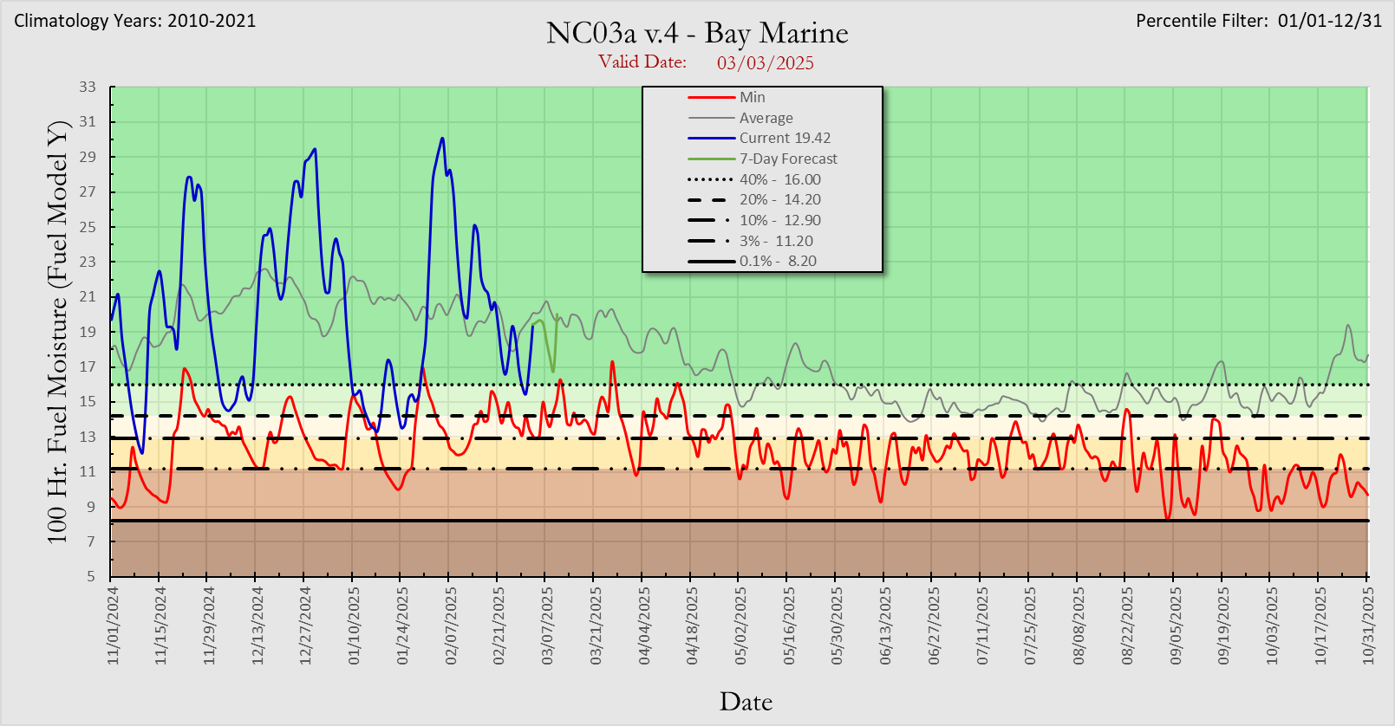
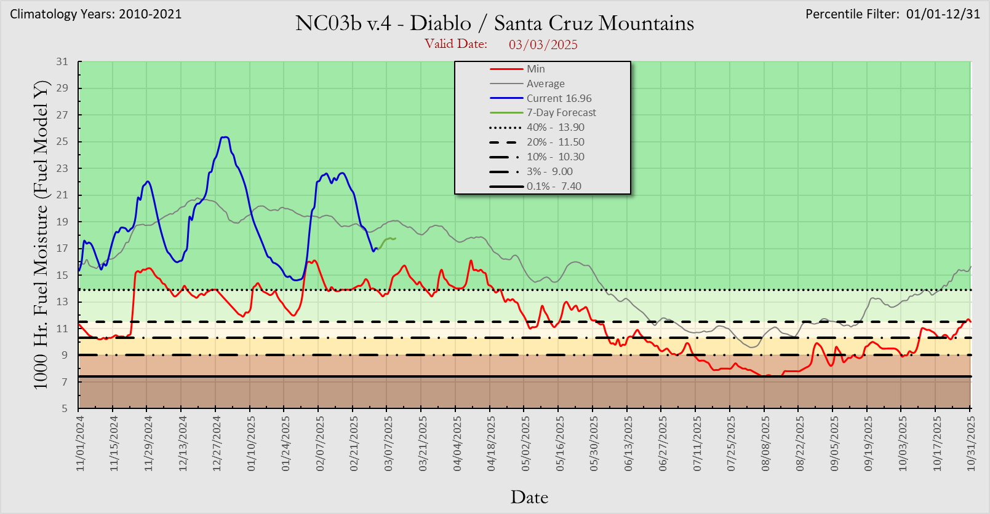
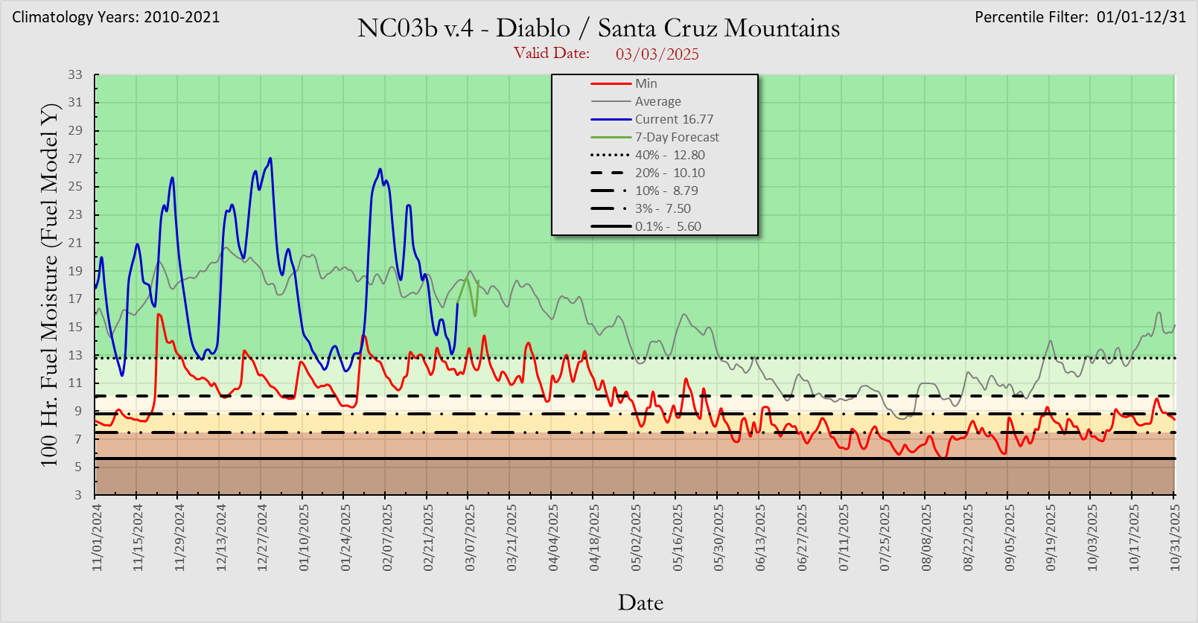
Fuel Moisture Levels
1,000 Hour Fuels
100 Hour Fuels
Bay Marine
Bay Marine
Diablo/SC Mtns
Diablo/SC Mtns

Slide 23
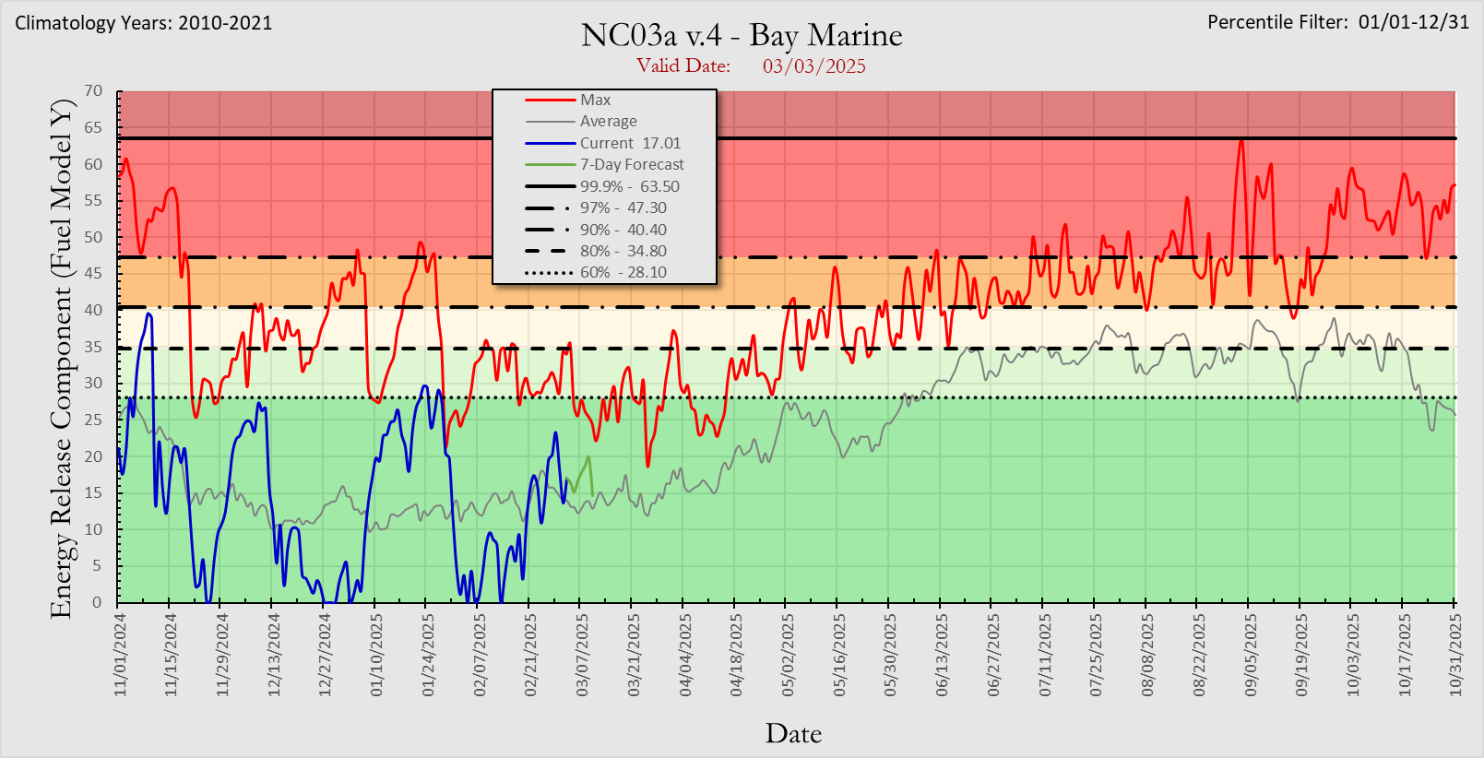
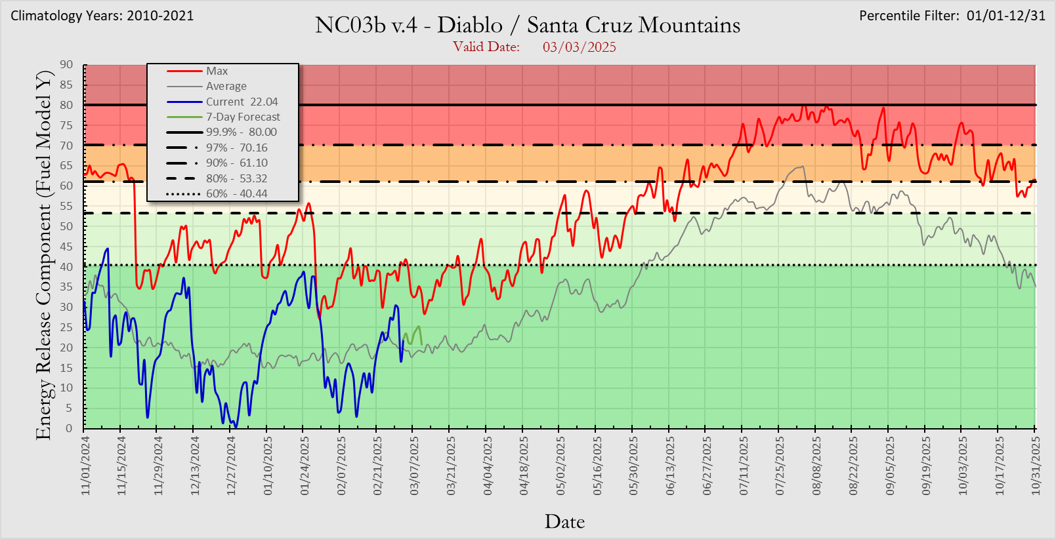
Energy Release Components (ERC)

Slide 24
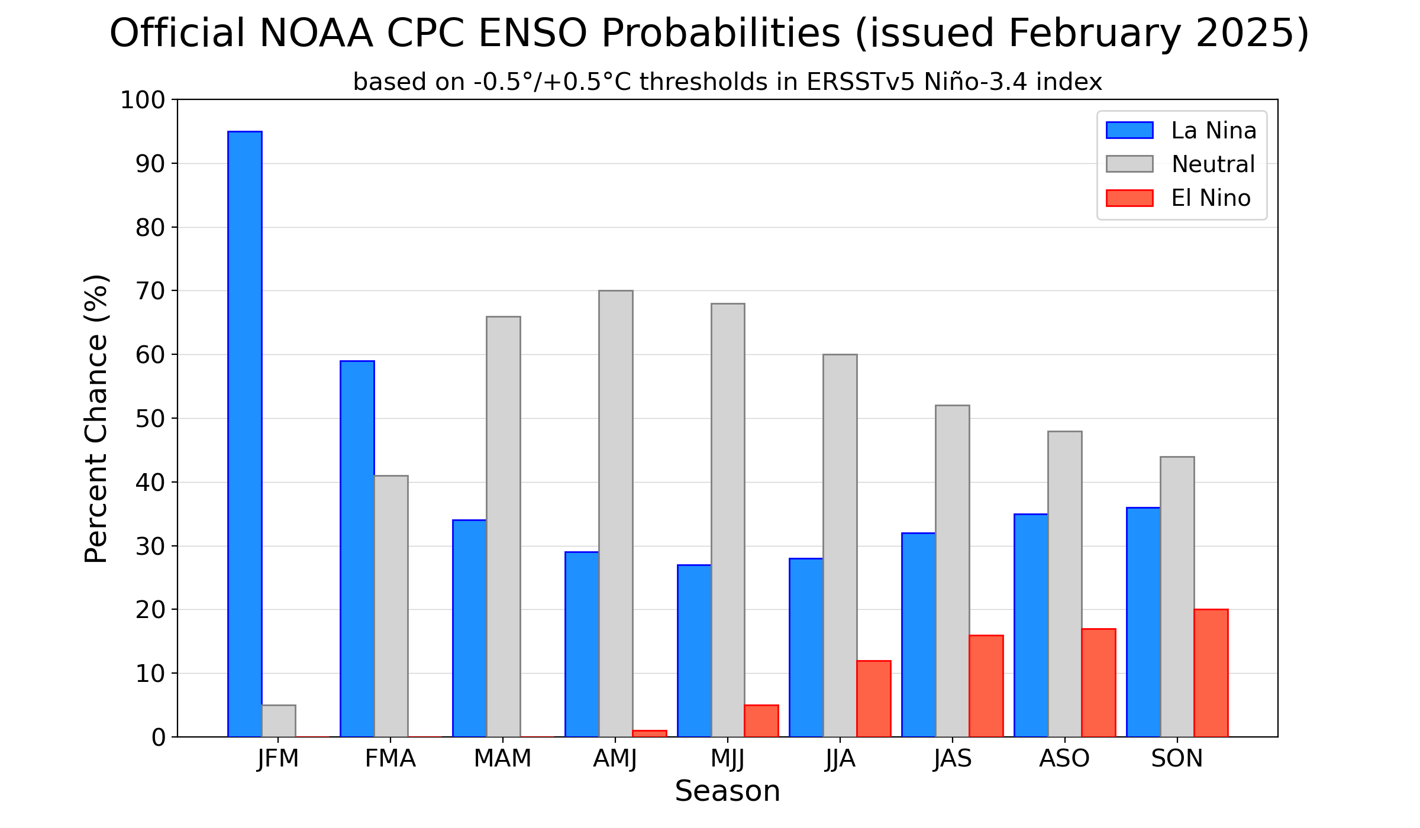

El Nino Southern Oscillation (ENSO)
La Niña conditions are expected to persist in the near-term, with a transition to ENSO-neutral likely during March-May 2025 (66% chance).

Slide 25
Weather Recap
• Active jet stream periods creating cool/moist weather expected during most of March.
• April is expected to be the transition month with timely moisture intrusions and near to above normal precipitation while May and June trend warmer and drier than normal.
• Transitional green-up and snow cover will serve as fire spread barriers during this period.
• Extended flammable fuel alignments in terms of cured grasses and critically dry dead fuels will be possible across the lowlands during June but confidence is not high enough at this time to warrant an above normal outlook.
• Significant Fire Potential is projected to be normal from March through June and June historically represents the month when large fire activity increases.
Outlook_NOps.pdf

