Slide 1

2014
Fire Preparation Meeting

Slide 2
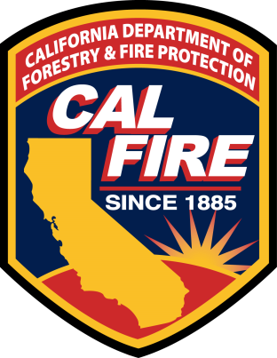
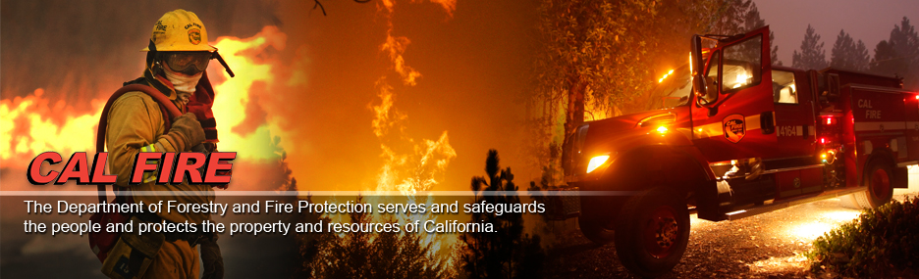
Battalion Chief Mike Mathiesen
Unit Safety Officer/VMP Program/Alma Helitack
Mike.Mathiesen@fire.ca.gov
(408) 472-1613 cell

Slide 3
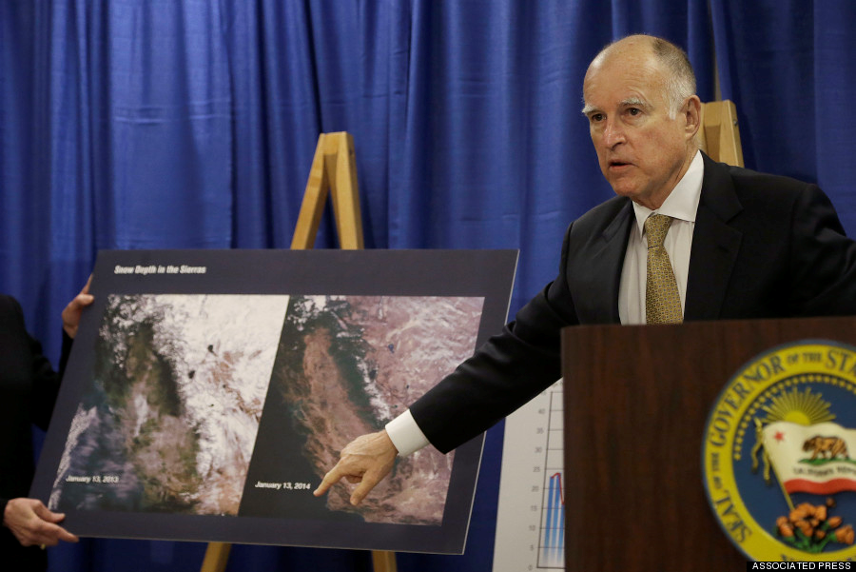
January 17th, 2014- With California facing water shortfalls in the driest year in recorded state history, Governor Edmund G. Brown Jr. proclaims a State of Emergency and directed state officials to take all necessary actions to prepare for these drought conditions.

Slide 4
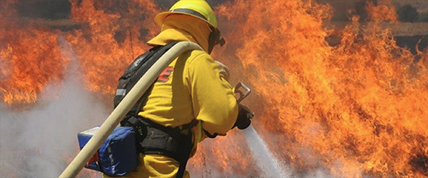
With unseasonably high temperatures, limited rainfall and moisture levels resembling the state’s peak fire season, on January 25, 2014, CAL FIRE hired 125 supplemental firefighters in Northern California and extended seasonal firefighting forces in Southern California due to dry winter conditions.

Slide 5
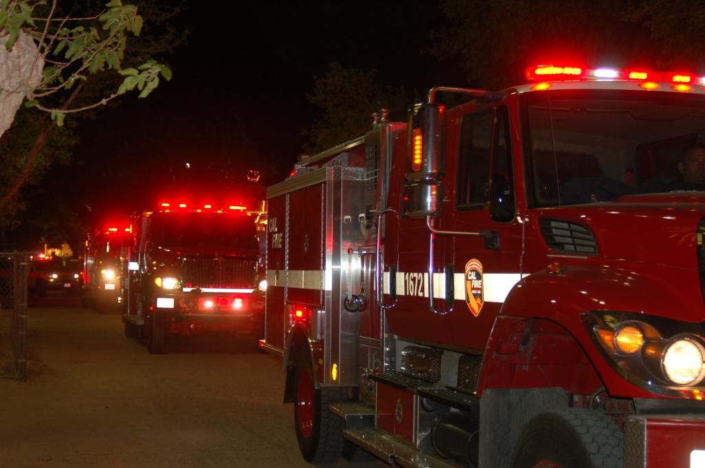
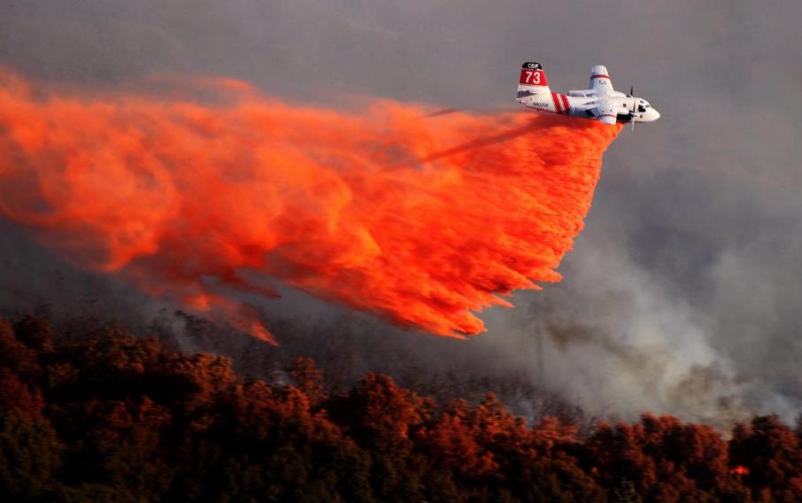
In Northern California, this added two additional fire engines in each of the 12 northern administrative units, which in the Santa Clara Unit re-opened our Almaden and Del Puerto Stations.
In addition, the Chico Air Attack Base was re-opened with two fixed wing aircraft

Slide 6
CAL FIRE Santa Clara Unit
April 7th 6-“Limited Term” Fire Apparatus Engineers and 12- Helitack Seasonal Firefighters were re-hired, with the Helicopter, Helitack crew and additional Stations coming on-line April 21.
April 14th 45-Seasonal Firefighters were re-hired
2 more groups to be re-hired the weeks of April 28 and in early May

Slide 7
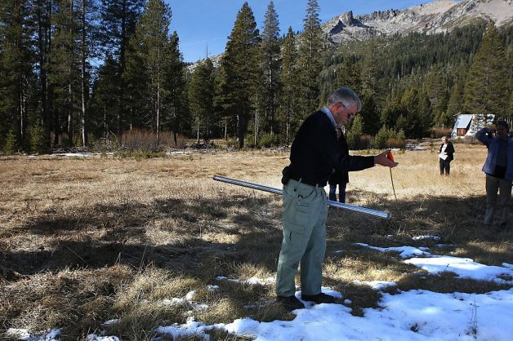
While the near to above normal precipitation of Feb. and March 2014 helped mitigate longer term drought, it by no means ended it.
One of the key effects of the winter drought, when combined with fairly mild temperatures during our relatively few storms, is that between 4500 - 6500 ft elevation we have zero to much-below-average snowpack.

Slide 8
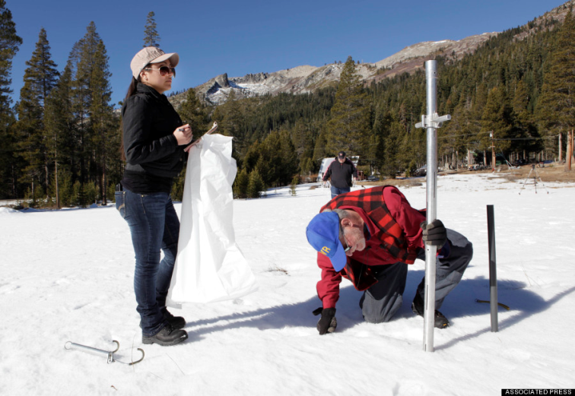
The California state snow survey on April 1 found that the snowpack contained just 32% of the average water content at that time of year, when snowpack typically reaches its annual peak.
This placed 2014 as among the lowest water-content years on record since such data began in 1930

Slide 9
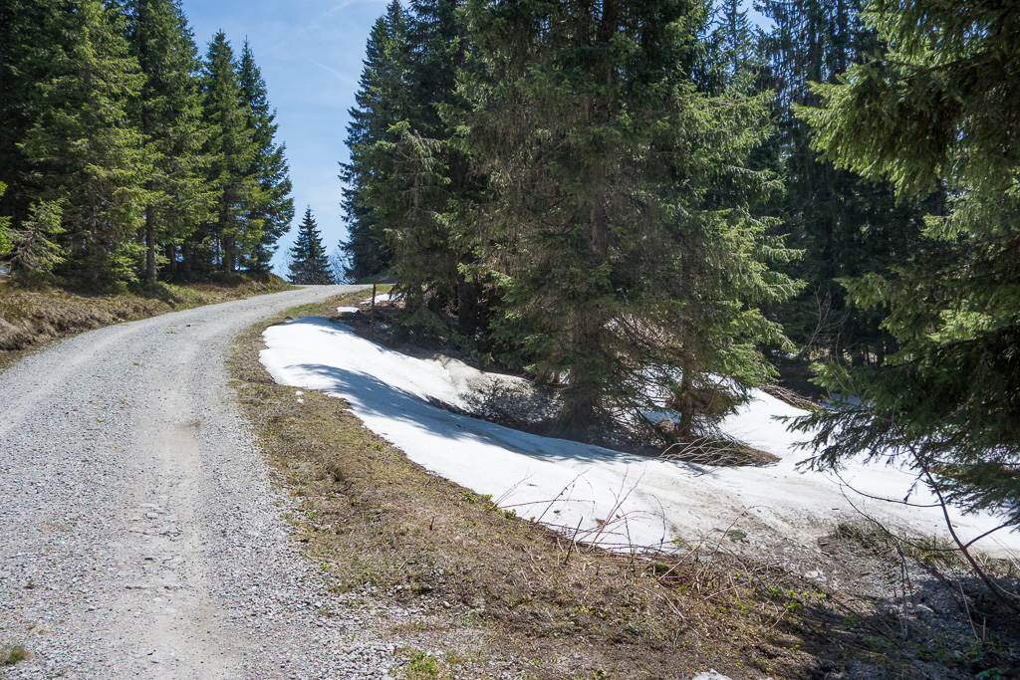
Huge expanse of NorCal ground has fuels that have been exposed to the weather elements much sooner and/or longer than average over the past several months. In most years, if hot dry spring weather arrives early, it is basically a non-factor for a time over the mid to high elevations.
This is due to the need for the winter’s snowpack to melt off before surface fuels can begin to dry out, and eventually become able to carry fire.

Slide 10
At this time, we anticipate that May will be near to a little above normal in temperatures, and near to below normal precipitation-wise.
June and July may be similar regarding temp anomalies. If they do end up below normal in precip, it doesn’t means as much as in the wetter parts of the year.

Slide 11
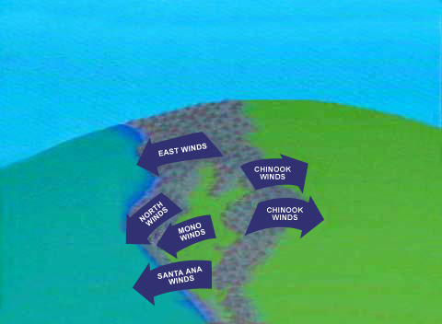
North to NE foehn winds in the Sacramento drainage are often a late May-June factor, and we see no reason 2014 will be different.

Slide 12
Above Normal Large Fire Potential for North Ops is expected to grow in Area coverage over time, as we progress from spring into summer.

Slide 13
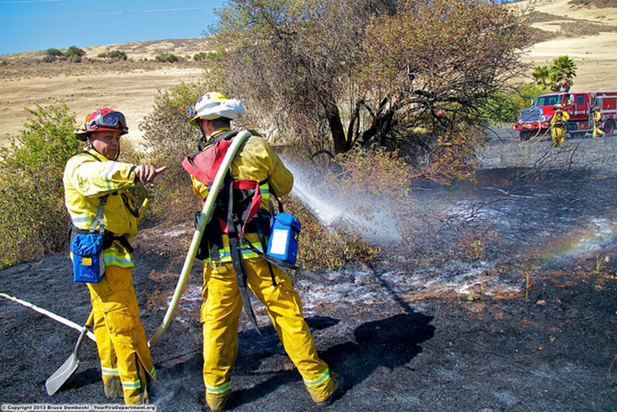
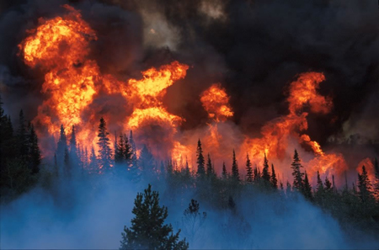
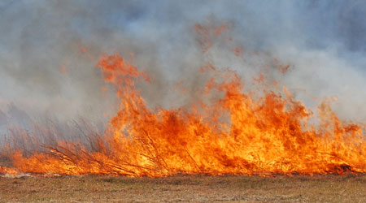
While the lower-elevation grass fire season may not be exceptional, the above discussion on the much-below-normal snowpack is supportive of the NOPS timber fire season having an earlier than average onset, perhaps by 3-6 weeks.

Slide 14
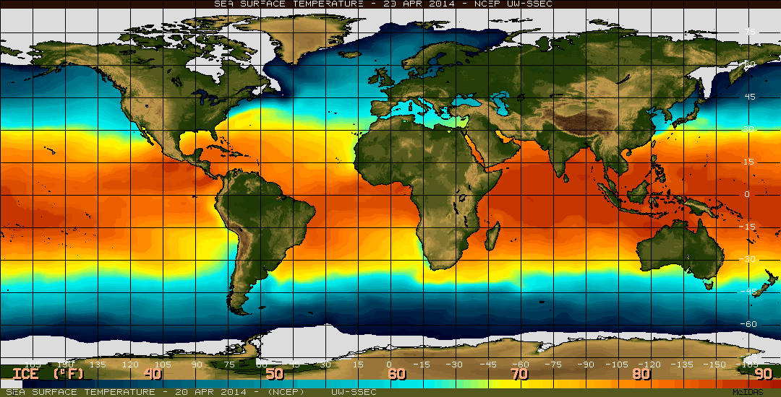
Regarding weather/climate for this May –July, any early signs of a coming El Nino will probably not yet be a NOPS factor

Slide 15
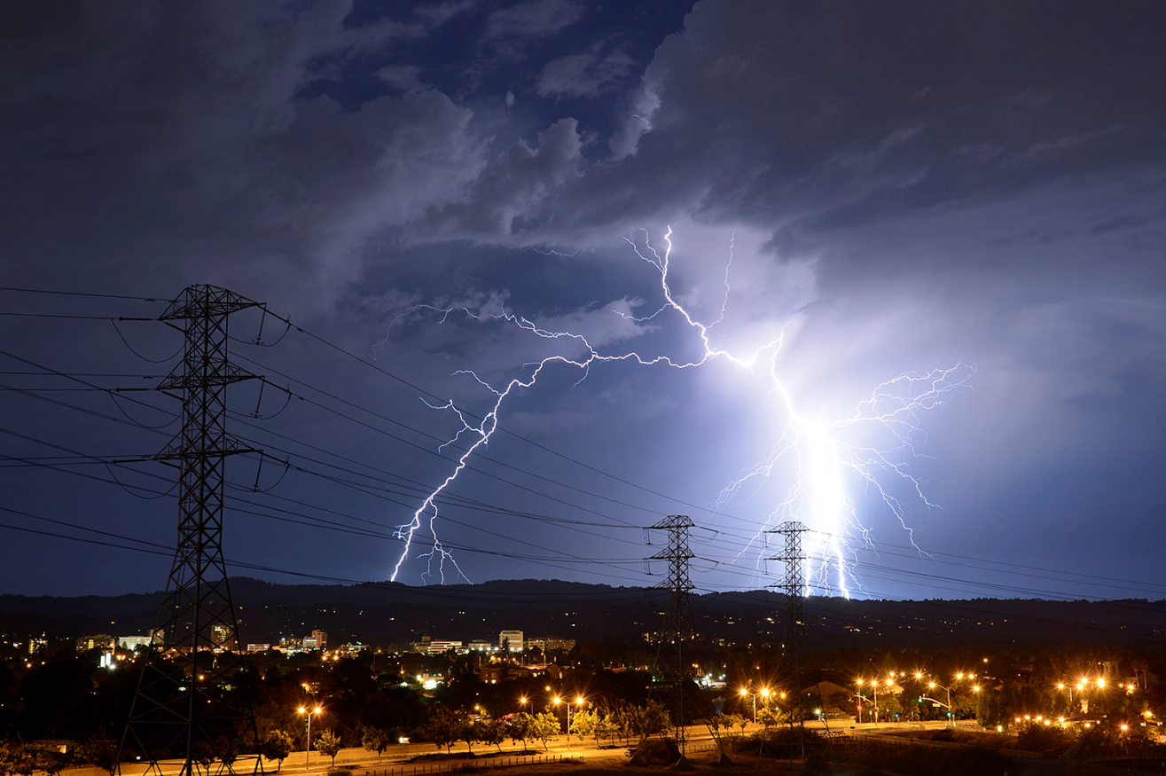
As always dry lightning will be a ‘wild card’. It can make any season suddenly busier, and especially so during drought years.

Slide 16

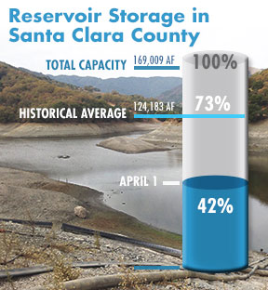
In consideration of the worsening water supply outlook for Santa Clara County, the Santa Clara Valley Water District Board of Directors unanimously passed a resolution February 25, 2014 calling for mandatory measures to reach a water use reduction target equal to 20 percent of 2013 water use, through Dec. 31, 2014

Slide 17
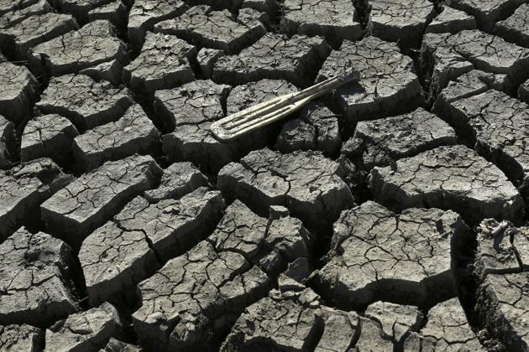
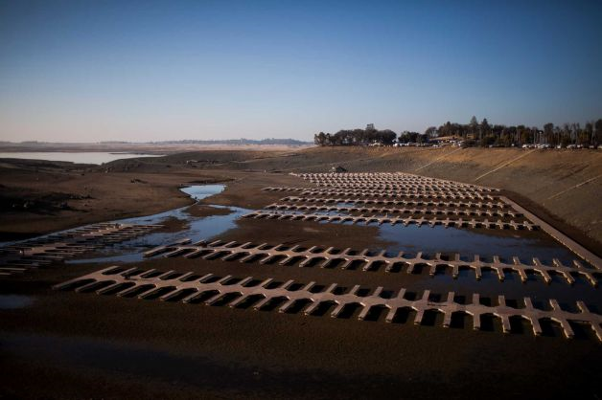
Boat oar at bottom of Almaden Reservoir-2014
Folsom Lake-2014

Slide 18
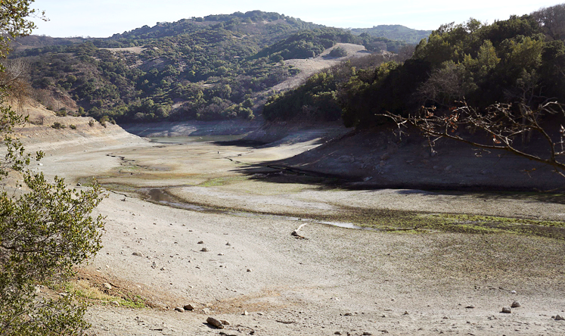
Almaden Reservoir- January 2014

Slide 19
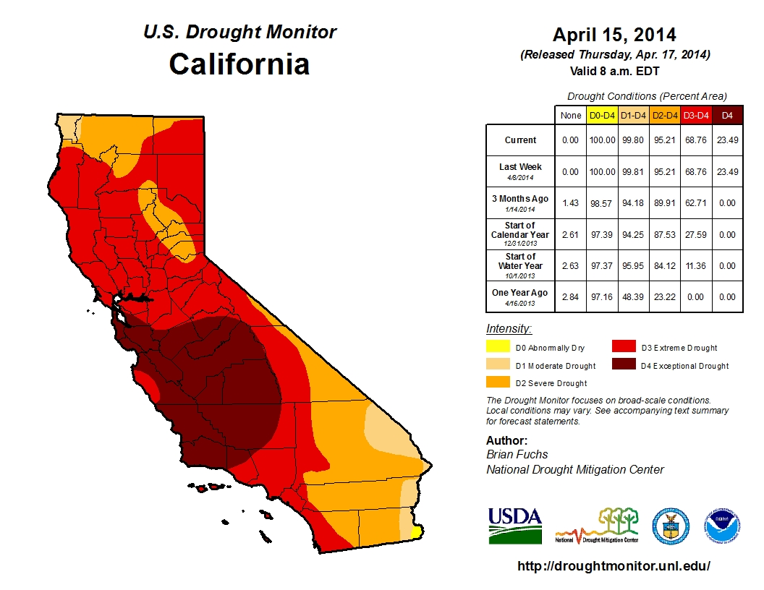

Slide 20
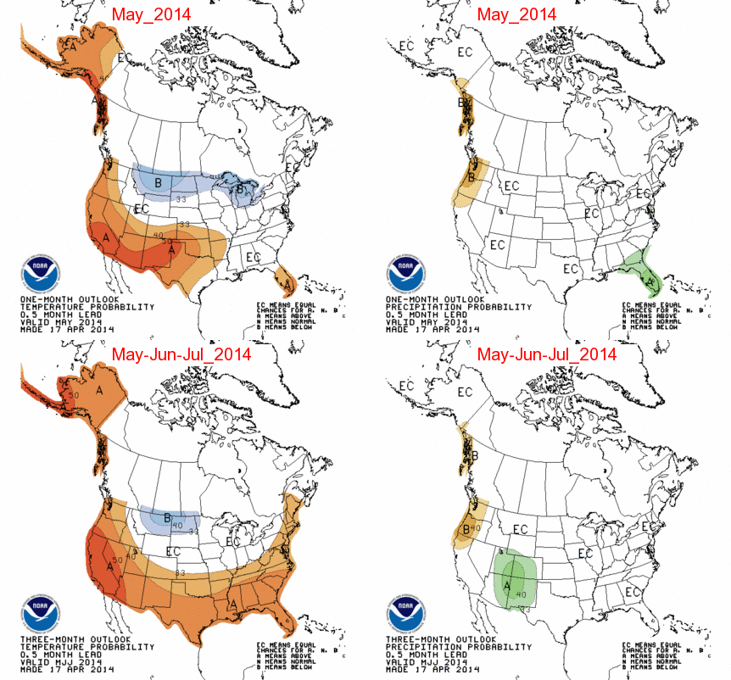

Slide 21
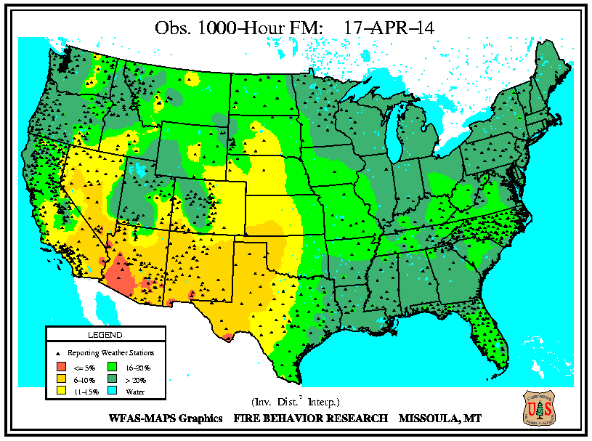

Slide 22
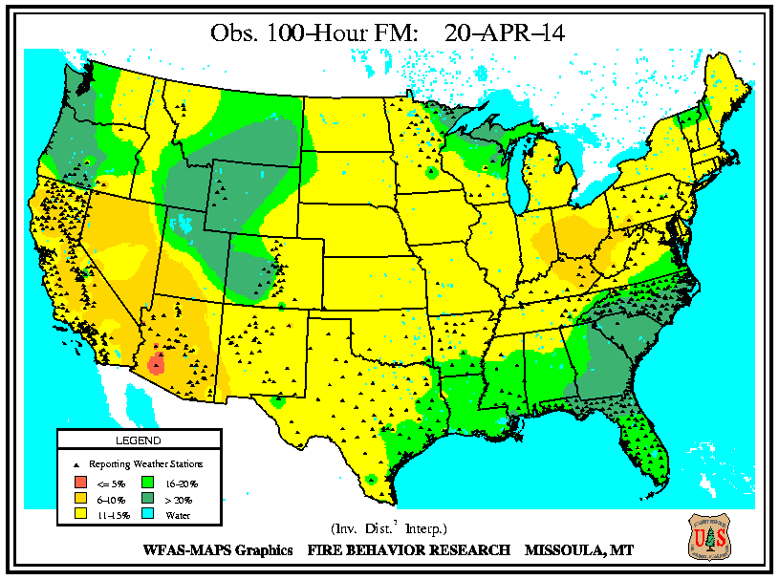

Slide 23
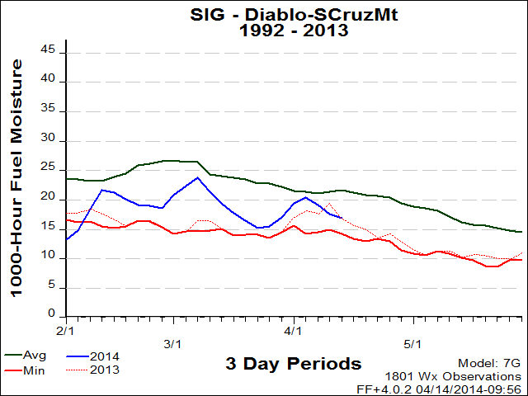
Recent wetting rains received in March did little to change the dire water situation and fuel moisture levels in our vegetation this spring. Many fuel types stayed in critical levels, meaning fire would readily carry throughout the stand, until just recently.

Slide 24
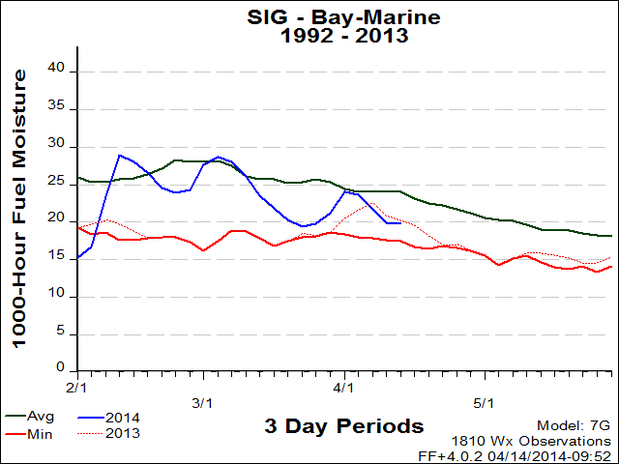
Areas covered- Las Trampas, La Honda, Pulgas, Oakland North, Corralitos
Fuel Model- Short Needle/Heavy Dead

Slide 25
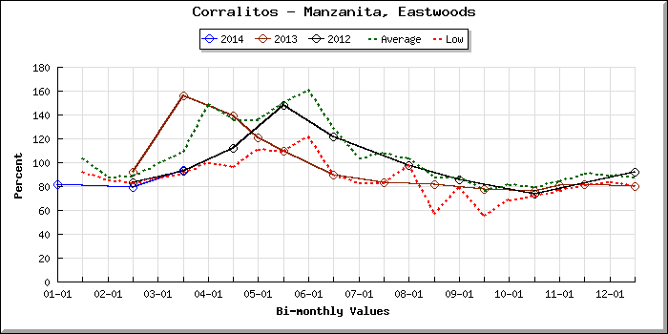

Slide 26
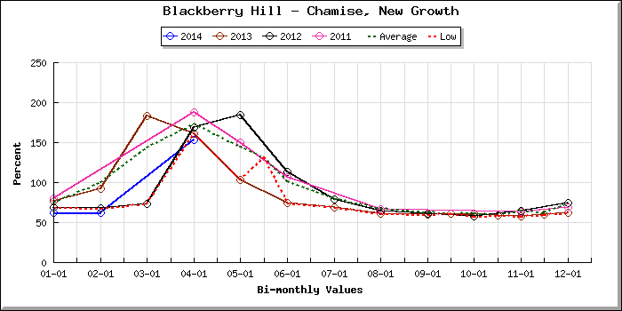

Slide 27
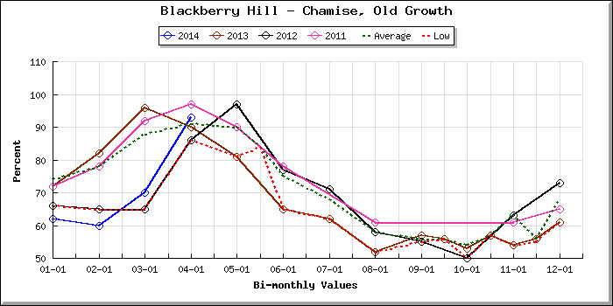

Slide 28
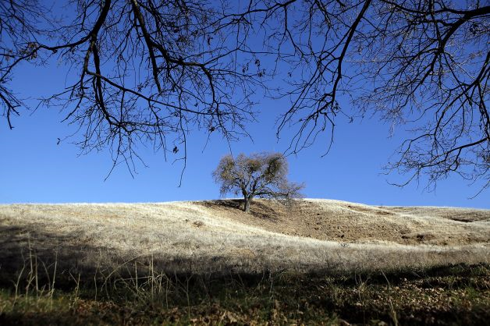
With Spring now here, the daylight hours and burn windows are increasing as fuel conditions worsen statewide. There is considerable drought stress in many species –Chemise, Conifers, Manzanita and Eucalyptus are showing signs of stress.

Slide 29
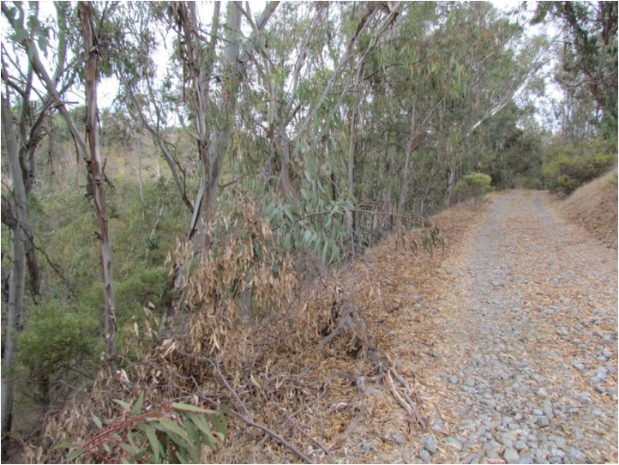
The hard freeze our area encountered in early December is very evident especially in Eucalyptus groves where large amounts of dead tree limbs in otherwise healthy trees add an explosive element to an already dangerous tree.

Slide 30
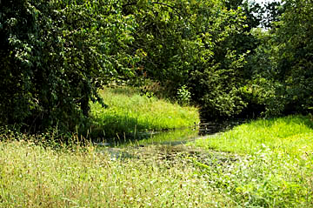
Riparian zones (streamside vegetation), which normally resist fire more so than other areas are stressed and susceptible to fire encroachment.
Don’t expect the Riparian Zones to thwart fire spread this fire season, expect them to have more dead component- including the fine dead fuel for supporting fire advancement

Slide 31
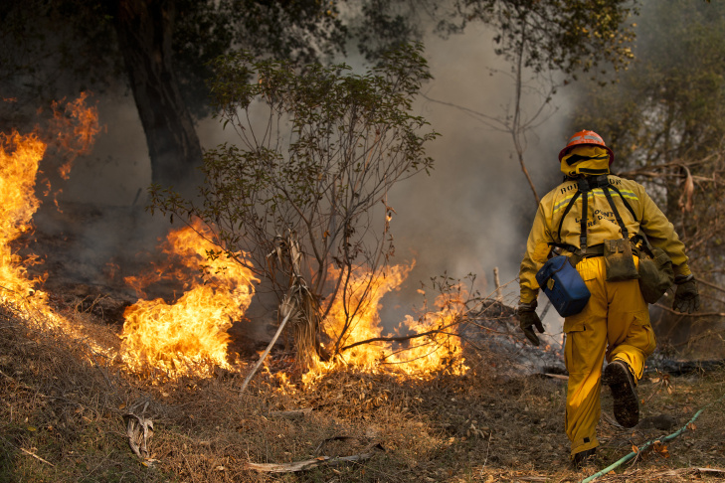
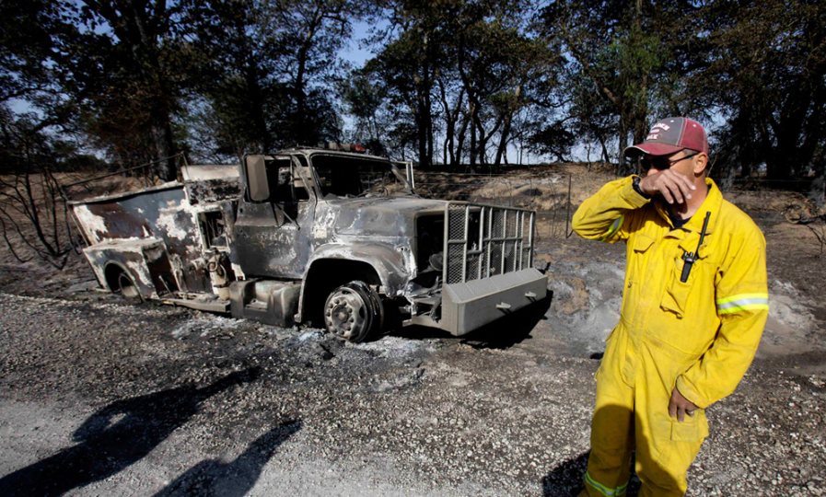
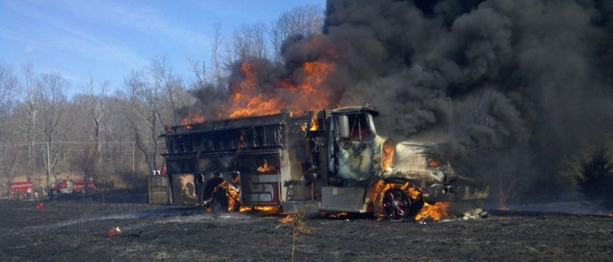
Be aware of the potential for increased fire behavior in all fuels. Make sure your decision points take into account the aggressive burning you will encounter and allow adequate time for your resources to utilize their escape routes.

