Slide 1
Region II Strike Team Leader, Single Resource & Overhead Refresher 2024

Slide 2
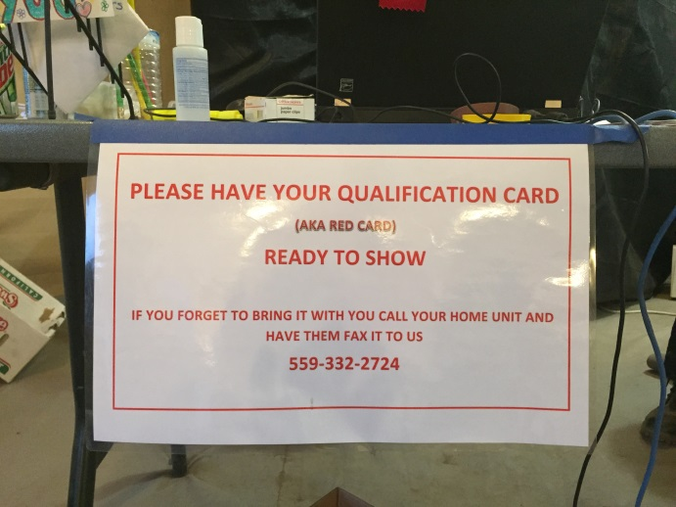
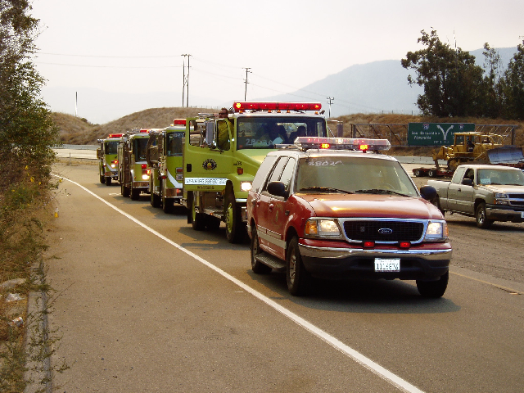
We expect you to….
Gather Dispatch Information
CICCS Qualification
Determine Urgency
Appropriate STEN Vehicle
Attempt to fill STEN Trainee
"Flight Following” with Operational Area
Daily “SIT STAT” with
Home Operational Area
Notes:
STL (T) is approved for every assignment.
Discuss Leader’s Intent and CICCS Qualification Expectation

Slide 3
Strike Team/ Taskforce Leader
CFAA approves a Trainee.
If a OA does not have trainee (T) please reach out to a neighboring OA or Region IV to fill… we have several (T’s) that need to get out.
Notes:
STL (T) is approved for every assignment.
Discuss Leader’s Intent and CICCS Qualification Expectation

Slide 4
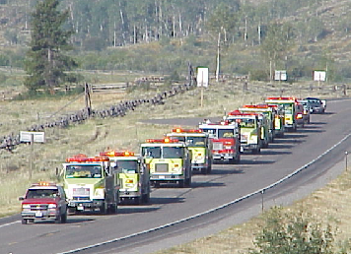
Determine Urgency
Response Modes
Initial Attack
Just like receiving a 911 call
Immediate Need
30 minute response expectation
Planned Need
1 hour response expectation
Notes:
Explain the difference between Immediate and planned need.

Slide 5
It is the responsibility of the Overhead*/STL/TFL to always know which agreement was used for your request and what mission (who pays) you were requested for!
THIS IS ON YOU!

Slide 6
AGREEMENTS
Master Mutual Aid (MMA) – free
(MARS (F-42) documentation)
California Fire Assistance Agreement (CFAA) – (12hrs free) – MARS (F-42)
Local Forest Agreement (LFA or ABH)
Whatever you agreed to
FC-33 or FSLA-5
Notes:
These are the three that come into play most often. You should be familiar with them and have copies of them in your kit or electronically. If you are ordered through the California Fire and Rescue Mutual Aid System the F-42 is going to be the financial document.

Slide 7
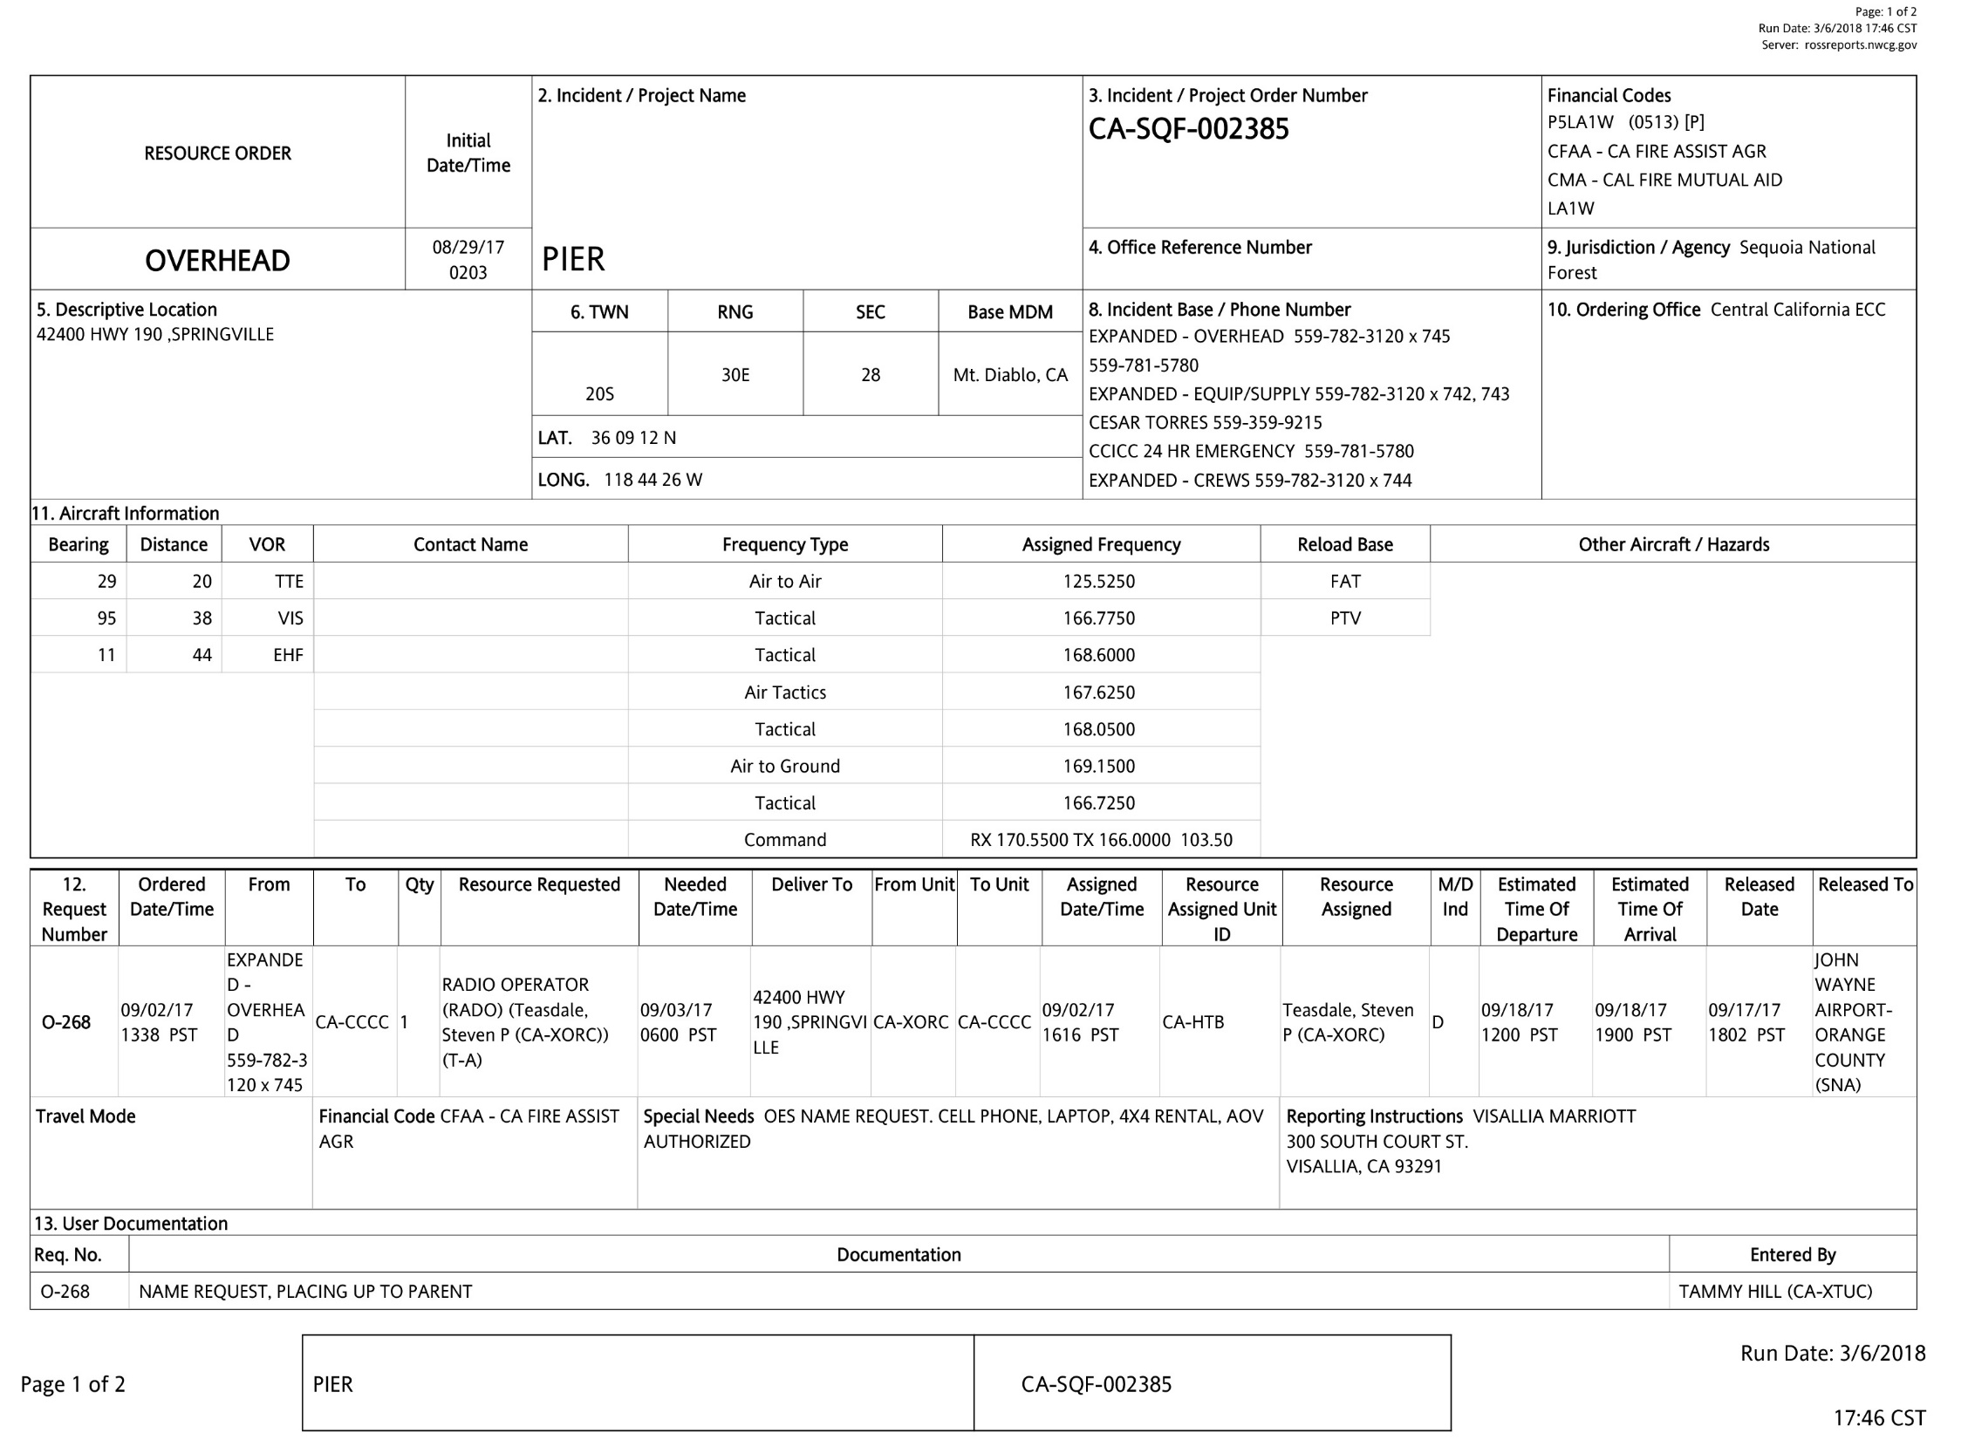
This box shows your financial code

Slide 8
The California Fire Assistance Agreement (CFAA)
USFS
NPS
BLM
BIA
Cal OES
CAL FIRE
FWS
Notes:
Agreement for local government fire and emergency assistance to the State of California and Federal Fire Agencies. These are the agencies.

Slide 9
CA Fire Assistance Agreement
Workers’ Compensation
Liability for workers compensation claims and/or payment of unemployment benefits shall remain the responsibility of the responding local, state, federal, and tribal agencies that directly employ the personnel
Your workers compensation follows you to your assignment. If you are injured at the incident, you must file a workers compensation claim with your employer
Notes:
Workers’ Compensation:
Except as otherwise provided in Recital 25 of this Agreement, all parties to this Agreement hereby waive claims between and/or against each other arising from the performance of this Agreement for compensation for loss or damage to each other’s property, and personal injury including death of employees, agents, and contractors. This waiver shall not apply to intentional torts.

Slide 10
CFAA
Reimbursement - Travel Expenses: Exhibit H
Reimbursement for travel expenses such as fuel, food,
and lodging while assigned at incident must be
approved in writing by the incident.
Meals and incidentals not provided by the incident on
the first and last travel days are reimbursable. (No
documentation required)
Fuel to and from incident is not reimbursable
Lodging while traveling to and from incident needs
prior approval
Notes:
I usually have a conversation about the strike team who got gas in town because the fuel line in camp was too long. I also talk about no fuel in camp and the exception to buying fuel in town. AND GETTING PRIOR APPROVAL. Just because it’s approved by the incident does not mean that it will be reimbursed.

Slide 11
Some more things to know about the CFAA
Reimbursement - Travel Expenses:
At no time will local government fire agencies seek reimbursement for travel expenses such as fuel, food, and lodging responding to, during, or returning from a State of California or Federal Fire Agency incident unless documented and approved in writing by the incident.
For information on APPROVED travel expense reimbursement, refer to Exhibit H
Notes:
I usually have a conversation about the strike team who got gas in town because the fuel line in camp was too long. I also talk about no fuel in camp and the exception to buying fuel in town. AND GETTING PRIOR APPROVAL. Just because it’s approved by the incident does not mean that it will be reimbursed.

Slide 12
Lodging Rate
$184.00
*Reimbursed up to a ceiling of 150%
Meal and Incidental Rates
Breakfast | $17.00
Lunch | $18.00
Dinner | $34.00
Incidentals | $5.00

Slide 13
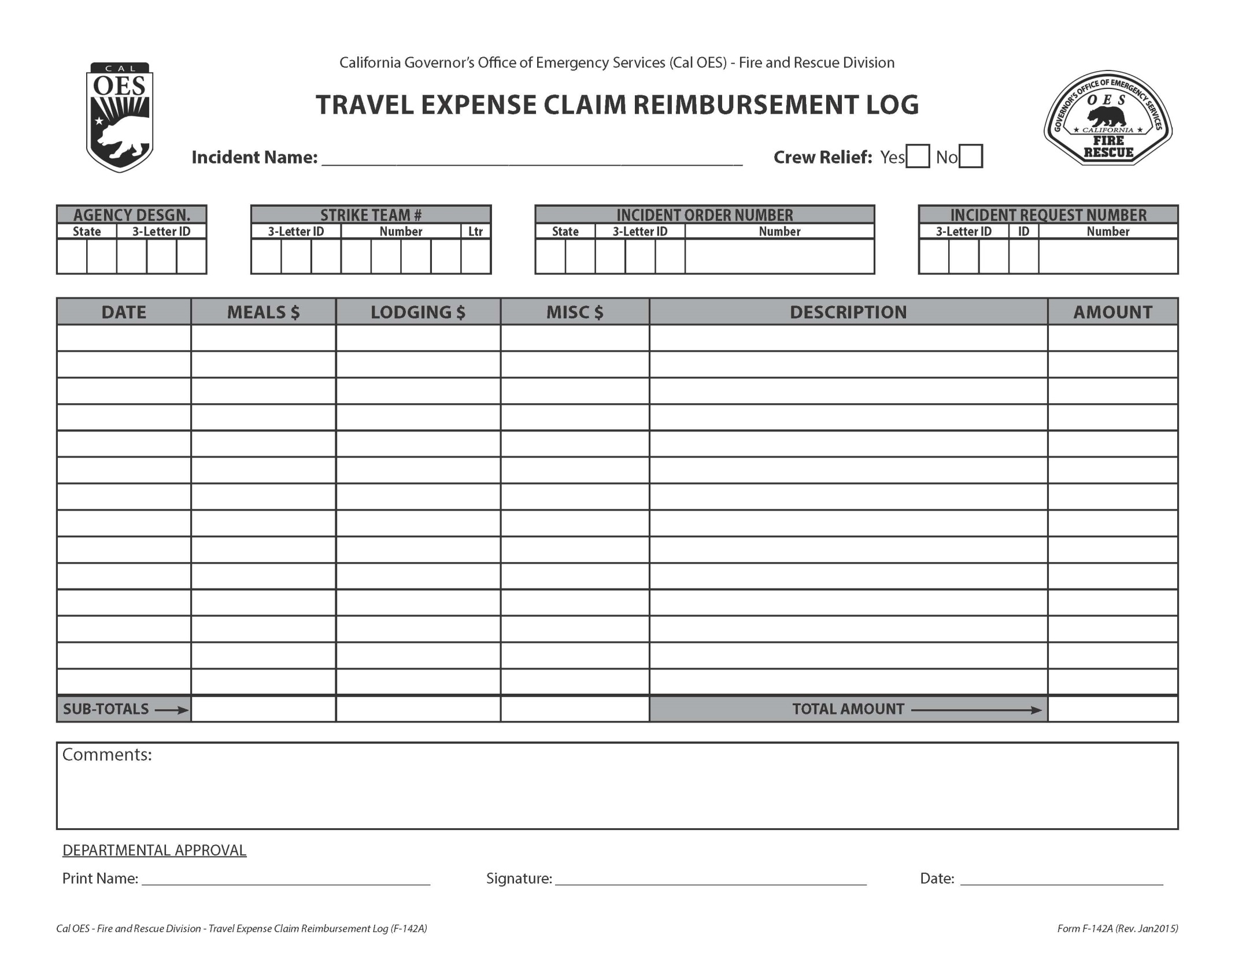
Notes:
This form is just as important as the F-42. If you have extra expenses that have been approved and completed at the time of demobilization, this form and all pertaining documents must be filled out and given to the OES AREP. If you are incurring costs enroute home or to another incident, then this step must be completed upon your return.

Slide 14
Some things to know about the CFAA
Reimbursement – Approved Personal Rotation: Personnel under this agreement are expected to be available a minimum of 7 days (portal to portal) excluding travel, before needing replacement, regardless of the number of assignments from original dispatch.
Some Operational Areas have agreed to a 14 day commitment on assignments exclusive of travel.

Slide 15
Personnel Rotations
If a OES AREP is on scene, all crew rotations should start with them.
Crew rotation process should start at least 48hrs prior to the request date.
All crew rotations will happen when units are on an OFF status.

Slide 16
Approved Personnel Rotations
The personnel rotation and transportation plan must be coordinated through the incident, the ordering point, agency representative, and/or the overhead responsible for the personnel to be rotated

Slide 17
Approved Personnel Rotations
Rotations will be documented on the Resource Rotation – Job Aid (v9) which will be signed by the IC through the OES AREP.
The Incident Commander or MOB Center Mgr. to which the resources are assigned must approve the personnel rotation and method of transportation. Such approval should not be denied without substantial cause. (Imminent planned release 24-36 hours or a negotiated extension through the OES AREP).

Slide 18
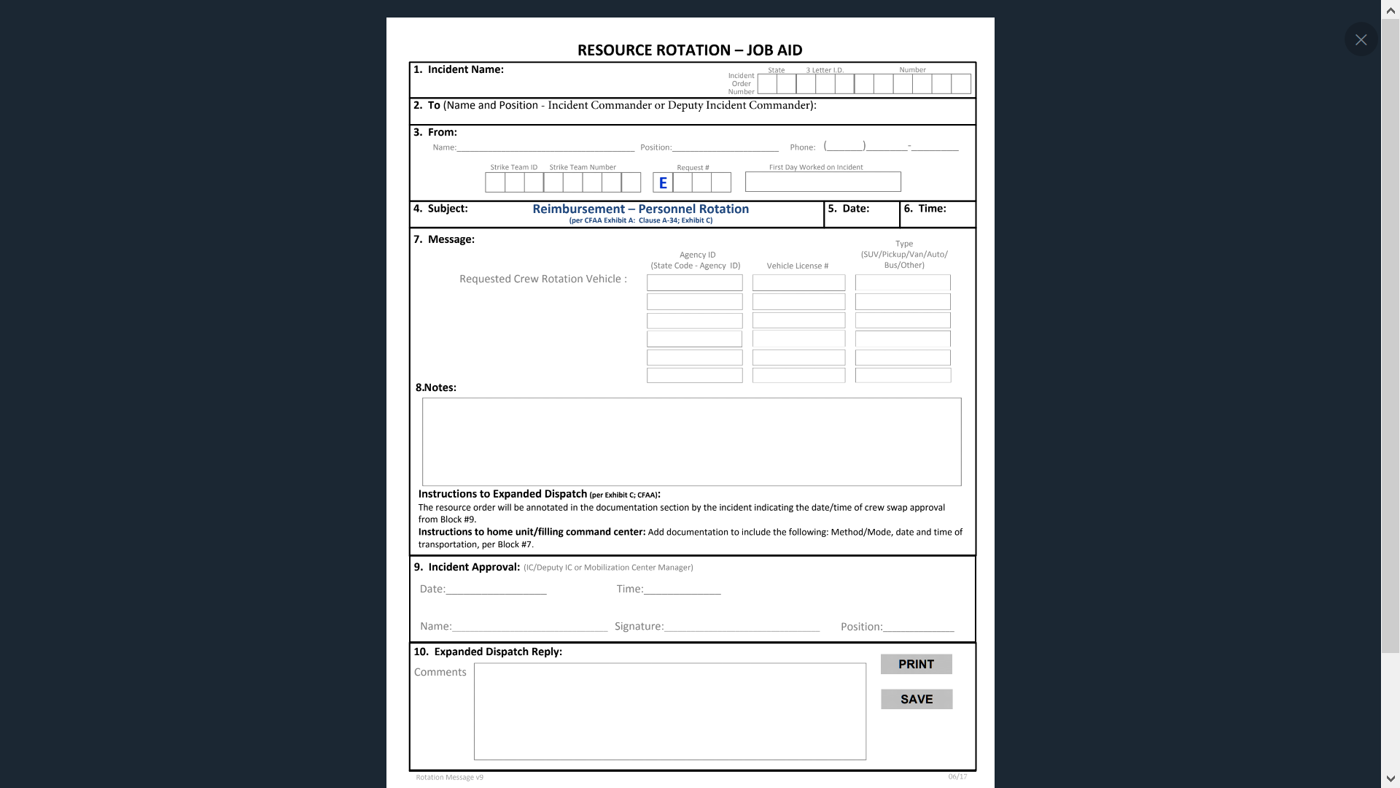

Slide 19
Approved Personnel Rotations
If the home agency/s will be using a commercial bus for the movement of personnel for the rotation, the cost for the bus must be approved. (when submitting your request for rotation, you will need to provide a estimate for the bus cost for approval)
Notes:
This comes from the buses used to transport entire strike teams

Slide 20
Approved Personnel Rotations
Crews coming off shift will be required to rest prior to departing the incident (safety reason)
The exception would be if drivers were sent and/or a commercial bus was used
Notes:
This comes from the buses used to transport entire strike teams

Slide 21
Rental Car
Rental agreements is between Local Government Fire Department and the rental car company.
Ensure rental car is noted and approved on IROC order form

Slide 22
Notes:
RADO Position may not need 4X4. Economy vehicle appropriate for position

Slide 23
Contact Information
Contract Questions:
Lisa Holmes
State of CA Account Manager
916-787-4733
Lisa.M.Holmes@ehi.com
General Account Questions:
Julie Lindberg
Business Rental Account Representative
916-787-4763
Julie.A.Lindberg@erac.com

Slide 24
Incident Off-Shift Rest & Sleeping Accommodations
The responsible Forest Agency will provide, when practical, shaded and/or climatically maintained accommodations for off shift sleeping, rest, and recuperation for local government resources confined to incident base

Slide 25
Incident Off-Shift Rest & Sleeping Accommodations
If the Incident Command finds it operationally feasible (i.e. Strike Team remains available), to place local government resources in a commercial sleeping accommodation, it may be provided by the forest agency

Slide 26
Incident Off-Shift Rest & Sleeping Accommodations
Local government and OES engines staffed by CAL FIRE personnel fall under the provisions of the CFAA
Never split up the strike team
Utilize the OES and CAL FIRE AREP to resolve issues

Slide 27
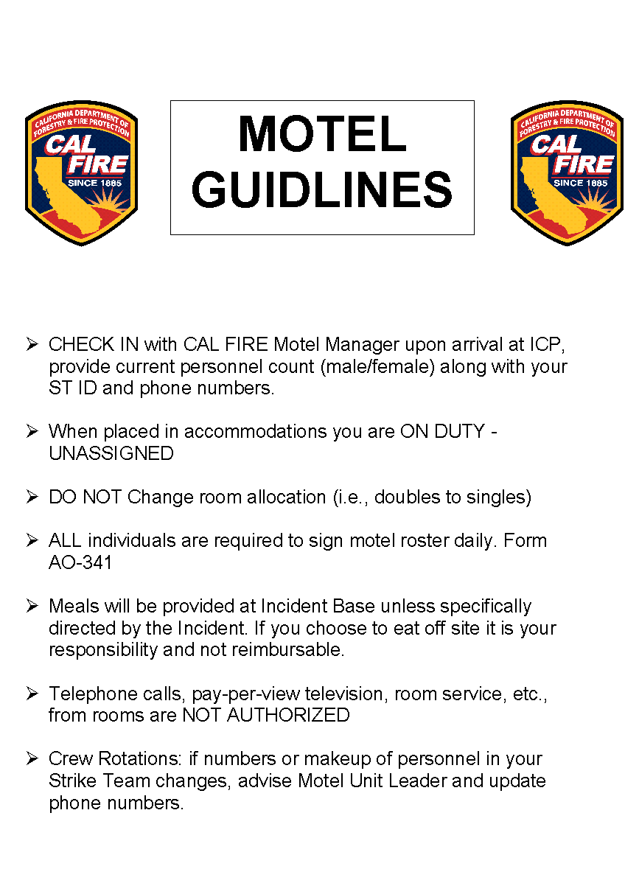
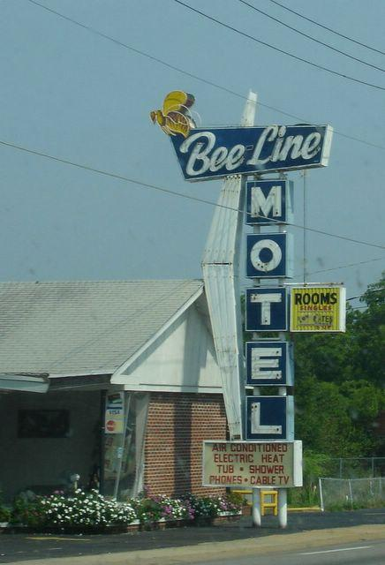

Slide 28
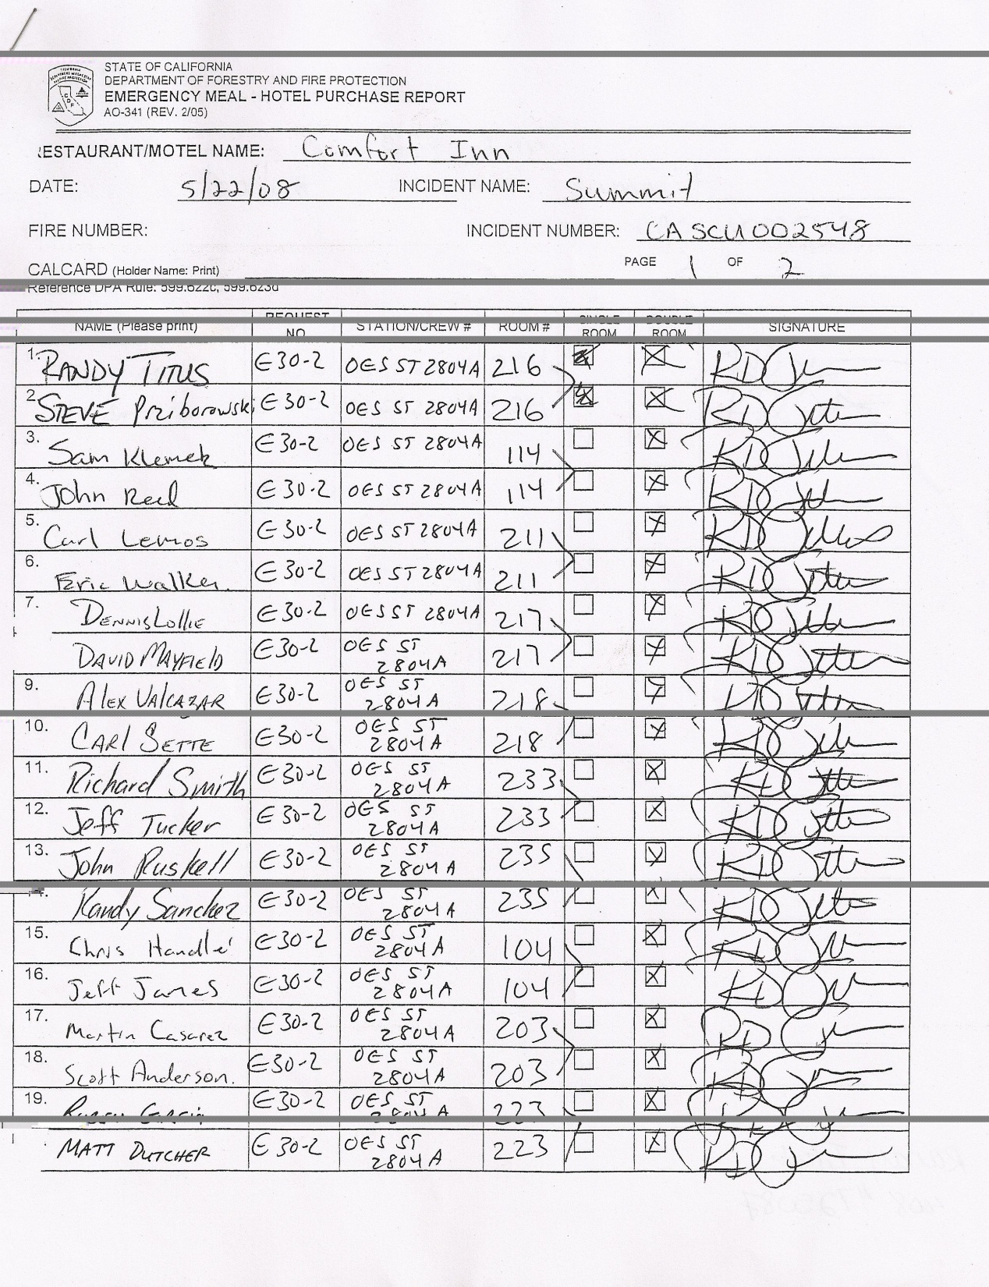
Each person occupying
rooms must sign the CAL FIRE
AO-341 (blue ink) so the bill
can be paid.
Remember that you are still
on the clock, representing
your department and OES.
Mistakes and errors in judgment
you make here will impact the
entire California Fire Service.

Slide 29
Fiscal Responsibility
A typical Engine Strike Team runs from $35,000 to $55,000 per 24-hour period.
If you were a business, how accountable would you be for these expenses?
The F-42 is the reimbursement document for this revenue.
Notes:
Self explanatory

Slide 30
Time Unit
Check with the OES AREP for process
If NO OES AREP
Be sure to get your MARS (F-42) signed by the incident authorized representative. (you will NOT have gold copy to take home)
Keep your paperwork current

Slide 31
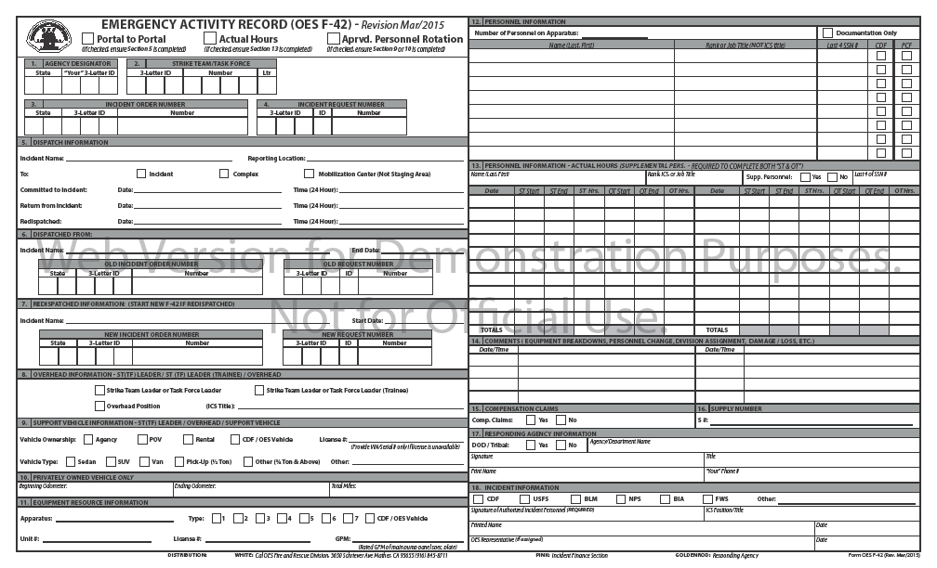

Slide 32
F-42 tips
Terms to avoid:
Structure protection / defense
Ensure these items are noted in the correct box:
Approved Personnel Rotation
Assigned / Re-assigned
Comp/Claims notations

Slide 33
F-42 tips
Don’t confuse block 14 (comments) on the F-42 with your ICS 214 Unit Log
Use your ICS 214 to document the daily events of your deployment
Accidents
Agreements

Slide 34
Compensation/Claims “S” Number Process
Damage to apparatus, equipment, hose left on the line, hose burned, etc. of items that may be involved in this process (if issue can’t be resolved by Supply)
There are steps that need to be followed to ensure that you are compensated for these losses
Failure to complete these processes will very likely result in a denial

Slide 35
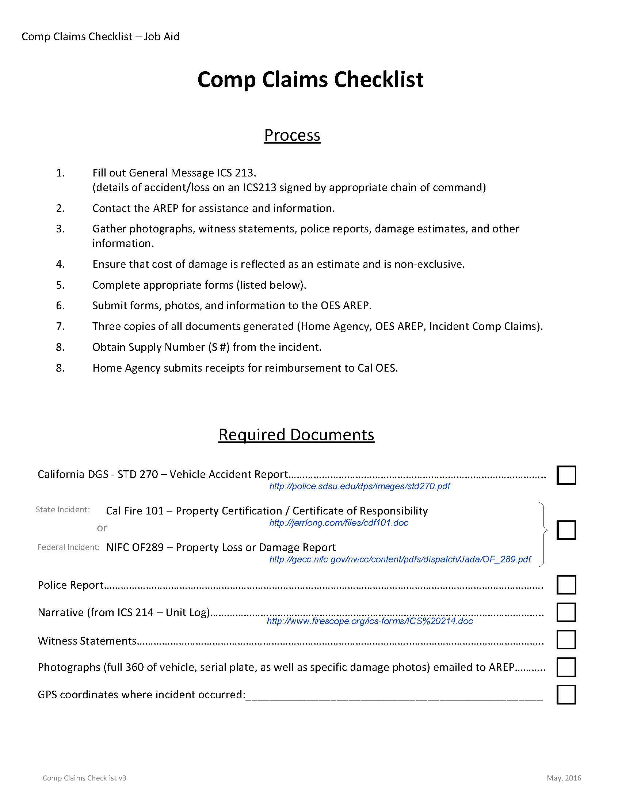
Comp/Claims Process
Start with this Checklist!

Slide 36
Some things to know about the CFAA
Reimbursement - Emergency Apparatus Loss or Damage:
The State of California and the Federal Fire Agencies may reimburse local government fire agencies for the cost of emergency apparatus or equipment loss or damage where the loss or damage is directly attributable to the incident and where the local agency, its employees and/or operational failures in the emergency apparatus or support equipment are not a contributing factor to such damage or loss.
Loss or damage to a local agency emergency apparatus or support equipment while traveling to or from an incident and repairs due to normal wear and tear or due to negligent or unlawful operation by the operator shall be the responsibility of the local agency providing the emergency apparatus or equipment
Notes:
Cover the exclusions of damage or loss of equipment and that the process for both is arduous, time consuming and has to be done correctly in order to be reimbursed.

Slide 37
Comp/Claims Process
Complete formal documentation
Accident Report STD Form 270
Complete including diagrams, statements, witnesses
ICS Form 213
Describing event or circumstance
Signed by DIVS, Branch or immediate supervisor
Photos
Include plate, vin plate, door logo, damage
Date and time stamped helps
On thumb drive for electronic distribution

Slide 38
State Vehicle Accident Report STD Form 270
State Vehicle Accident Report (STD-270) this form can be located on the DGS website under forms
Description of damages
Narrative and diagram of the accident
Assignee should request police report if needed. (Injuries or damage over $500.00 per state vehicle code.)
If on assignment, notify Strike Team Leader and Liaison, including Safety Officer for additional documentation.
Report needs to be received by Cal OES Fire and Rescue Division within 48 hours

Slide 39
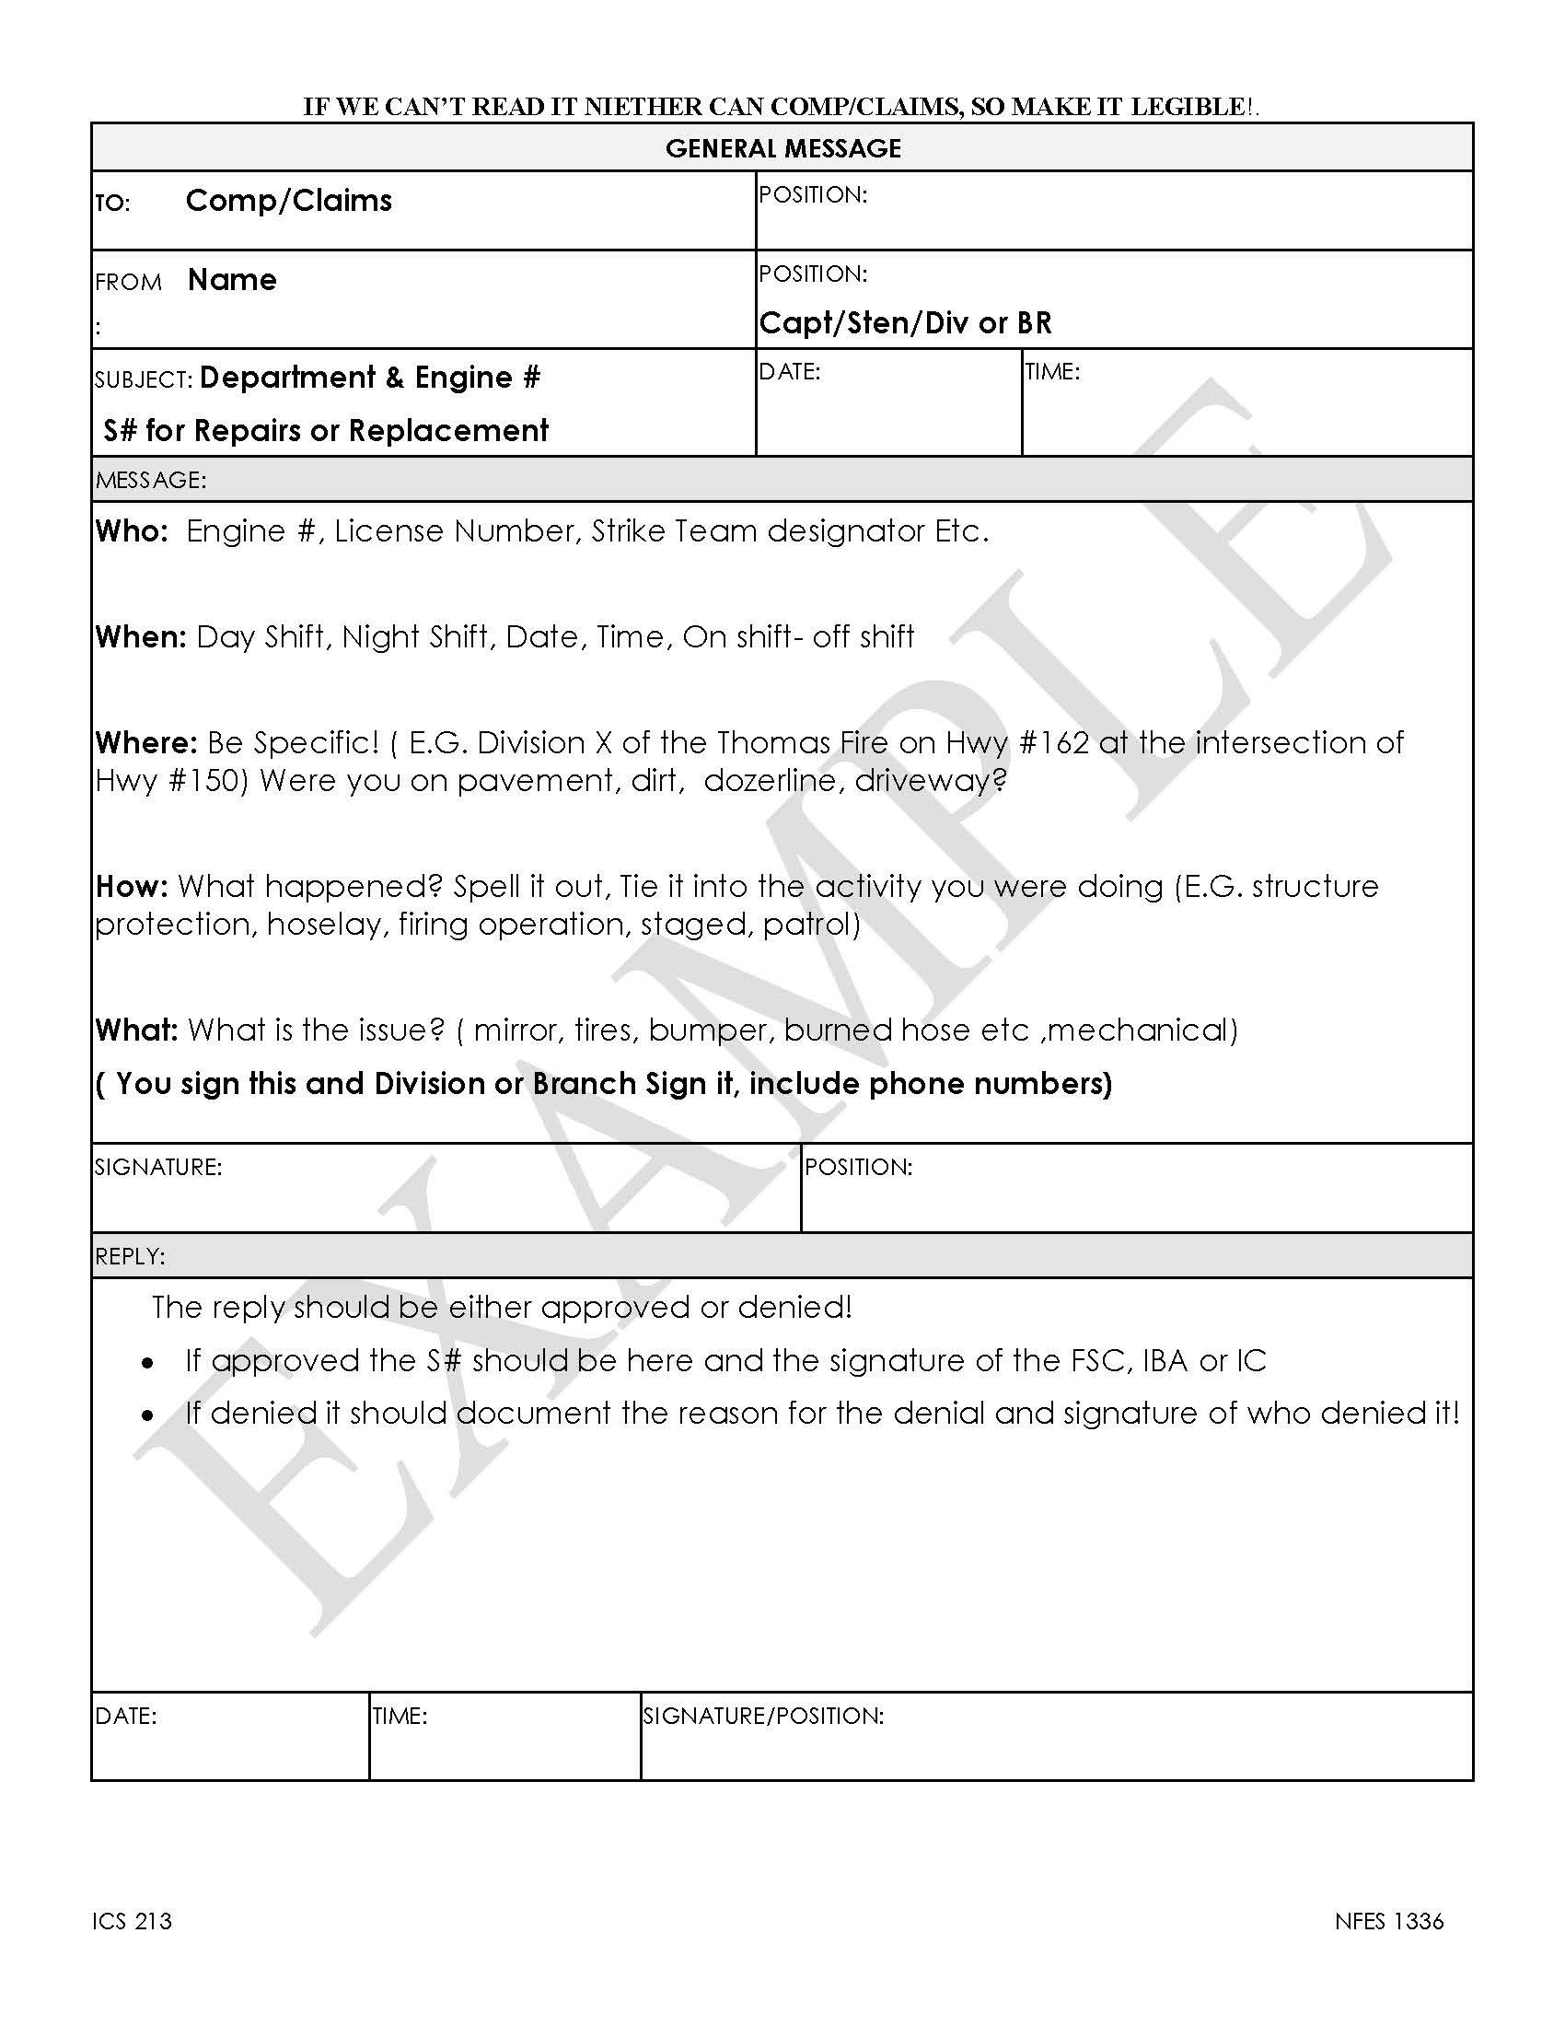
ICS 213 Form
Example
Don’t wait!
Get your Division or
Branch to sign this before
you leave the line

Slide 40
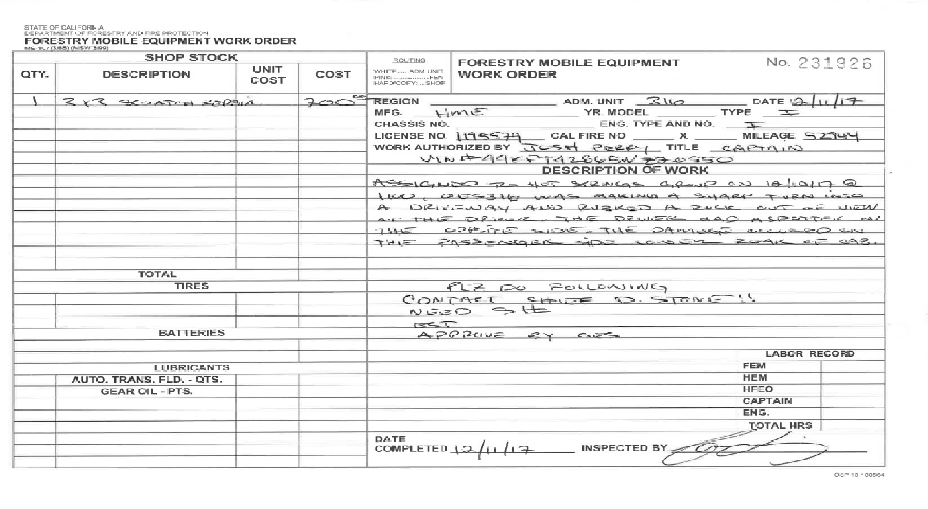
Required documentation form Ground Support

Slide 41
Compensation/Claims “S” Number Process
Damage to apparatus, equipment, hose left on the line, hose burned are only some examples of items that may be involved in this process
There are steps that need to be followed to ensure that you are compensated for these losses
Failure to complete these processes will very likely result in a denial

Slide 42
Comp/Claims Process
Complete formal documentation (cont.)
Complete agency specific Comp/Claim form (Federal, State)
Different forms for different agencies and some require their specific form

Slide 43
Comp/Claims Process
How to you validate whether your claim is covered?
CFAA Page 6 and 7; #25 thru #28
“Reimbursement for Emergency Apparatus Loss or Damage
CFAA Exhibit “H”
“In-State Travel and Incident Related Expenses”
Check with the OES AREP
916-845-8911 Duty Officer
Notes:
Travel expense and Incident Related Expenses. Remember form is used for BOTH

Slide 44
Comp/Claims Process
Exhibit “H”
In order for your agency to be eligible for reimbursement of expenses related to this exhibit, the approval MUST be formally documented in writing by the approving State or Federal Agency responsible for said incident. ICS Form 213

Slide 45
Comp/Claims Process
Exhibit “H” (cont.)
The formal approval must be DOCUMENTED on a General Message Form ICS-213 and Resource Order of the associated “S #” validating the expense(S)
The General Message Form ICS-213 MUST be signed by the Finance Section Chief, Incident Business Advisor, or the Incident Commander
NOTE: S#’s should ONLY be issued when the incident cannot accommodate the expense and all other options to provide the expense(s) has been exhausted.

Slide 46
Other Reimbursements Thru the F-42 Process
Any incident approved expense.
Example: Motels approved to finish your travel leg home.
Must have copies of all documentation from the incident.
Must mail in receipts and documentation so the invoice can reflect the expenditure.
In-State Travel Form (OES Web site)

Slide 47
Notes:
This form is just as important as the F-42. If you have extra expenses that have been approved and completed at the time of demobilization, this form and all pertaining documents must be filled out and given to the OES AREP. If you are incurring costs enroute home or to another incident, then this step must be completed upon your return.

Slide 48
IWI - Notifications
INCIDENT SAFETY OFFICER
Home Agency
OES AREP
COMP/CLAIMS
Operational vs. Administrative/Paperwork
Notes:
Division, Safety for Operational

Slide 49
OES Support Unit 5264 This means we will be here for awhile

Slide 50
Expectations at Incident Base
What to do if you have problems
Incident Commander
Information Officer
Liaison Officer
Agency Representatives
Safety Officer

Slide 51
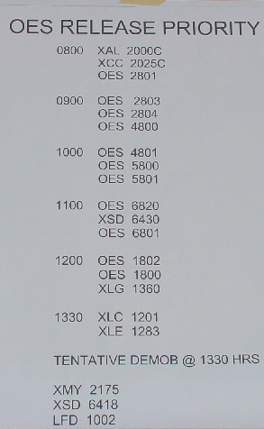
Demobilization
Be familiar with the demob plan
The ICS Form 221 start’s the
release process
Follow the steps
Don’t shortcut, be prompt, be
patient
Once ICS Form 221 is complete,
status is pending until released or
reassigned

Slide 52
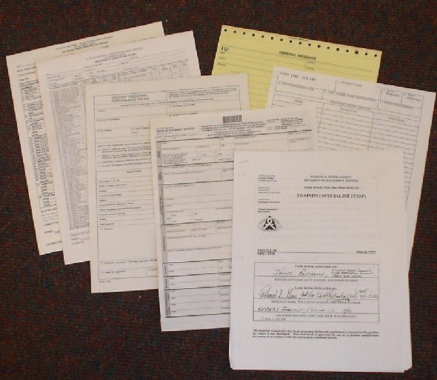
Other Documentation
Taskbooks
ICS-225
Yourself
Company Officers
Inventories
STD Form 270
Notes:
STD Form 270 – Accident Report (If applicable)

Slide 53
Cal OES Assistant Chiefs
Region I Greg McKeown (916) 208-2525
Region I James Harris (279) 224-5918
Region II Ryan Wakefield (916) 704-3445
Region II Mark Courson (916) 281-4484
Region III Rick Young (916) 541-3165
Region III Vacant

Slide 54
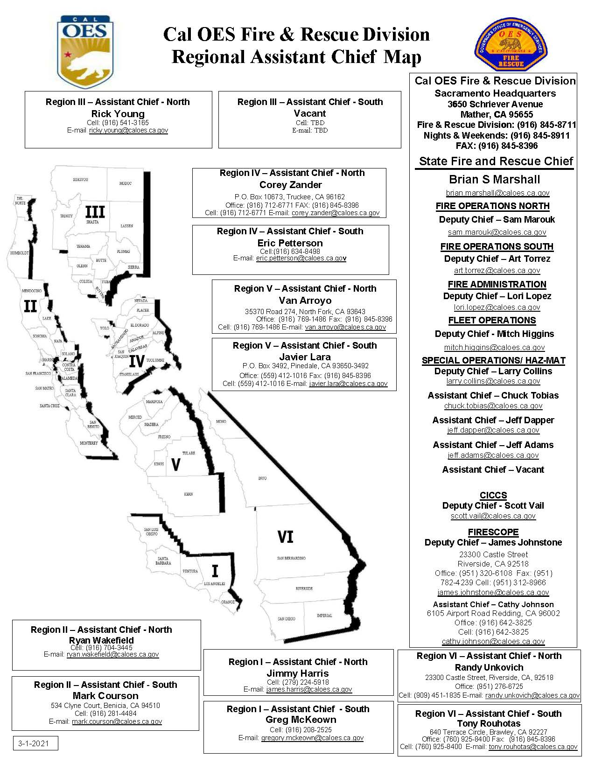

Slide 55
Cal OES Assistant Chiefs
Region IV Corey Zander (916) 712-6771
Region IV Eric Petterson (530) 227-6717
Region V Van Arroyo (916)769-1486
Region V Javier Lara (559) 412-1016
Region VI Tony Rouhotas (760) 925-8400
Region VI Randy Unkovich (909) 451-1835
Fire Duty Chief (916) 845-8670

Slide 56
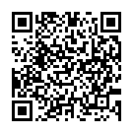
OES JOB AIDS, FORMS, SAMPLES AND CFAA AGREEMENT

Slide 57
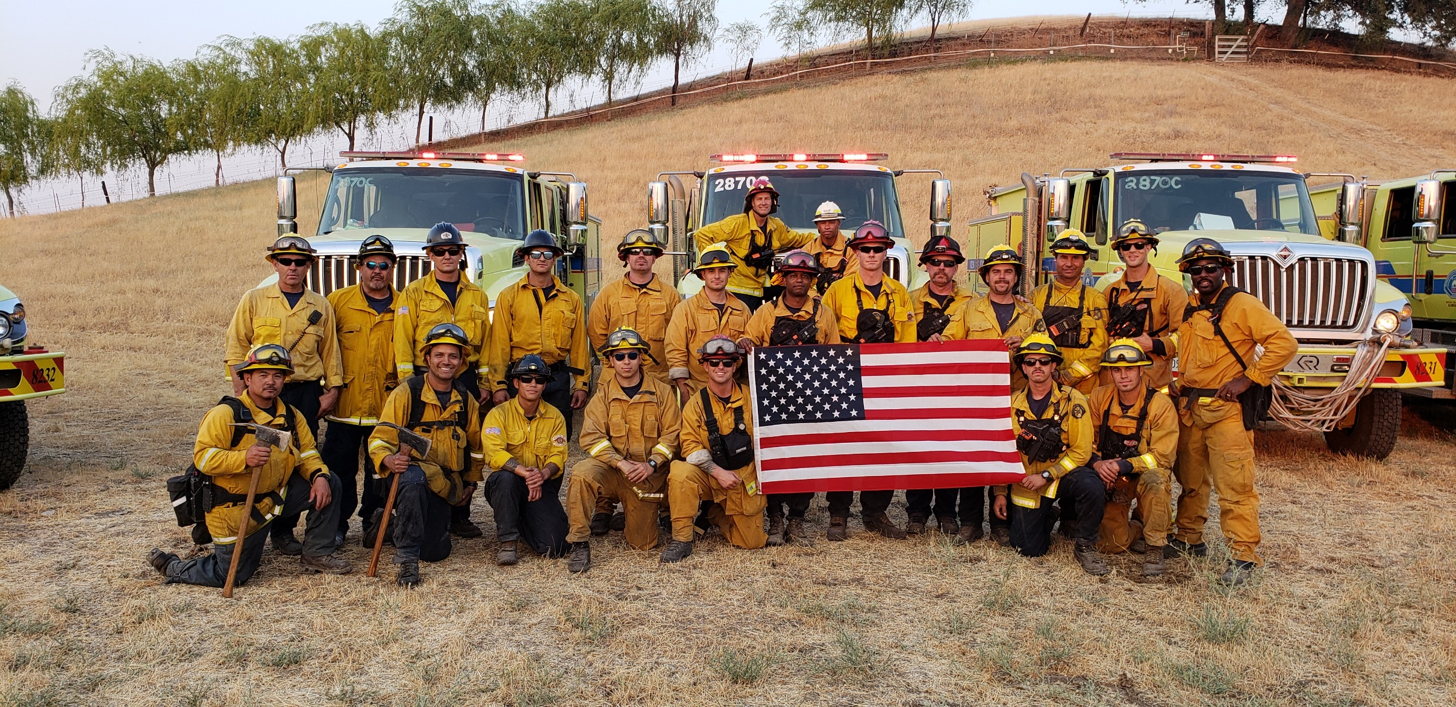
Thank you for your commitment to the Mutual Aid System

Slide 58
MARS

Slide 59
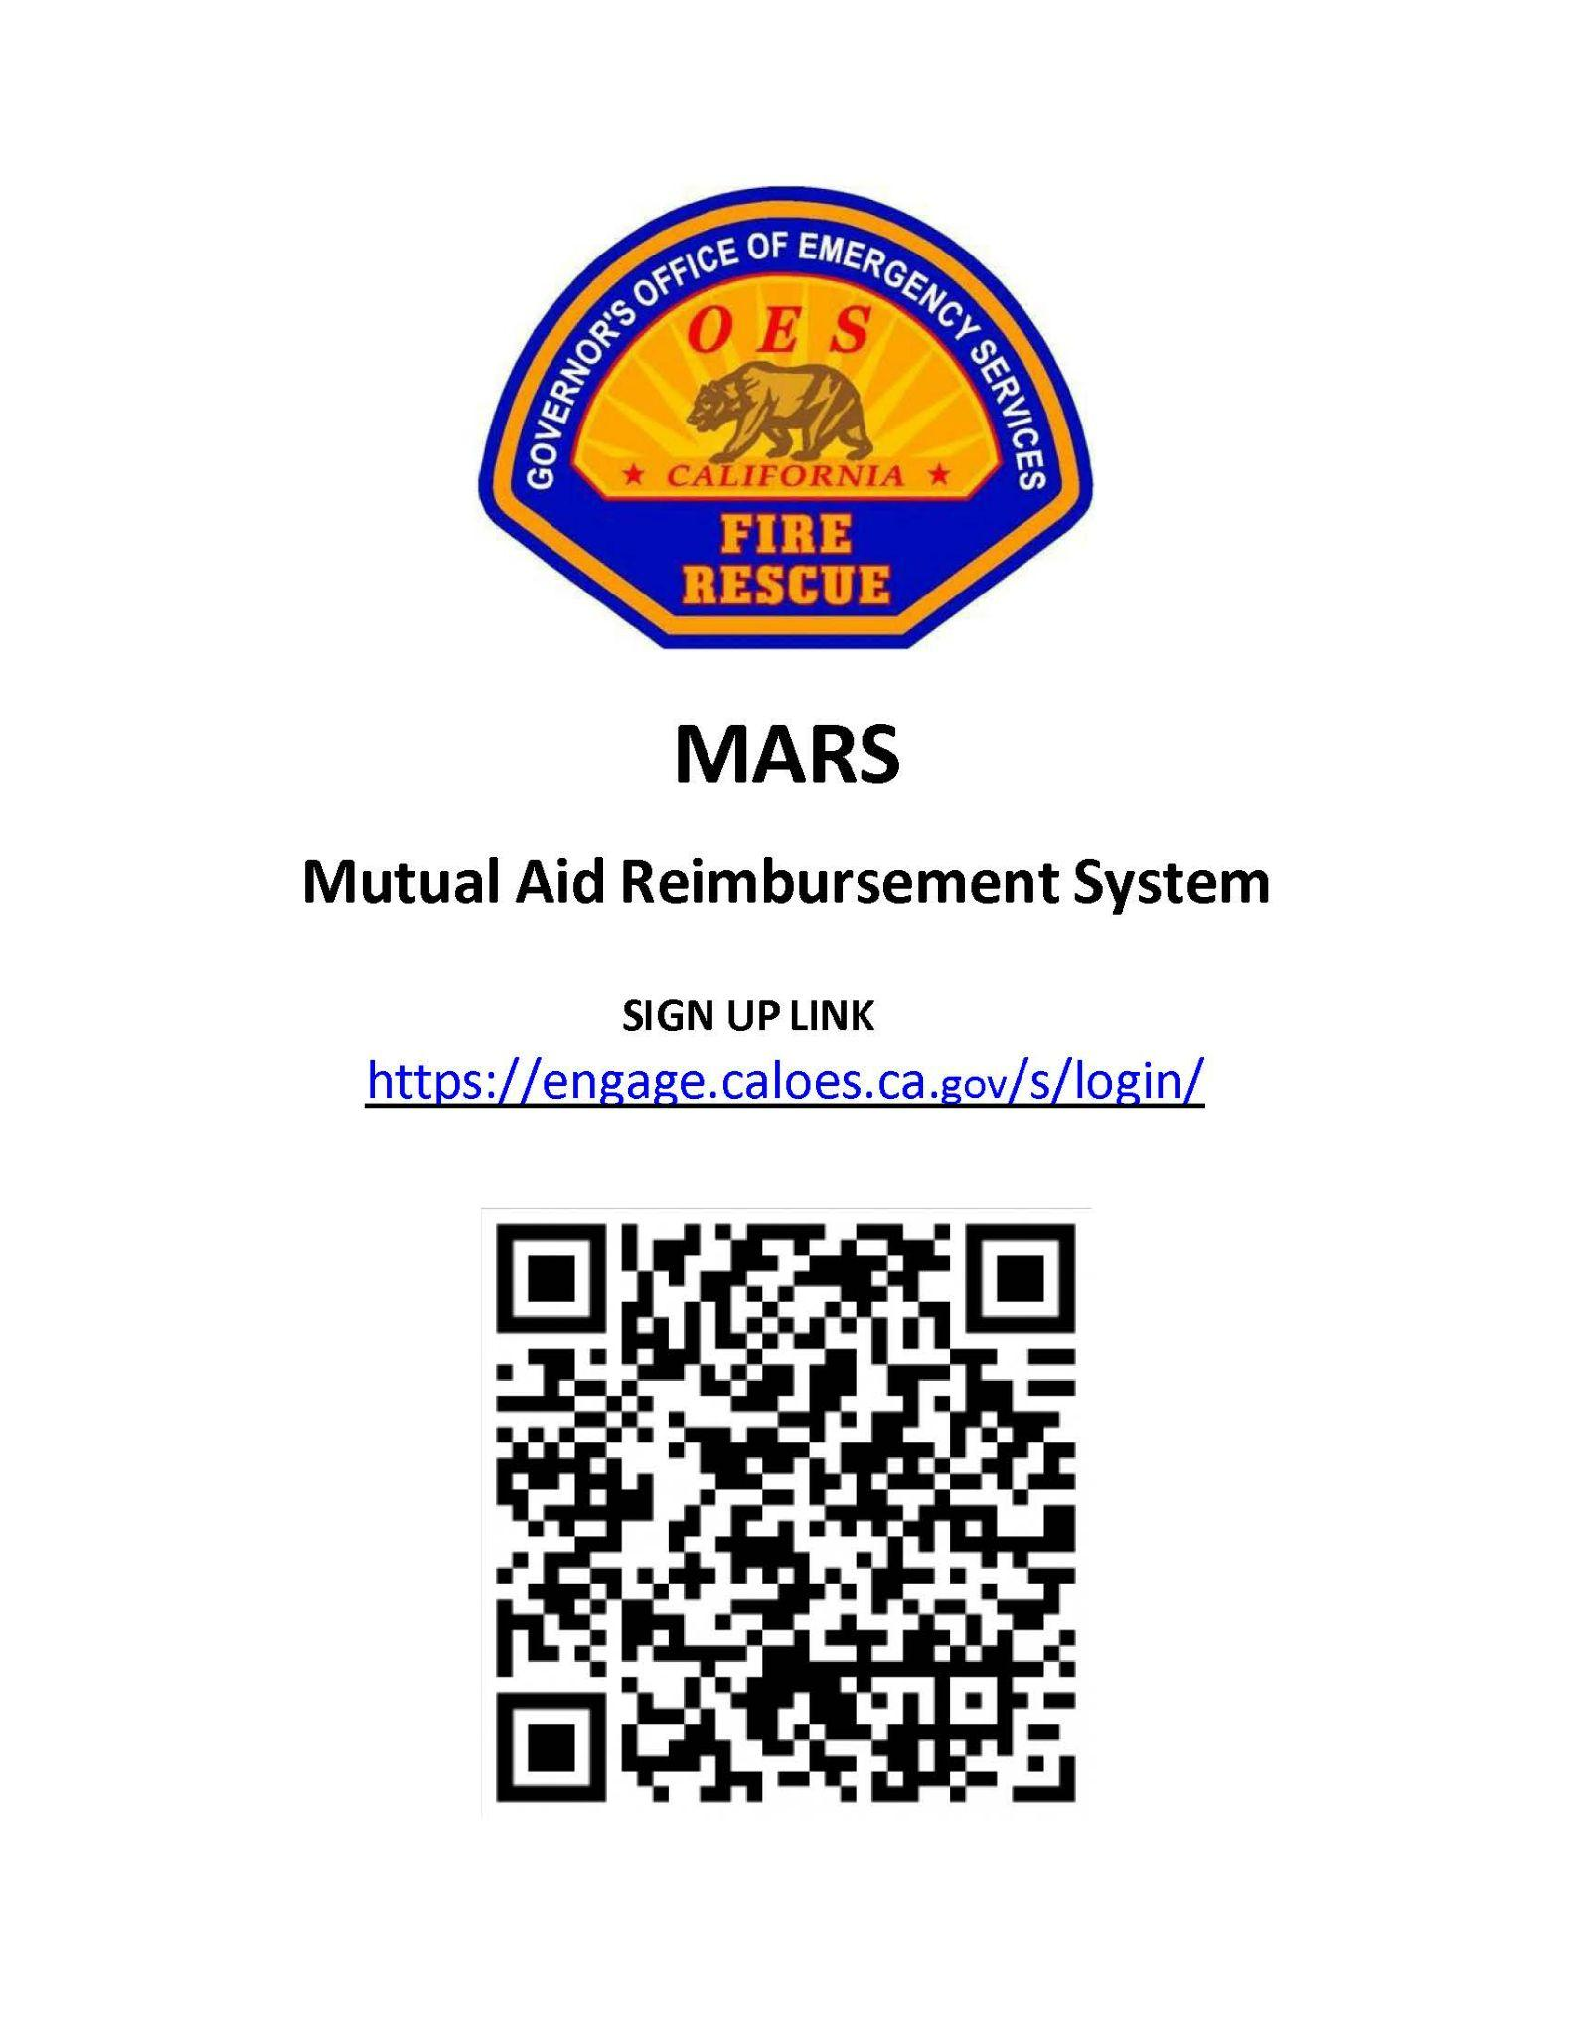

Slide 60
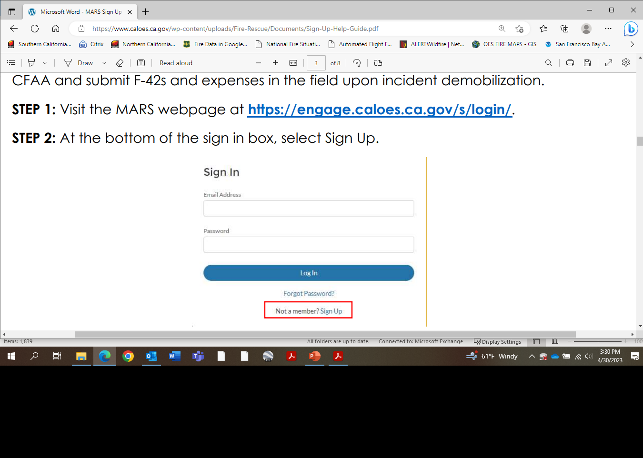

Slide 61
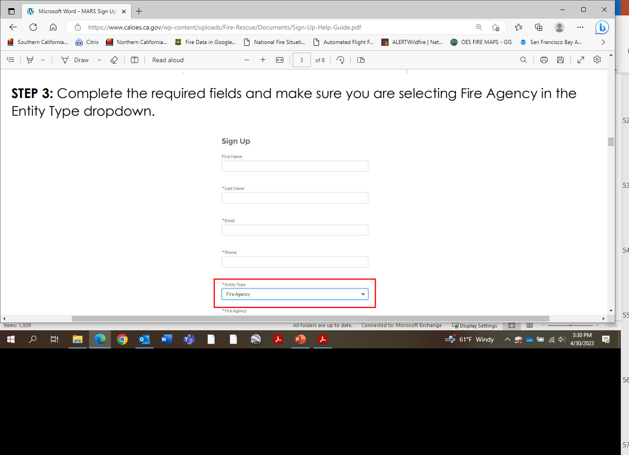
Select: FIRE AGENCY

Slide 62
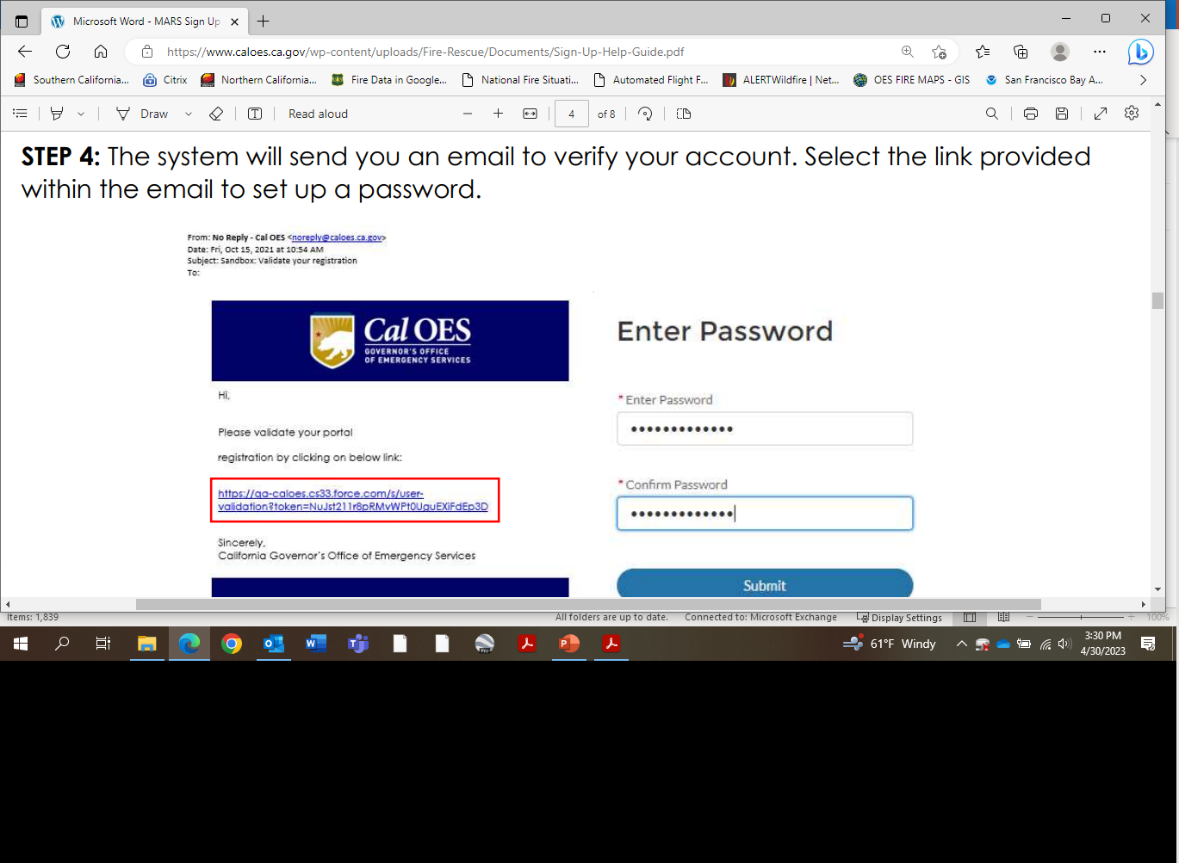

Slide 63
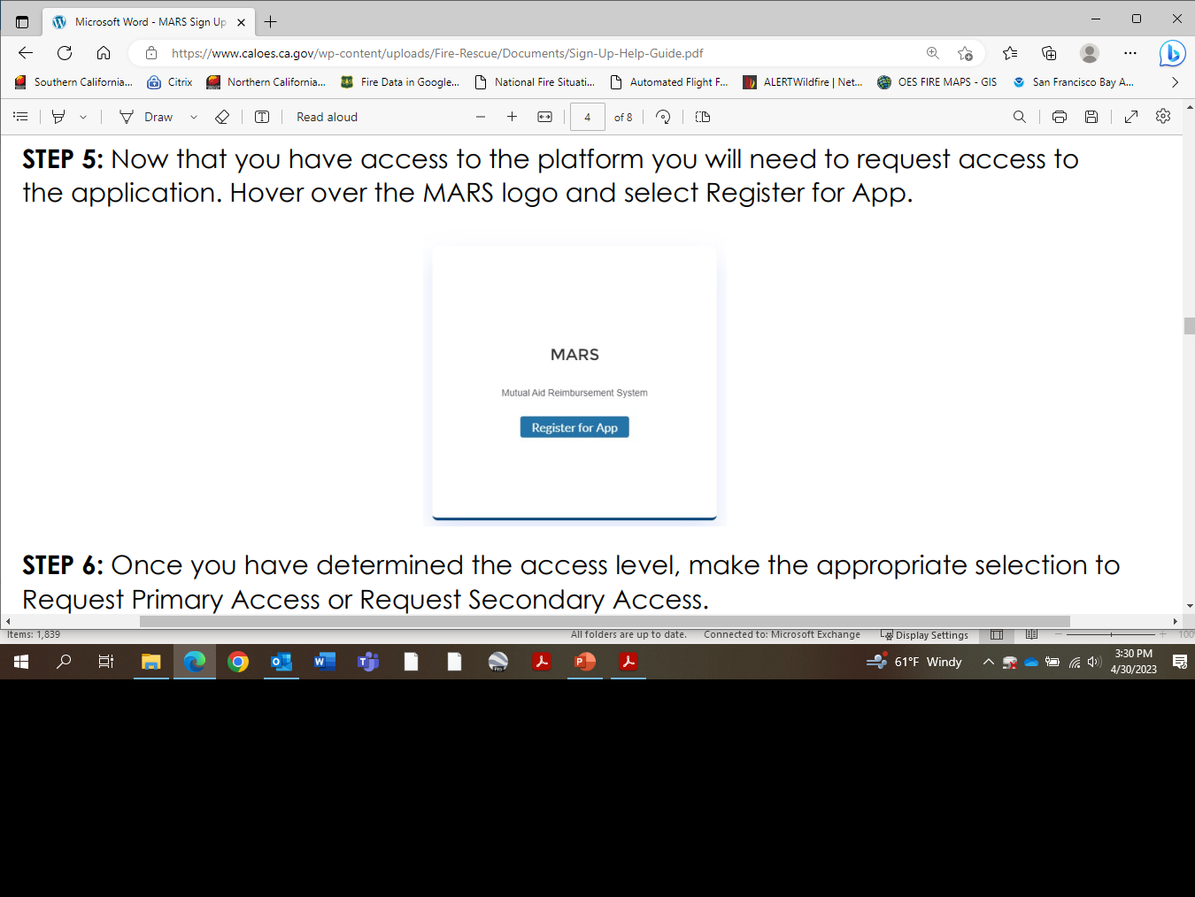

Slide 64
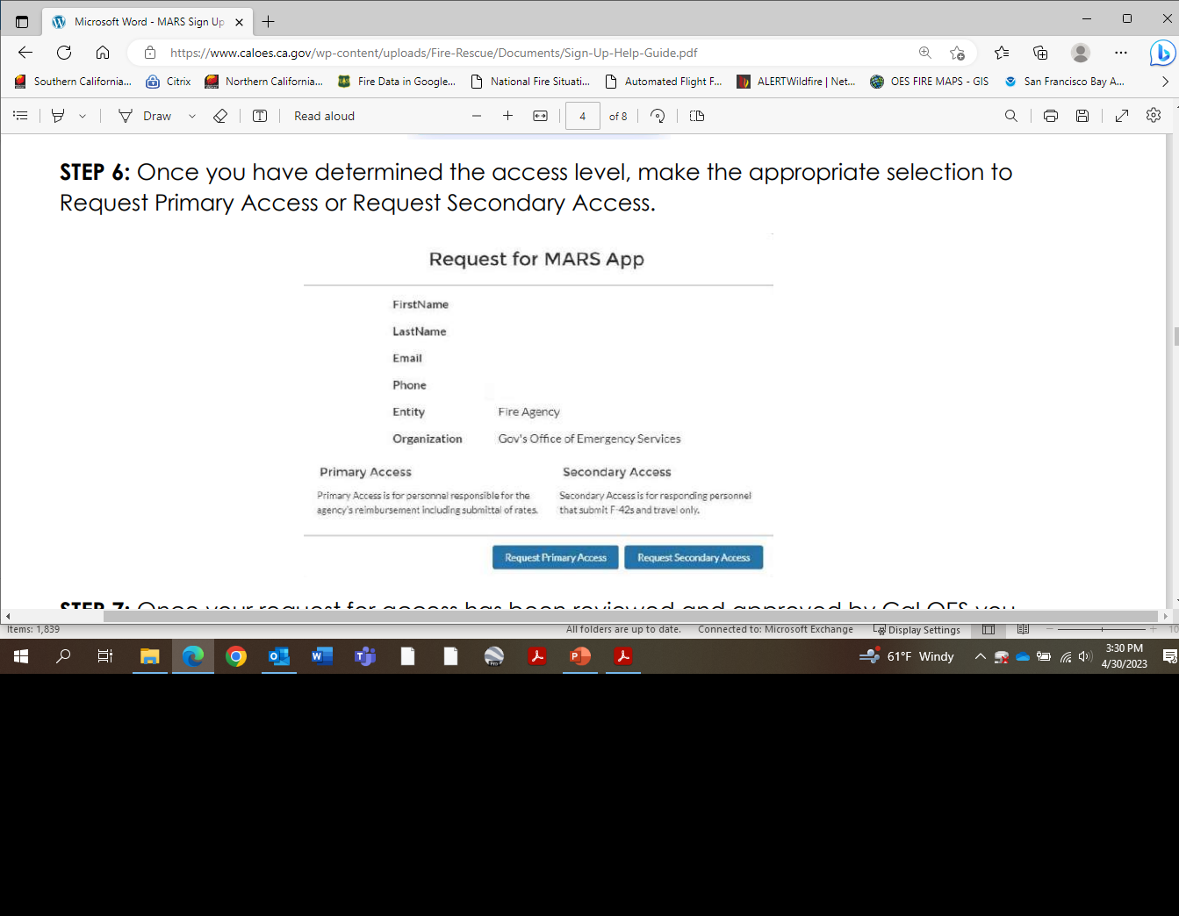

Slide 65
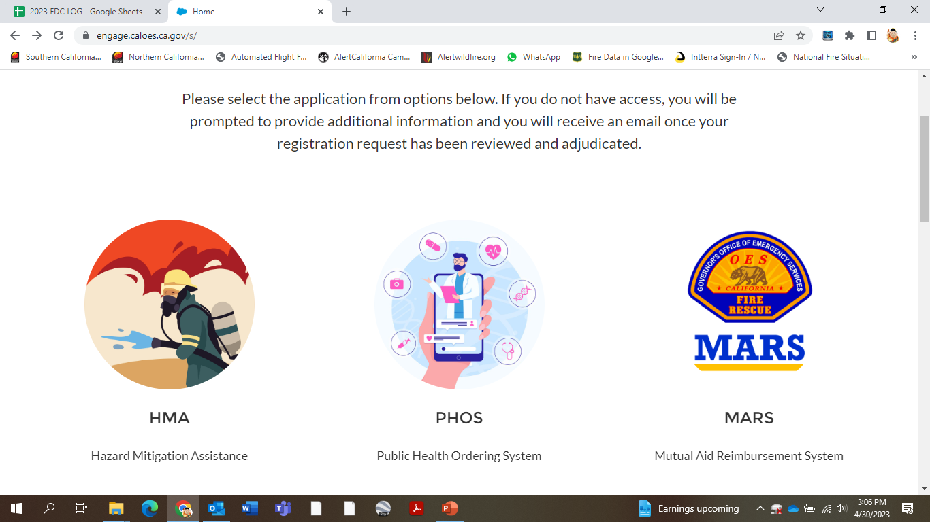

Slide 66
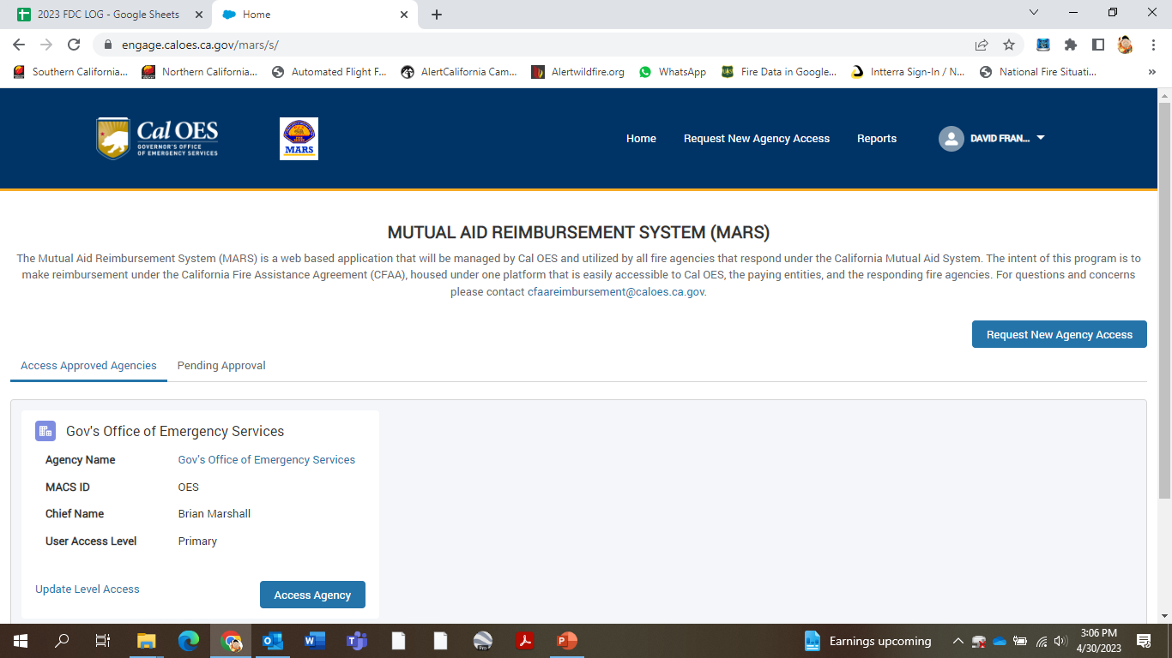

Slide 67
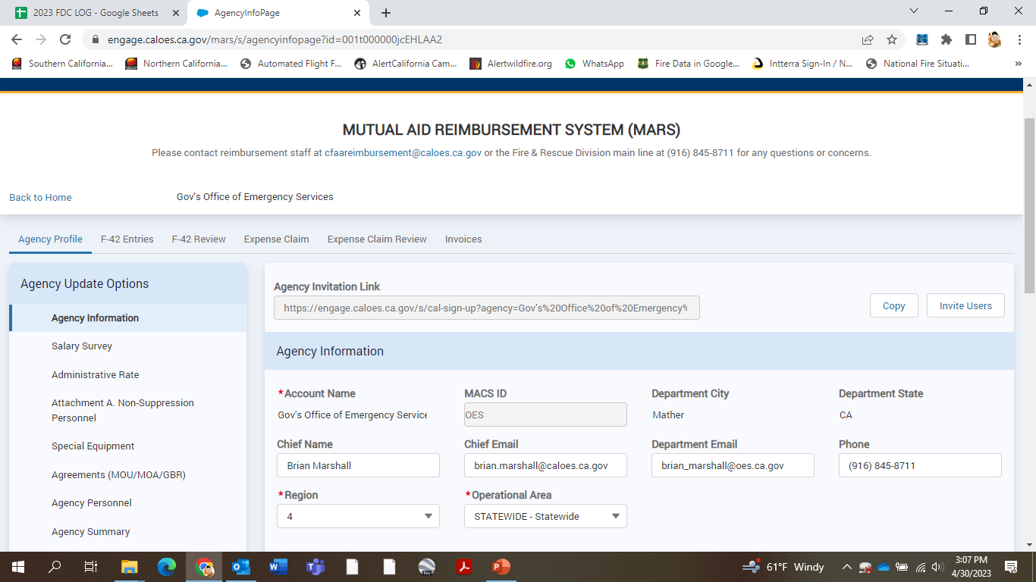

Slide 68
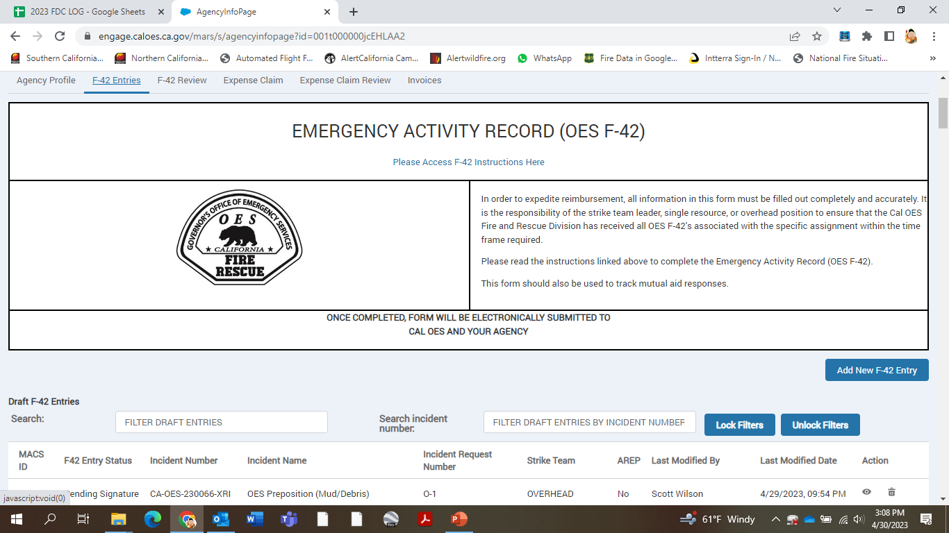

Slide 69
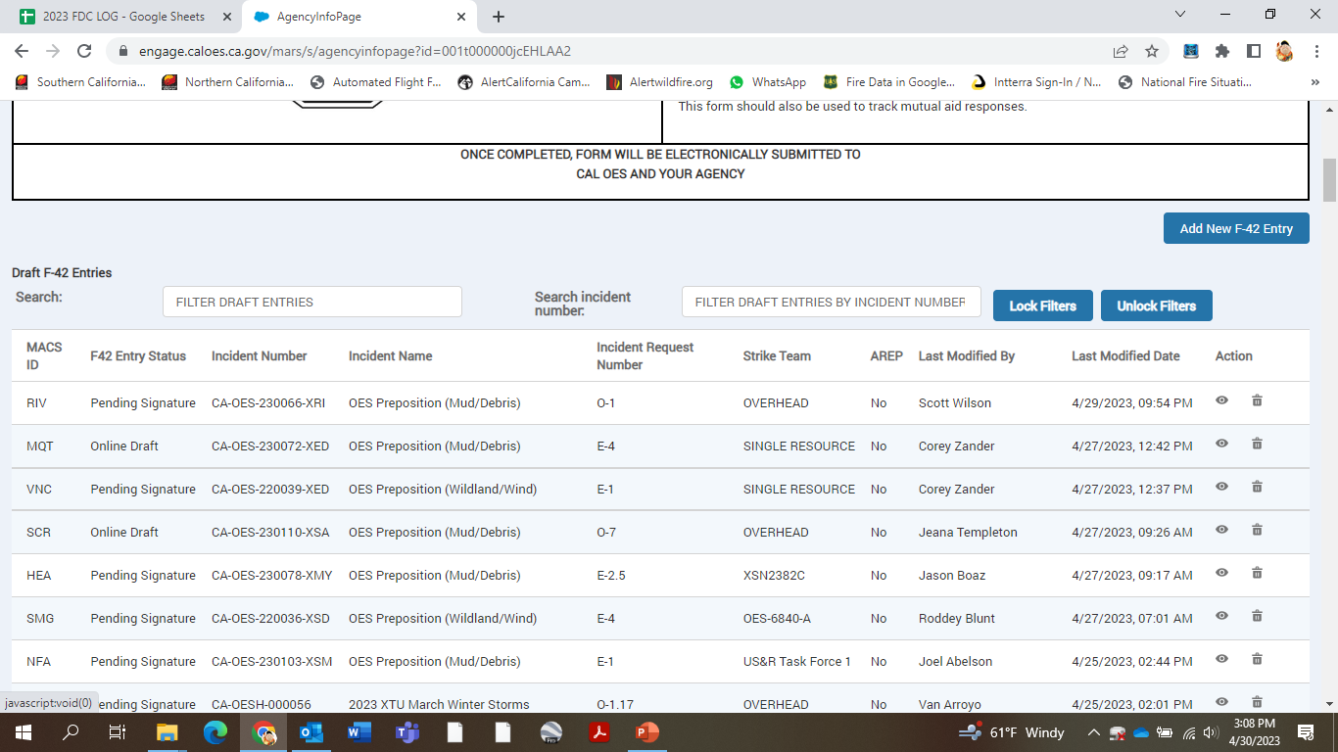

Slide 70
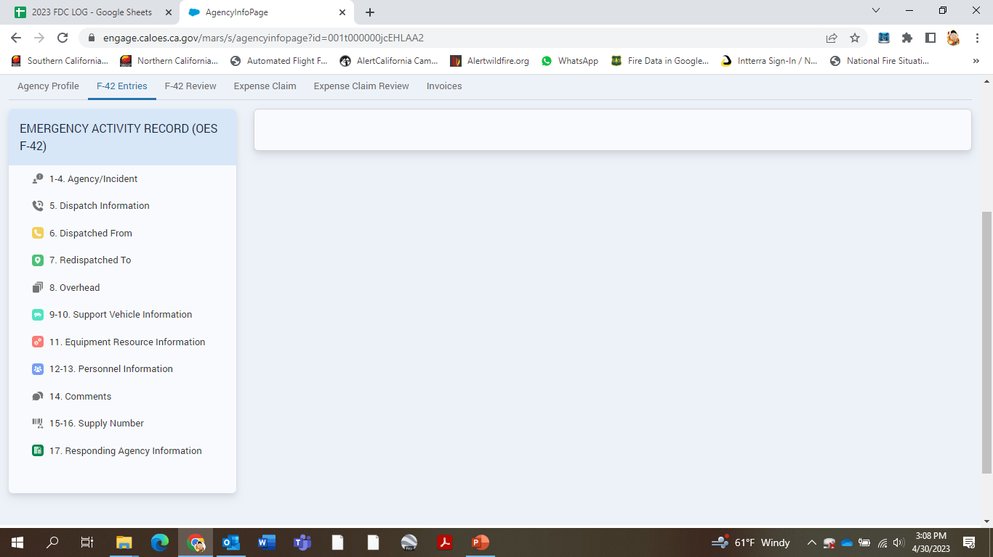

Slide 71
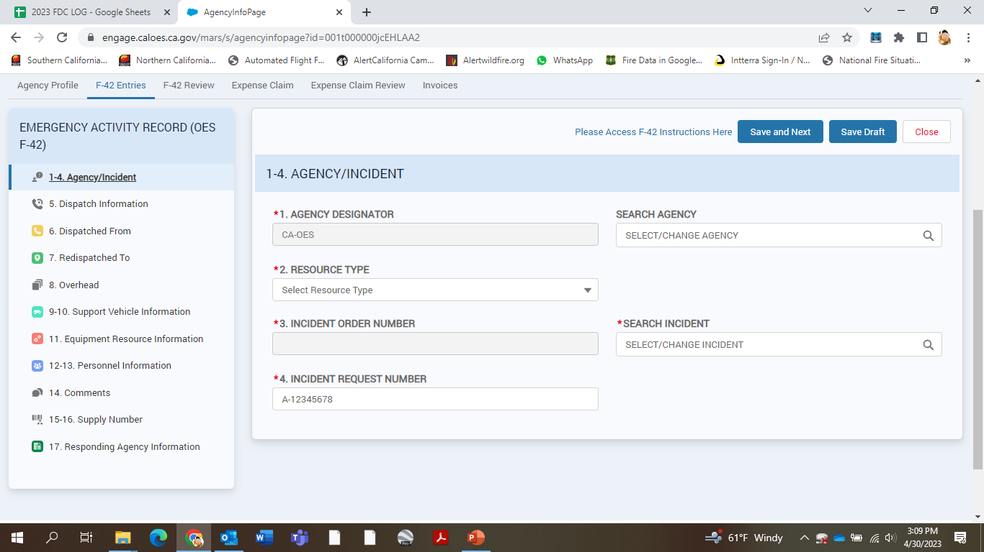

Slide 72
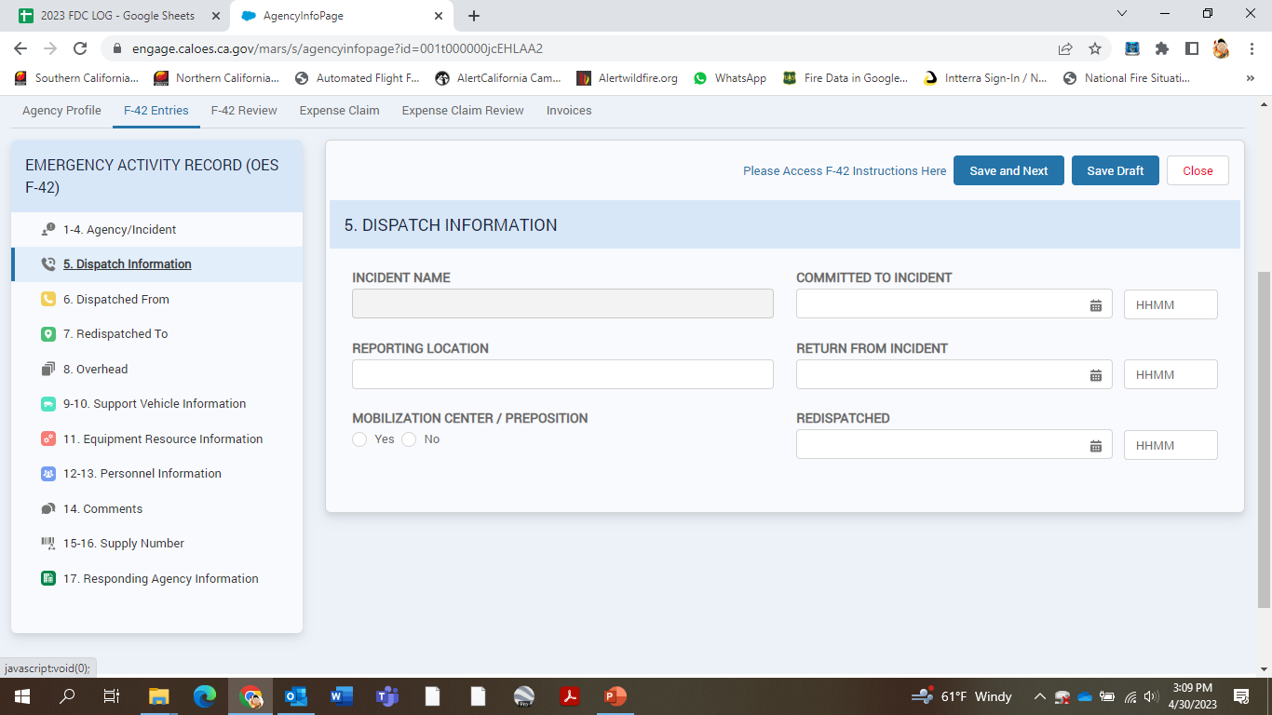

Slide 73
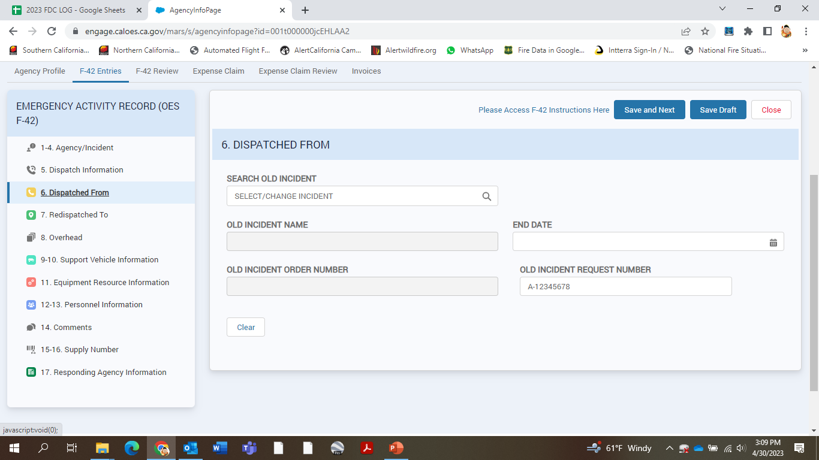

Slide 74
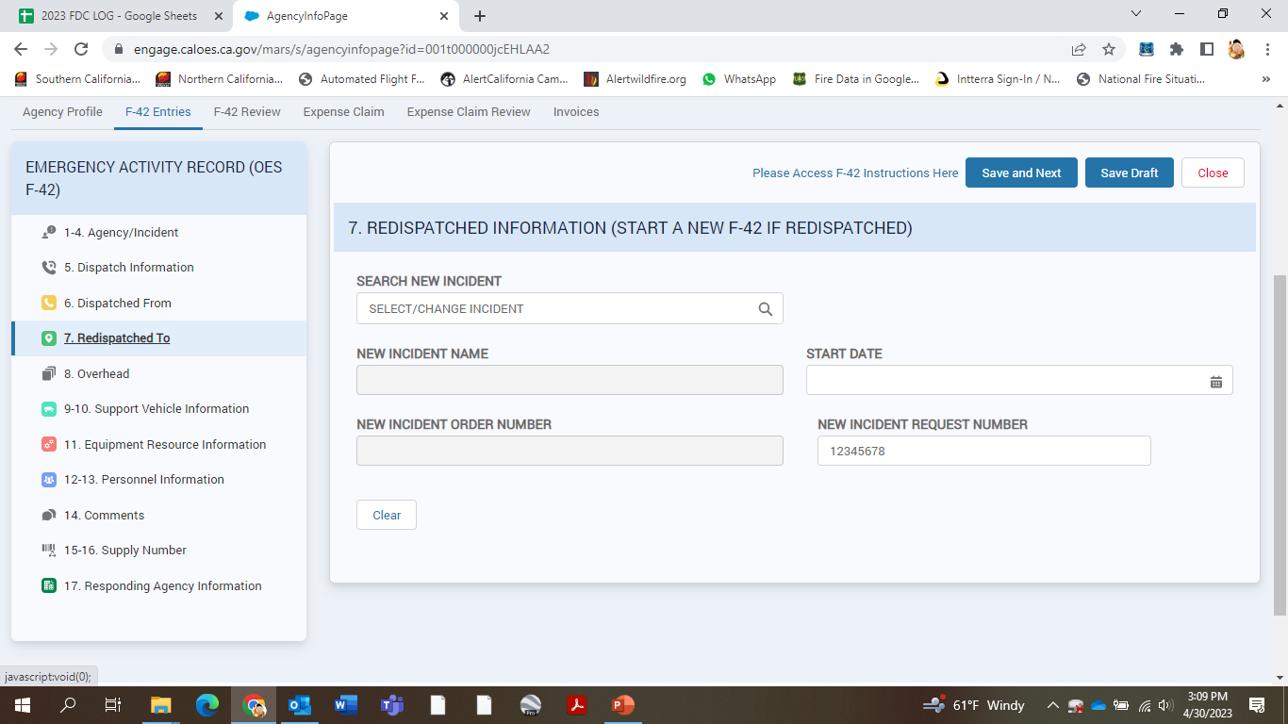

Slide 75
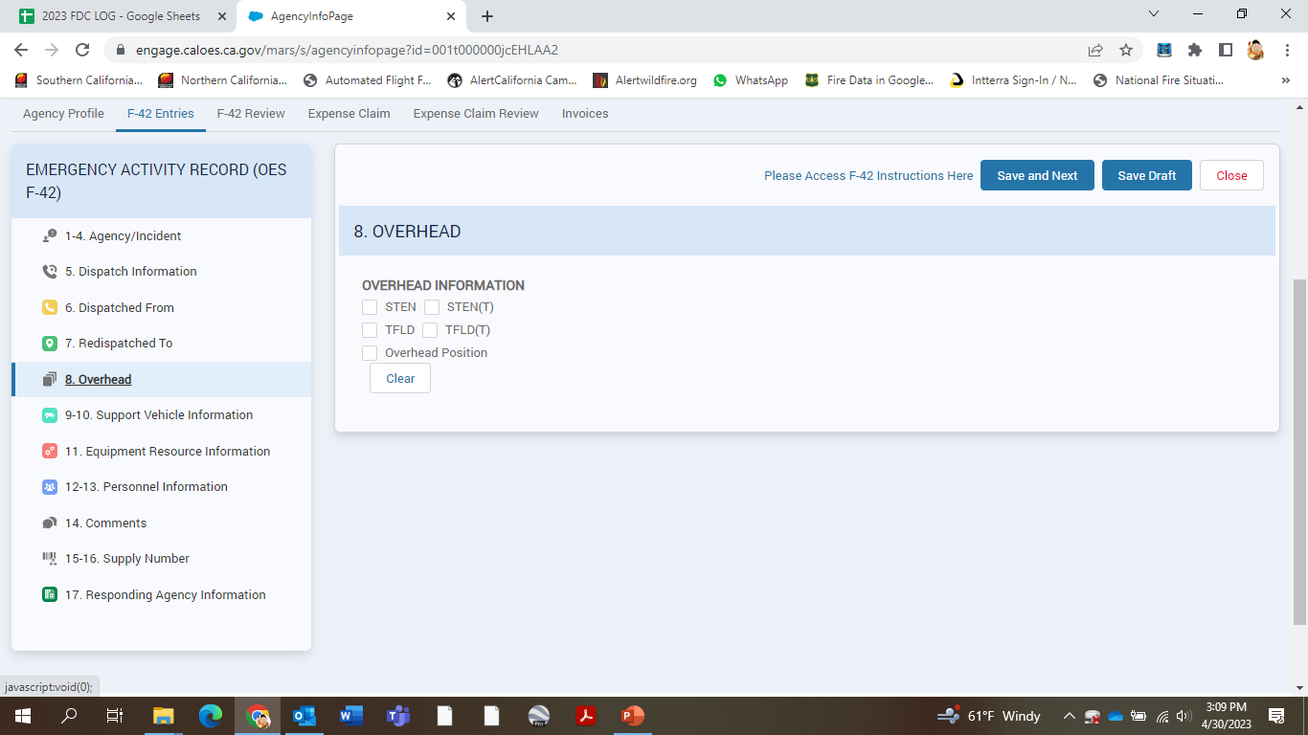

Slide 76
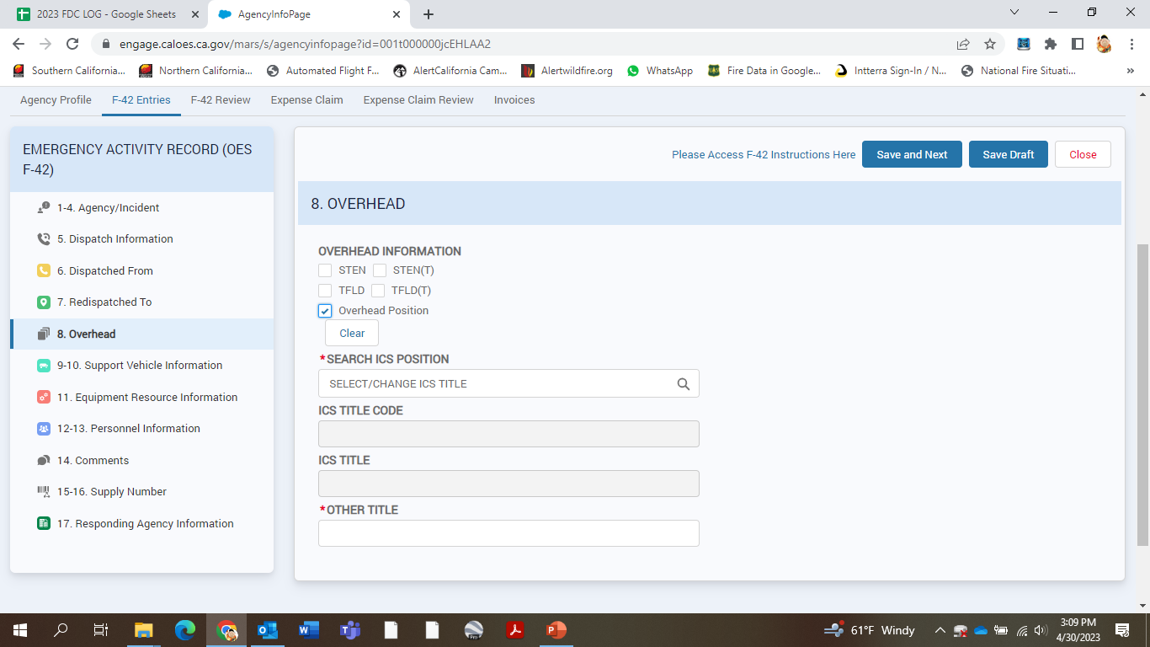

Slide 77
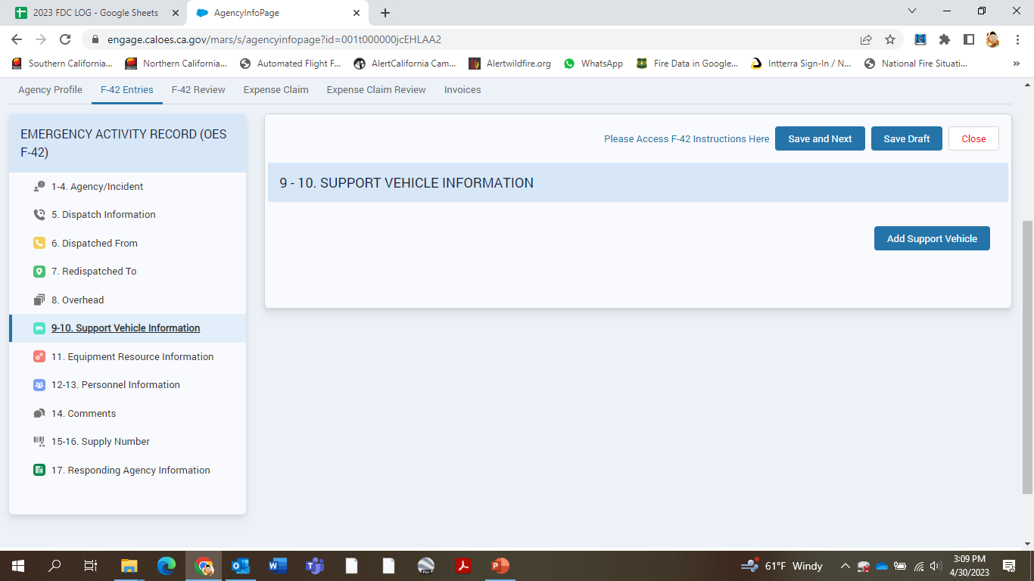

Slide 78
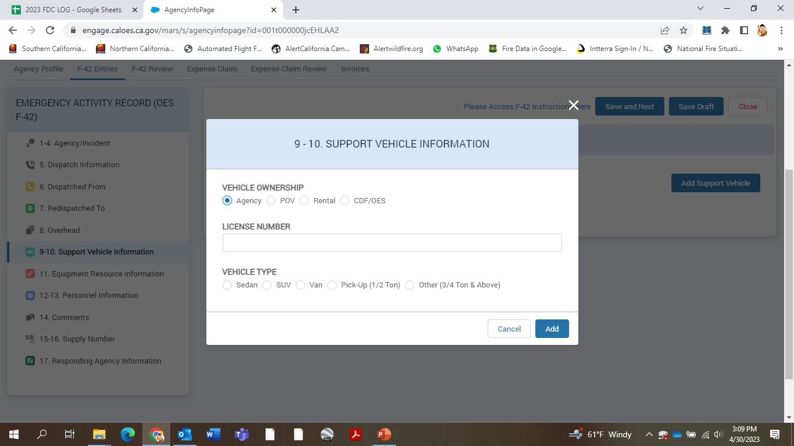

Slide 79
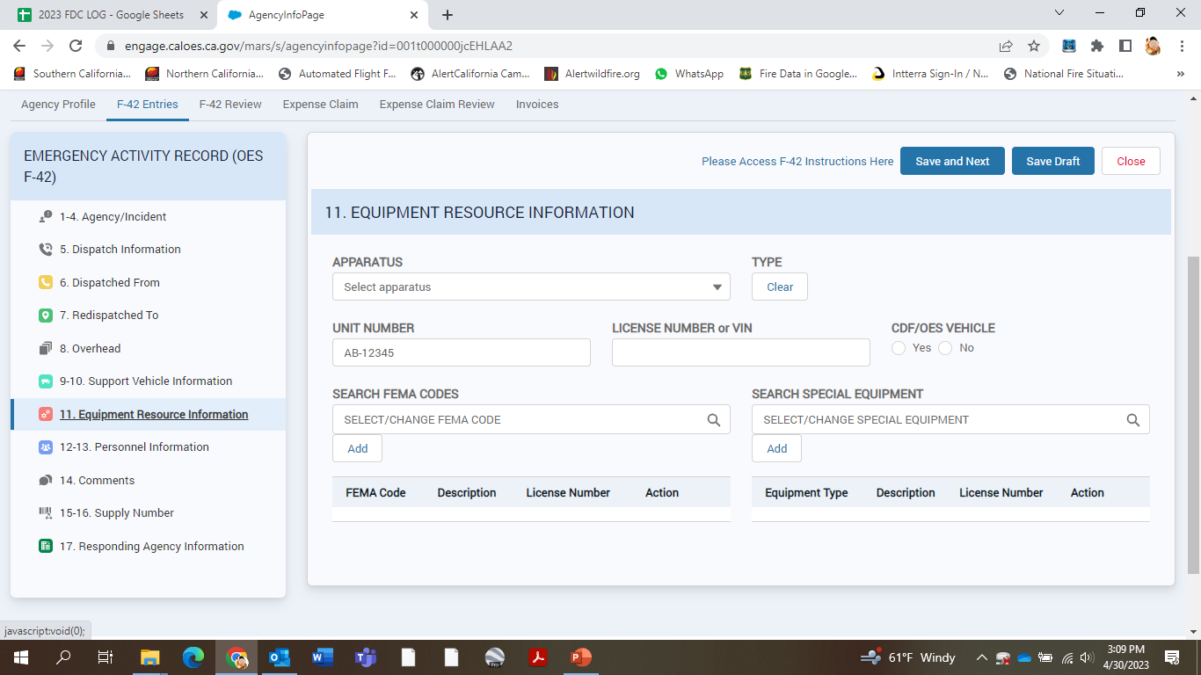

Slide 80
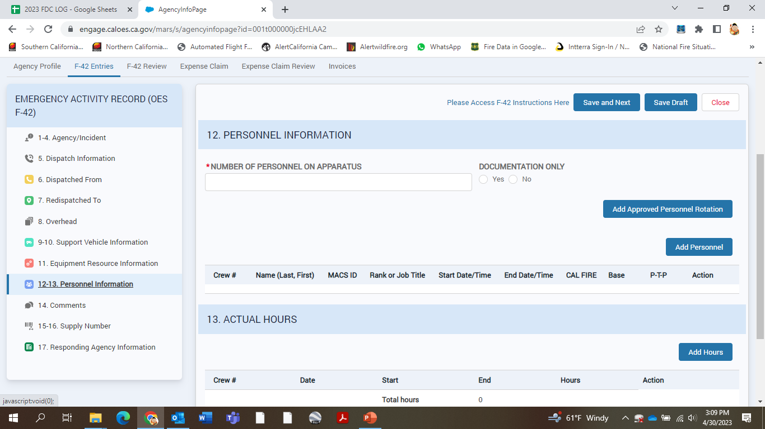

Slide 81
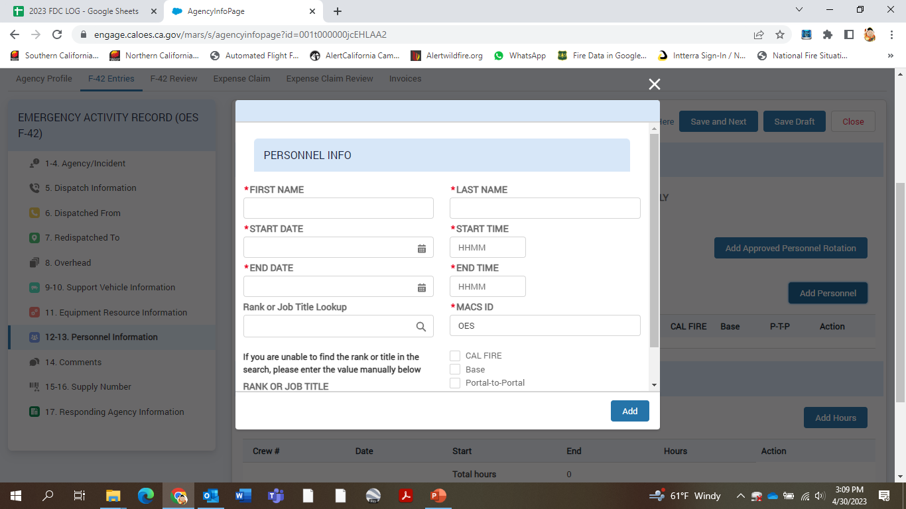

Slide 82
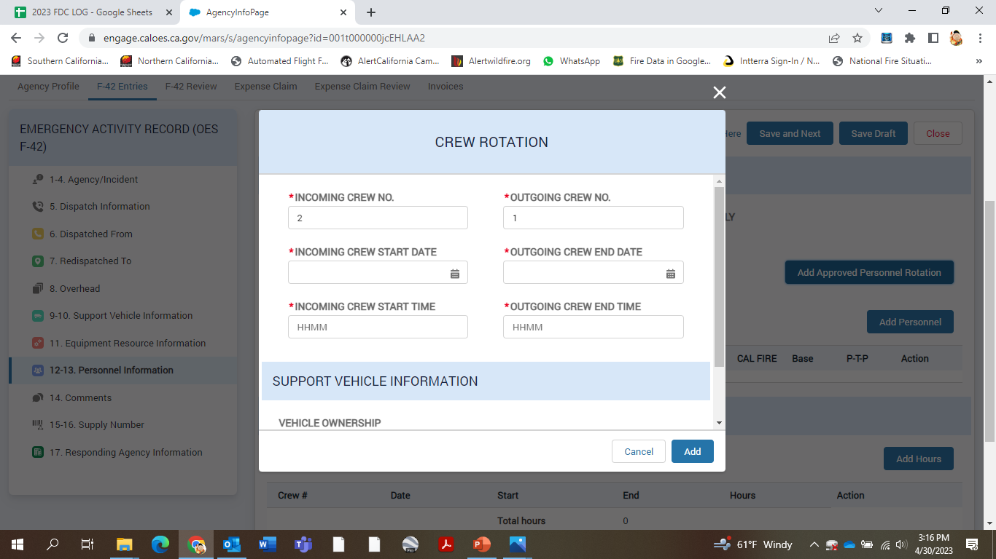

Slide 83
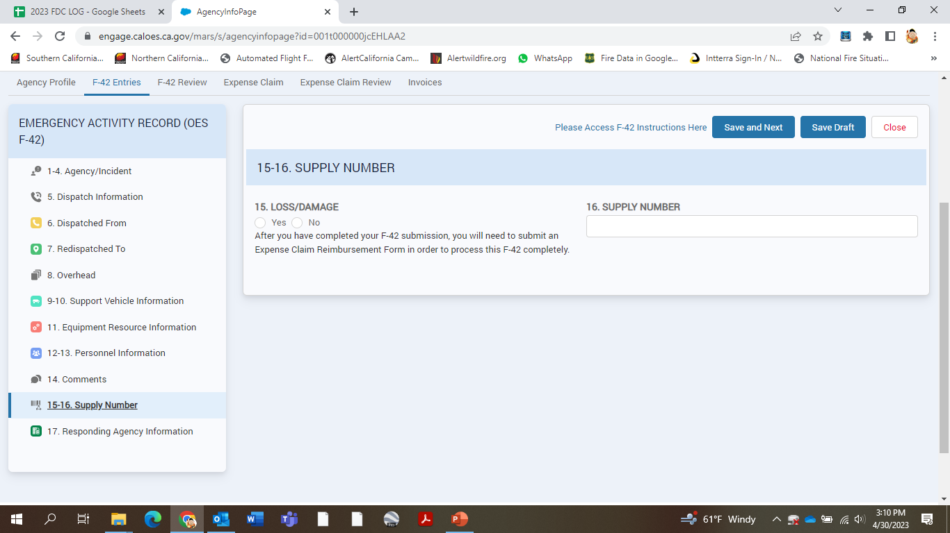

Slide 84
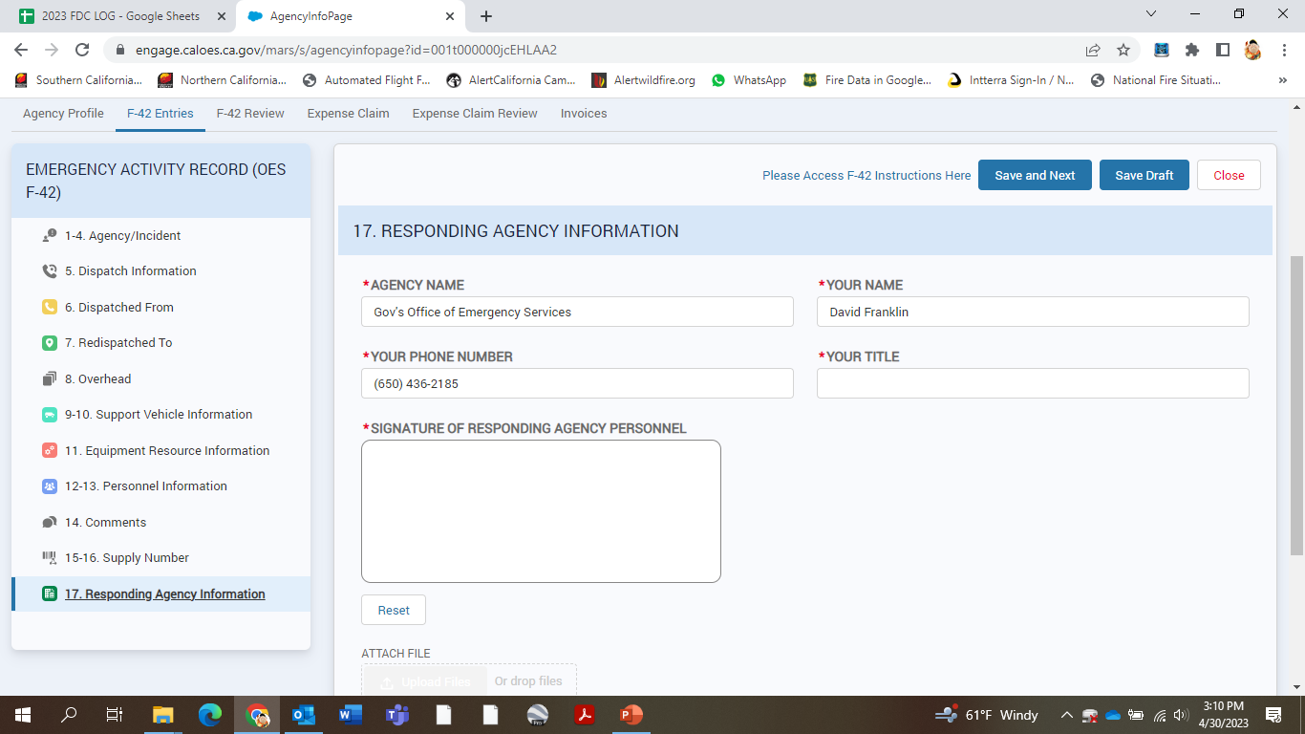

Slide 85
