Slide 1
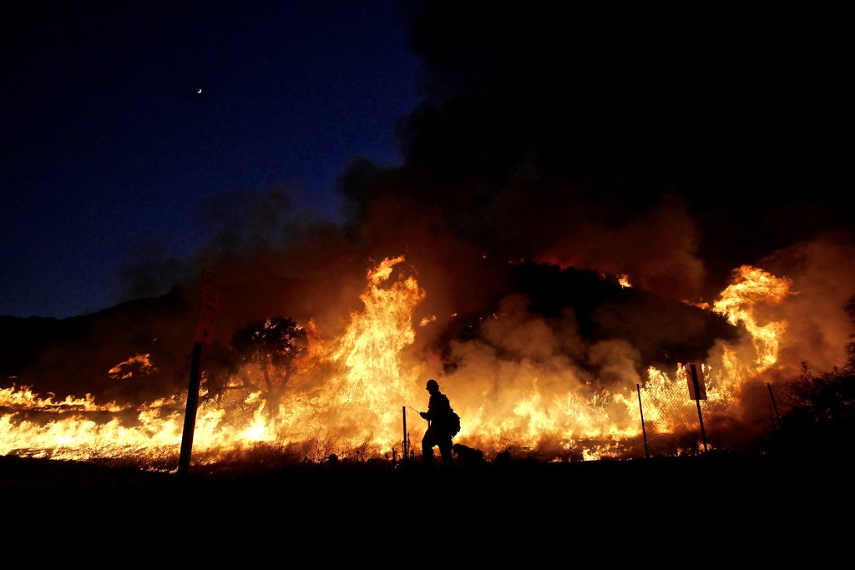
2023 CAL FIRE PRESEASON MEETING
CAL FIRE SANTA CLARA UNIT 2024 Unit Update

Slide 2
UNIT CHIEF
DEPUTY CHIEF OPS
C1600 Baraka Carter
Cell (408)-472-1600
C1601 Chuck Carroll
Cell (408) 472-1601
EAST BAY DIVISION
LAW ENFORCEMENT/ FIRE PREVENTION
SOUTH BAY DIVISION
SSCCFD/MHFD DIVISION
ADMINISTRATION
MOBILE EQUIPMENT
D1604 Steven Blythe
Cell (408) 472-1604
D1603 Vacant
Cell (408) 472-1603
D1602 Vacant
Cell (408) 472-1602
Office (408) 778-8602
FIRE EQUIPMENT MANAGER
R1630 James Lopez
Cell (408) 472-1608
Office (209) 892-5781
D1605 Venmer Deocariza
Cell (408) 472-1605
Office (408) 778-8605
FAX (408)779-1679
PREVENTION BATTALION
B1620 Zach Rutherford
Office (408) 778-8620
ALAMEDA BATTALION
B1614 Jeff Nichols
Cell (408) 472-1614
Office (925) 862-2197
MORGAN HILL BATTALION
B1611 Alex Mikesell
Cell (408) 472-1611
RESOURCE MANAGEMENT
FIRE CAPTAIN SPECIALIST
P1621 Scott Weatherby
Office (408)778-8620
SOUTH SANTA CLARA CO FD
B67 Tim Main
Cell (408) 234-1617
UNIT FORESTER
D1606 Ed Orre
Cell (408) 206-3704
HEAVY EQUIPMENT MECH.
R1631 Tiffany Black
Cell (408) 310-7395
STANISLAUS BATTALION
B1615 Jason Novak
Cell (408) 472-1615
Office (209) 892-5781
SAN JOSE BATTALION
B1612 Vacant
Cell (408) 472-1612
Office (408) 268-1600
FIRE CAPTAIN SPECIALIST
P1622 Vacant
Office (408) 778-8620
MORGAN HILL CITY BATT
B57 Juan Navarro
Cell (408) 722-8507
Office (408) 778-3259
HEAVY EQUIPMENT MECH.
R1635 Vacant
Cell (408)602-3991
FORESTER I
F1691 Vacant
Cell (408) 499-4255
CONTRA COSTA BATTALION
B1616 Bryan Goff
Cell (408) 472-1616
Office (925) 672-6400
ALMA BATTALION
B1613 Jeff Cox
Cell (408) 472-1613
Office (408) 867-1613
FIRE PREVENTION SPEC.
FPS 1623 C. Burkett
Office (408) 778-8623
FAX (408) 778-6041
MORGAN HILL CITY FIRE MARSHAL
B59 Carlos Alcantar
Cell (408) 722-5184
ENVIRONMENTAL SCIENTIST
F1692 Pearl Hoogs
Cell (699) 253-3366
HEAVY EQUIPMENT MECH.
R1637 Kevin Murry
Cell (408)-234-1106
SAFETY BATTALION
B1618 Nick Giampaoli
Cell (408) 472-1618
TRAINING/EMS
TRAINING BATTALION
B1606 Nicole Benty
Cell (408) 206-3706
SERVICE CENTER
HEADQUARTERS
PRE-FIRE ENGINEER
P1625 John Reynolds
Cell (408) 489-2086
ECC
Unit PIO Duty
(408) 201-4378
FORESTRY LOGISTIC OFFICERS
S1610A Derek Lyon-McKeil
Cell (408) 763-9038
S1610B Averell Ramirez
Cell (408) 710-1846
Office (408) 779-2121
FAX (408) 779-1679
ECC BATTALION
B1609 Erik Alldrin
Cell (408) 472-1609
ECC Contact Numbers Public
(408) 779-6611
24 Hr. Non-Emergency
(408) 201-0490 (Agency Only)
Emergency
(408) 779-4111
FAX (408) 778-6149
EMS BATTALION
B69 Josh Shifrin
Cell (408) 710-7196

Slide 3
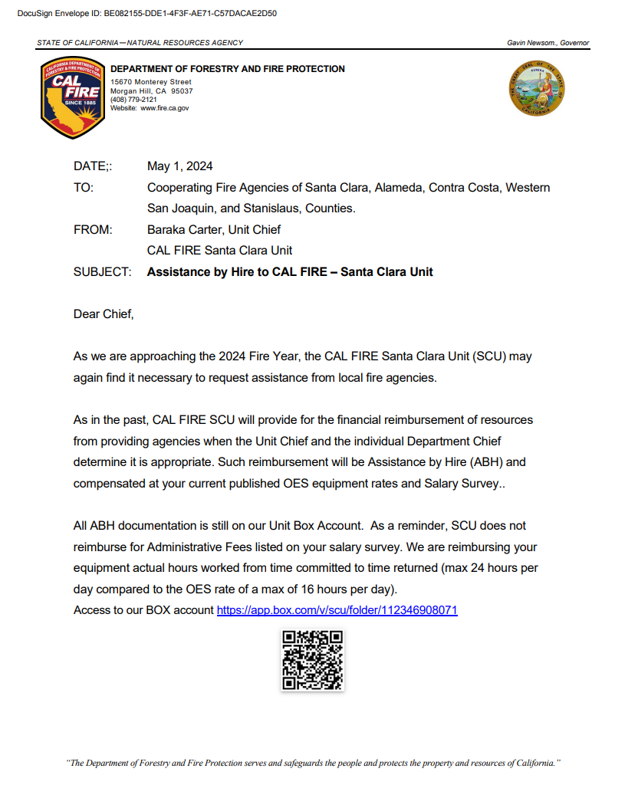
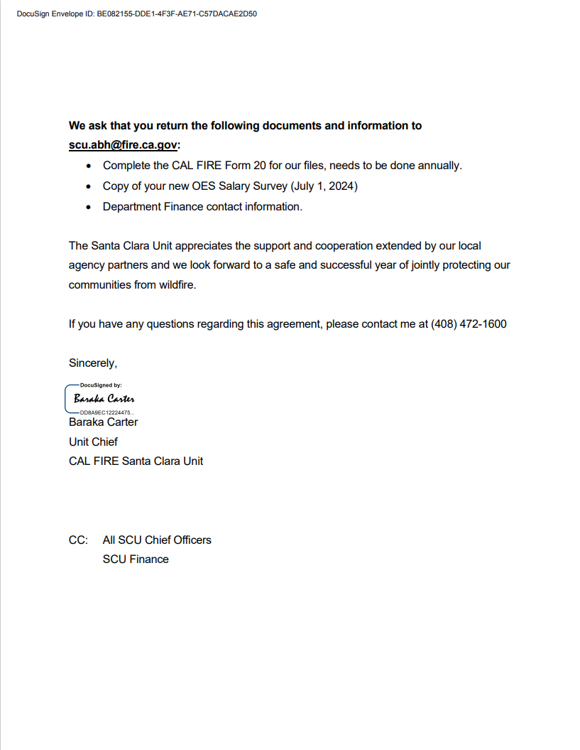
Assistance by Hire to CAL FIRE

Slide 4
CAL FIRE SANTA CLARA
WILDLAND FIRE STANDARD RESPONSE PLAN
LOW DISPATCH LEVEL
1 Battalion Chief
4 Engines
1 Dozer
MEDIUM DISPATCH LEVEL
1 Battalion Chief
1 Air Attack
2 Air Tankers
1 Copter
6 Engines
2 Dozers
2 Fire Crews
HIGH DISPATCH LEVEL
1 Battalion Chief
1 Air Attack
2 Air Tankers
1 Copter
8 Engines
2 Dozers
2 Fire Crews
1 Safety Officer

Slide 5
Fire Danger Rating Area

Slide 6
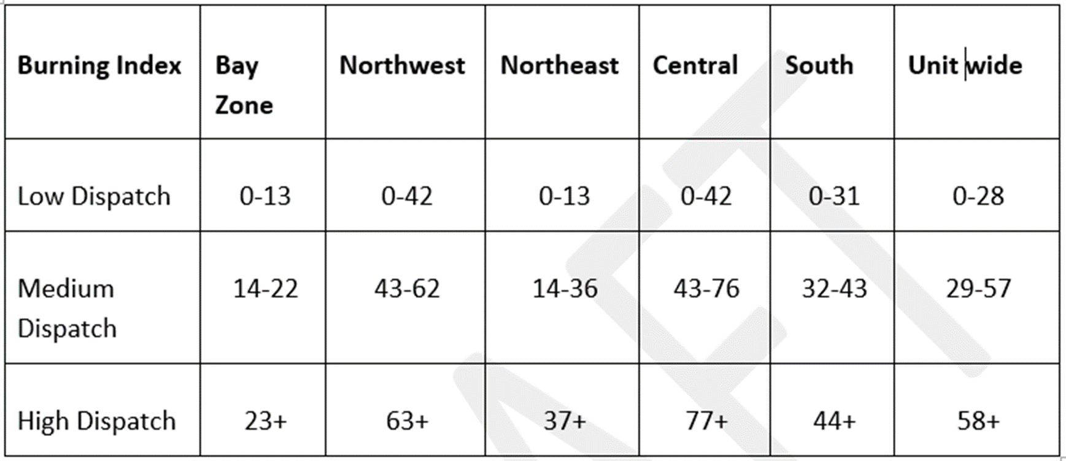

Slide 7
CAL FIRE Santa Clara Unit
TACTICAL RADIO FREQUENCY ASSIGNMENTS FOR WILDLAND FIRES BY COUNTY
Incidents that automatically include a CAL FIRE response (SRA or MTZ fires) will be assigned a tactical frequency by CAL FIRE as established in advance planning. Frequencies will be assigned in the established order with a new incident receiving the first preferred frequency unless it is in use elsewhere in the Santa Clara Unit. Once contacted by the local agency dispatch center, CAL FIRE Morgan Hill will establish the incident name, a tactical frequency, and a command frequency. The information is relayed to the local agency dispatch center to advise their responding resources.
ALAMEDA COUNTY
SAN JOAQUIN and STANISLAUS COUNTY
CDF TAC 2
VFIRE 22
VFIRE 23
CDF TAC 6
CDF TAC 2
VFIRE 22
VFIRE 23
CONTRA COSTA COUNTY
SANTA CLARA COUNTY
CDF TAC 2
VFIRE 22
VFIRE 23
CDF TAC 9
CDF TAC 6
CDF TAC 9
VFIRE 22
VFIRE 23
OTHER AVAILABLE FREQUENCIES
CDF TAC 10
VFIRE 26

Slide 8
CAL FIRE SCU FREQUENCY LIST
FREQUENCY | RX | RX PL | TX | TX PL
SCU LOCAL | 151.4450 | 156.7 | 159.3450 | Tone 1-6
CDF COMMAND 1 | 151.3550 | 103.5 | 159.3000 | Tone 1 and 9
CDF COMMAND 2 | 151.2650 | 103.5 | 159.3300 | Tone 7,9,11,12
CDF COMMAND 4 | 151.4000 | 103.5 | 159.3750 | Tone 7-8
CDF TAC 2 | 151.1600 | 192.8 | 151.1600 | 192.8
CDF TAC 6 | 151.3250 | 192.8 | 151.3250 | 192.8
CDF TAC 9 | 151.3850 | 192.8 | 151.3850 | 192.8
CDF TAC 10 | 151.4000 | 192.8 | 151.4000 | 192.8
CDF AIR TO GROUND 1 | 151.2200 | 192.8 | 151.2200 | 192.8
CDF AIR TO GROUND 2 | 159.2625 | 192.8 | 159.2625 | 192.8
CDF AIR TO GROUND 3 | 159.3675 | 192.8 | 159.3675 | 192.8

Slide 9
SCU OPERATIONS UPDATE - ENGINES
Base Staffing – Staffing Level 1
5 CAL FIRE Stations - 5 Engines
Transition Level 1 - Staffing Level II
7 CAL FIRE Stations - 7 Engines
Transition Level II - Staffing Level III
12 CAL FIRE Stations - 12 Engines
Peak Staffing – Staffing Level IV
12 CAL FIRE Stations - 16 Engines

Slide 10
SCU OPERATIONS UPDATE - CREWS
Mt. Hamilton/California National Guard (CMD) • Pacheco Firefighter I Crews (PCH)
Emergency Response & Fuel Mitigation
Type I
Emergency Response & Fuel Mitigation
Type I
Fireline Construction
Burning
Mop up
Falling
Fireline Construction
Burning
Mop up
Falling
13 Crew Members
1-Fire Captain
1-Fire Apparatus Engineer
B & A Level Sawyers
Emergency Crew Transports
Radio Identifiers: Mt. Hamilton Crew 1 and Crew 2.
13 Crew Members
1-Fire Captain
1-Fire Apparatus Engineer
B & A Level Sawyers
Emergency Crew Transports
Radio Identifiers Pacheco Crew 1 and Crew 2

Slide 11
SCU OPERATIONS UPDATE - AIRCRAFT
CAL FIRE S70i FireHawk status
Hollister AAB – Aircraft in service
All AAB - TBA
C-130 Info sheet
Alma FireHawk Info sheet
Alma Copter in service year-round for water dropping and Rescue Missions.
With Crew on May 6th
All Bases except one base are S70i FireHawk's.
New numbering on all S70i Copters. (C601-C613) No specific number per base.
Alma Copter will be doing NVG Training within the unit over the next couple months.

Slide 12
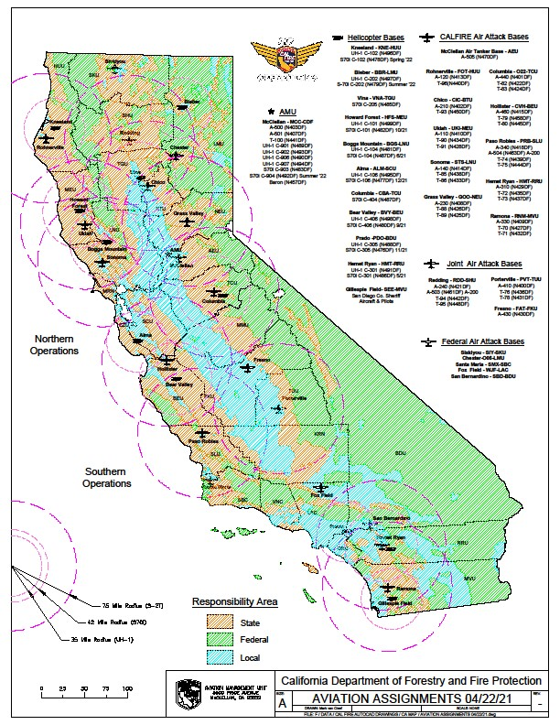
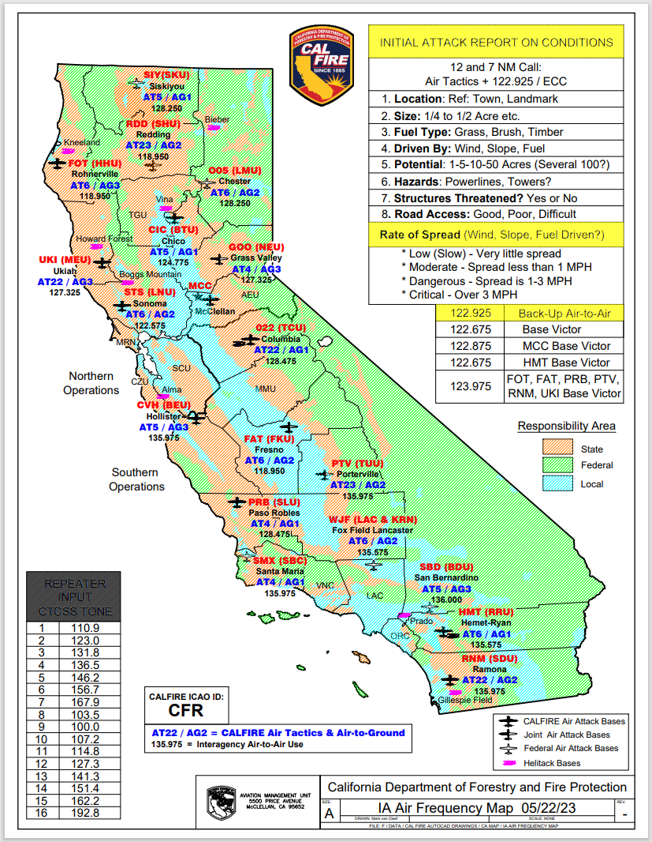

Slide 13
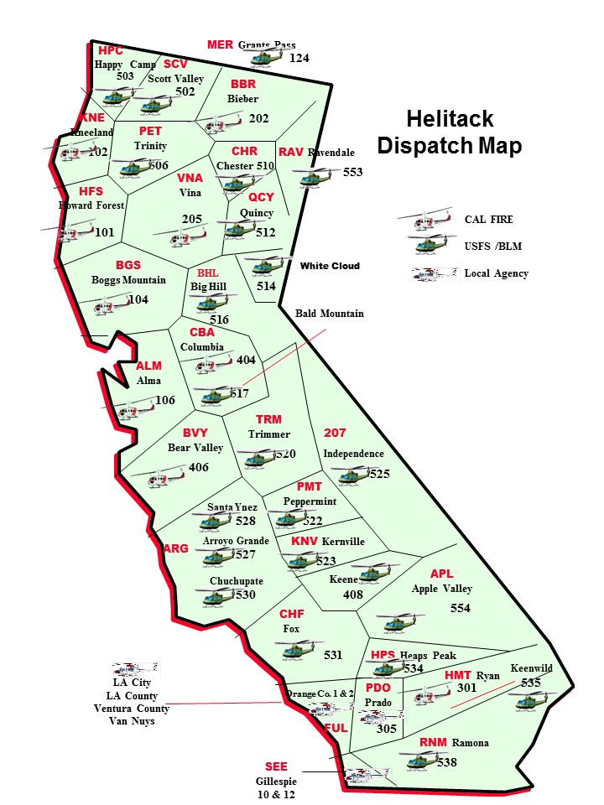
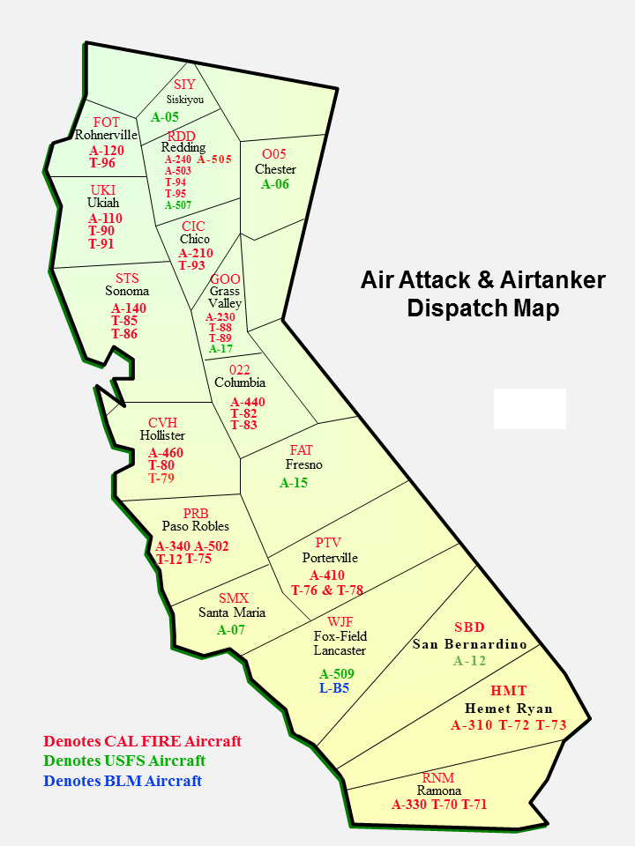

Slide 14
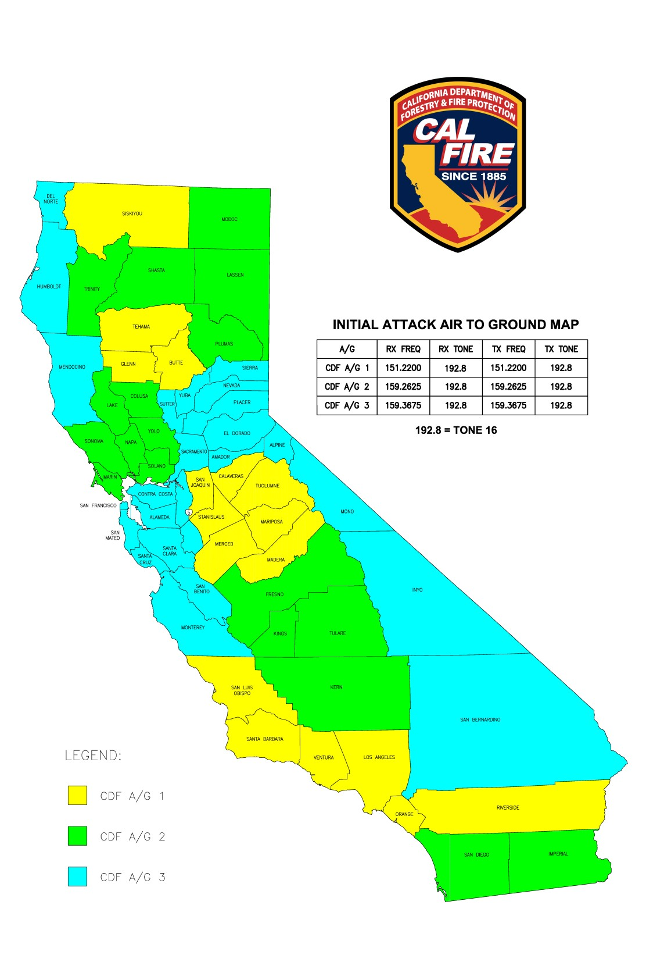
Initial Attack Air to Ground Map

Slide 15
North ops predictive services 2024 fire season outlook early analysis

Slide 16
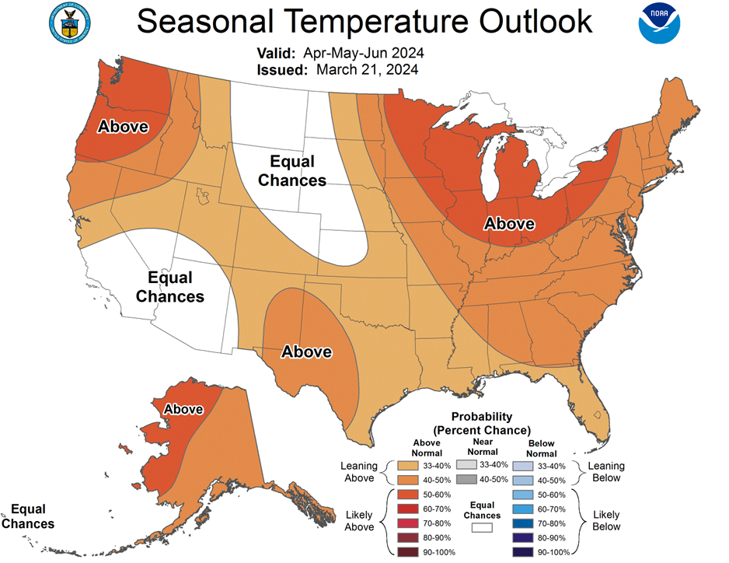
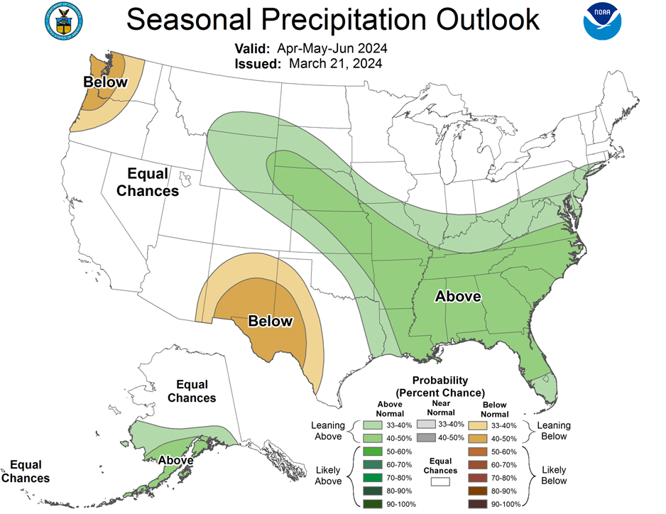
Seasonal Outlooks – June, July, August

Slide 17
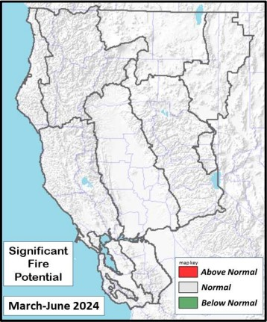
Looking Forward – Significant Fire Potential
•Atmosphere will be in a state of complex flux next 4 months with some uncertainties in the
pattern anomalies but there is the possibility for a cooler spring.
•Moisture found within the snowpack is expected to be near normal on April 1st, when
readings are usually at their highest.
•Growing season starting up normally with more noticeable herbaceous curing likely latter
half of May into June across the lowlands.
•Significant Fire Potential is normal for March through June which means very little if any
activity from March through May and generally 1-2 per PSA during June.

Slide 18
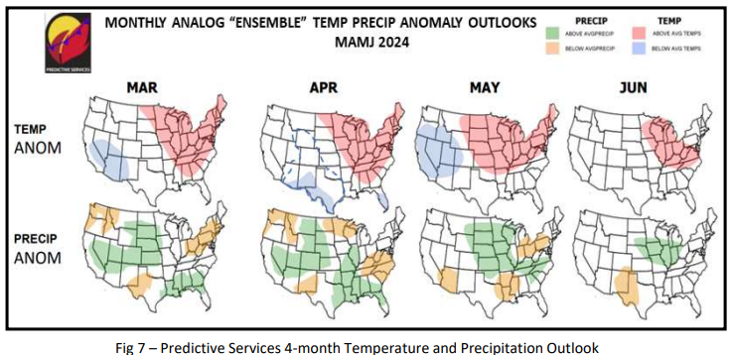
Predictive Services 4-Month Outlook​

Slide 19
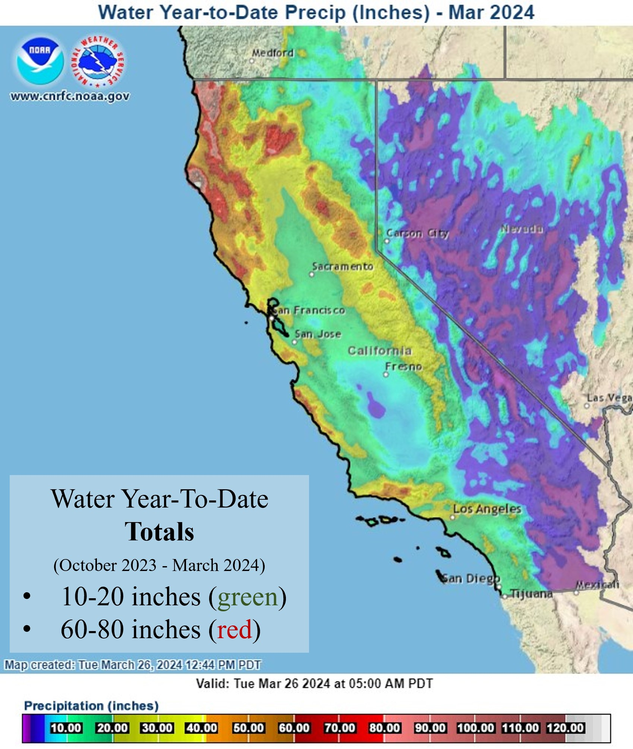
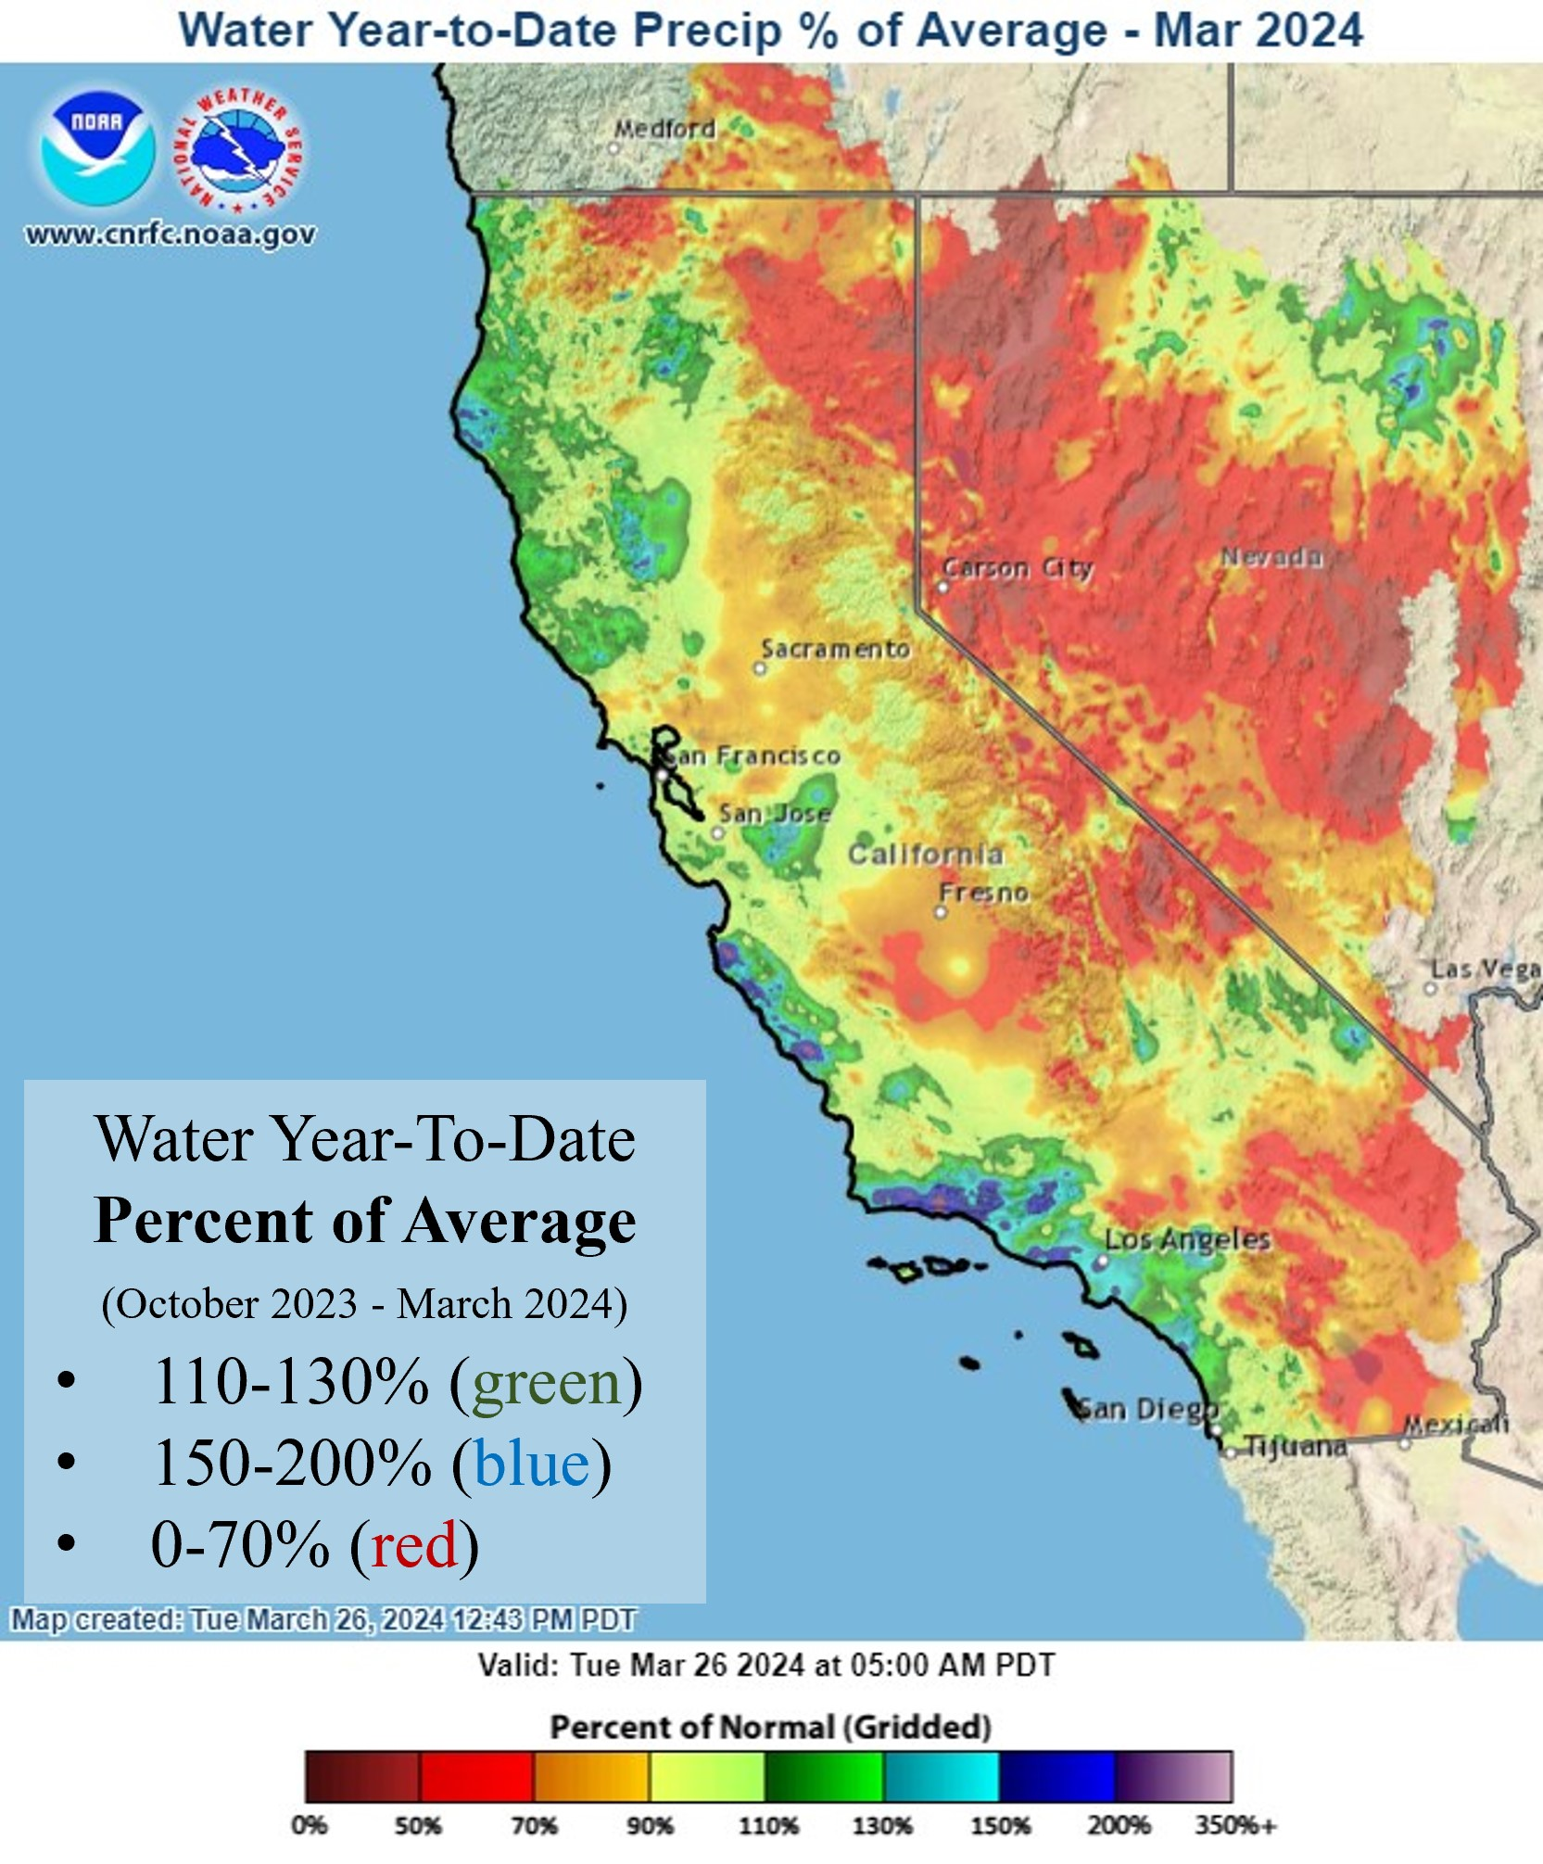
California Precipitation (Water Year)

Slide 20
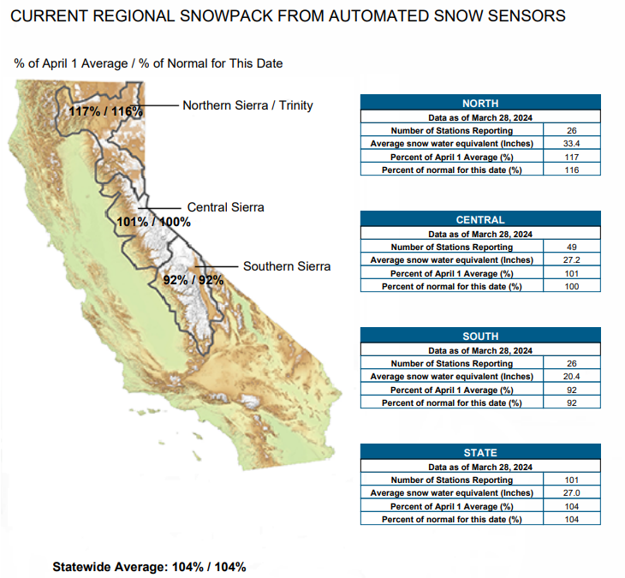
SNOWPACK

Slide 21
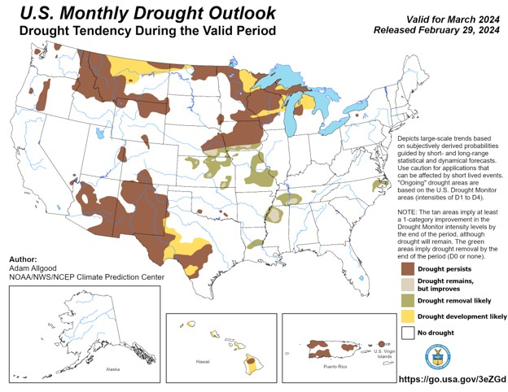
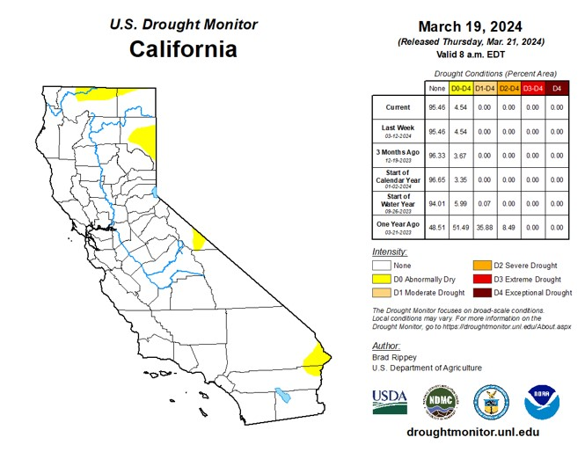
California Drought Monitor

Slide 22
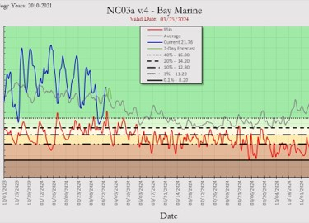
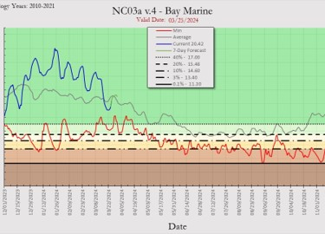
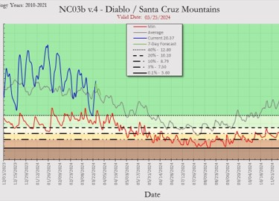
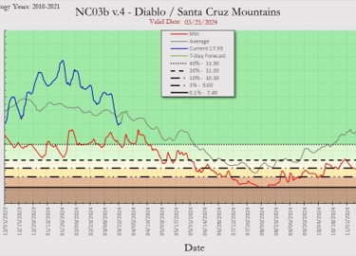
Fuel Moisture Levels
100 Hour Fuels
1,000 Hour Fuels
Bay Marine
Avg.
Bay Marine
Avg.
Diablo / SC Mountains
Diablo / SC Mountains
Avg.
Avg.

Slide 23
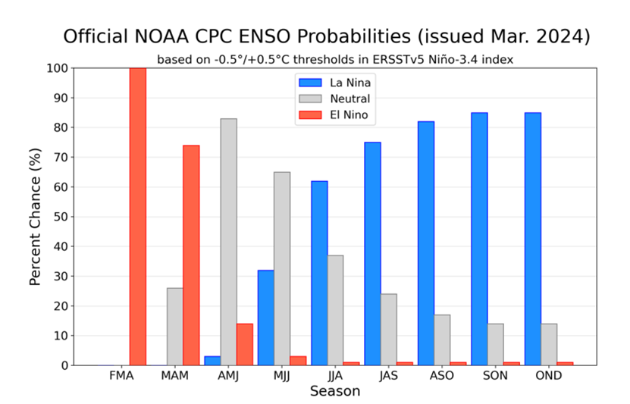
El Nino Southern Oscillation (ENSO)

Slide 24
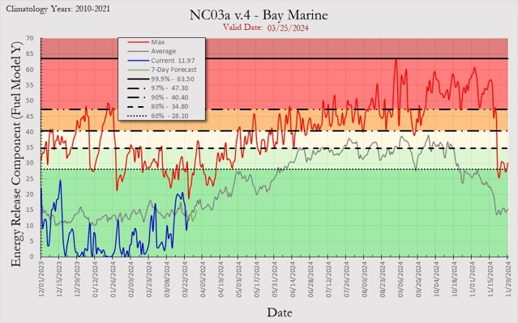
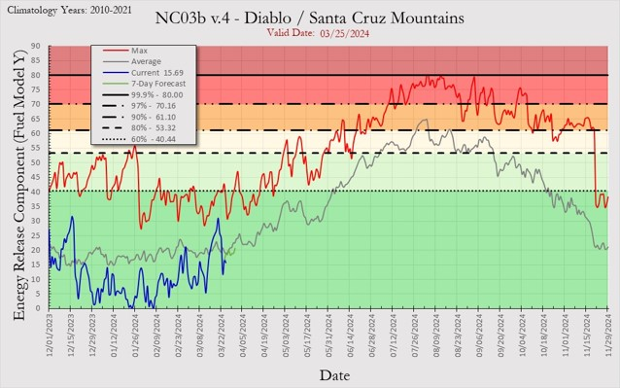
Energy Release Components (ERC)
Below Avg.
Below Avg.

Slide 25
Weather Recap
•Atmosphere will be in a state of complex flux next 4 months with some uncertainties in the pattern anomalies but there is the possibility for a cooler spring. ​
​
•Moisture found within the snowpack is expected to be near normal on April 1st, when ​
readings are usually at their highest. ​
​
•Growing season starting up normally with more noticeable herbaceous curing likely latter ​half of May into June across the lowlands. ​
​
•Significant Fire Potential is normal for March through June which means very little if any ​
activity from March through May and generally 1-2 per PSA during June.

